Slide 1
Ordering Decimals
Independent Task
Mathematics
Mr Whitehead
Author’s name goes here

Slide 2
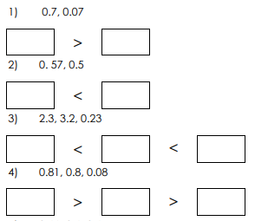
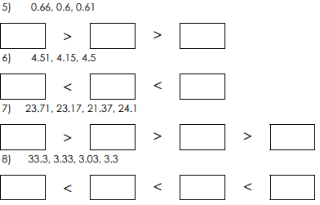
Order the decimal numbers

