Slide 1
Independent Task
To investigate a problem, describing position on a 2-D grid as coordinates
Maths
Mr Critchlow

Slide 2
To Start
Complete the number trees. The number at the top is the sum of the two numbers below it.
63
202
31
32
13
14
38
48
38
69
4
5
22
13
15
33
47
4
10
20
23
This one has been ALMOST completed for you

Slide 3
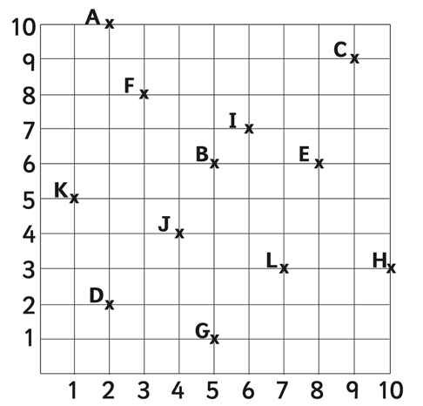
Moving on
What are the coordinates for each of the letters?
Letter | Coordinate | Letter | Coordinate
A |  | G
B |  | H
C |  | I
D |  | J
E |  | K
F |  | L

Slide 4
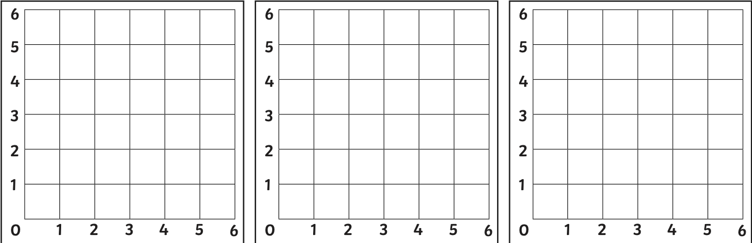
Moving on
Plot to coordinates then name each shape.
(1,1) (5,1) (5,5) (1,5)
Shape:
_________________
(1,3) (5,3) (5,5) (1,5)
Shape:
_________________
(0,3) (3,6) (6,3) (3,0)
Shape:
_________________

Slide 5
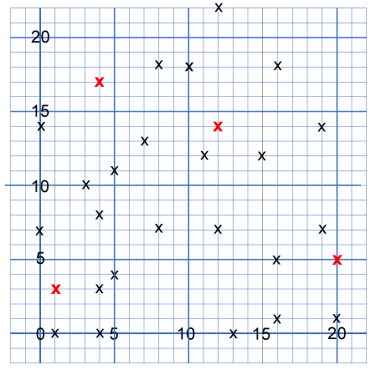
Main task
These points all mark the vertices (corners) of eight hidden squares.
Each of the 4 red points is a vertex shared by two squares.
The other 24 points are each a vertex of just one square.
All the squares are different sizes.

Slide 6
Main task
Can you find all 8 of the squares and mark them off on the grid by joining their vertices up?
I’ll give you the coordinates of one square for free!
(0,14) (3,10) (7,13) (4,17)

