Slide 1
A night out with friends [2 / 3]
Using the perfect tense with on
French
Monsieur Lowe

Slide 2
Phonétique

Slide 3
[ é ]
[-er]
[-et]
écrire

Slide 4
[ é / er / et ]
bébé
aller
et
[and]

Slide 5
[ ai ]
vrai

Slide 6
[ ai ]
maison
mauvais
[bad]

Slide 7
on est allé(e)s | we went, have been
on est sorti(e)s | we went out, have been out
c’était | it was
déjà | already
ensuite | then, next
puis | then
plus tard | later (on)
tard | late
tôt | early

Slide 8
Grammaire Using on in the perfect tense with être

Slide 9
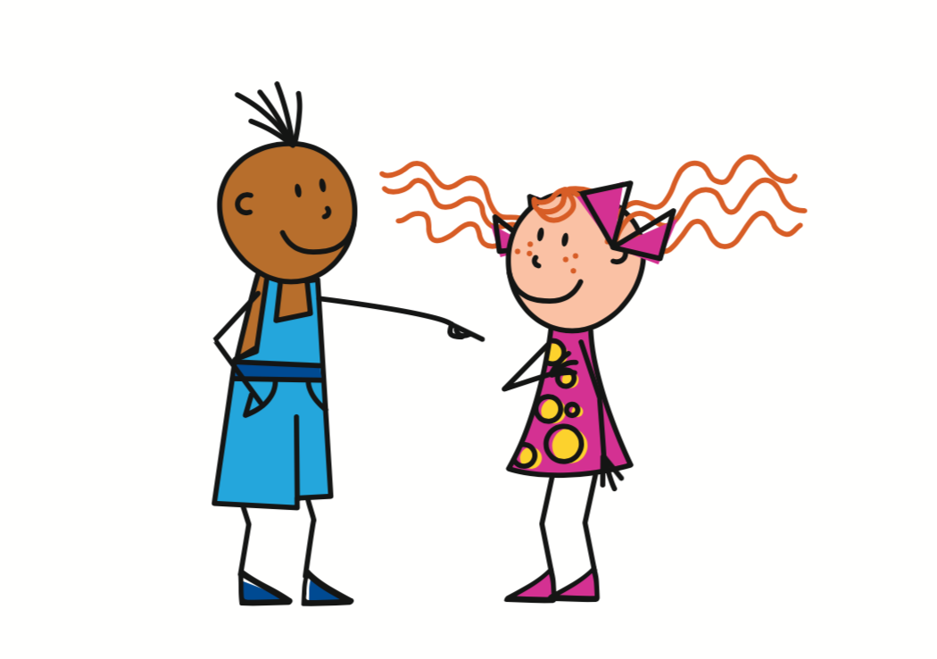
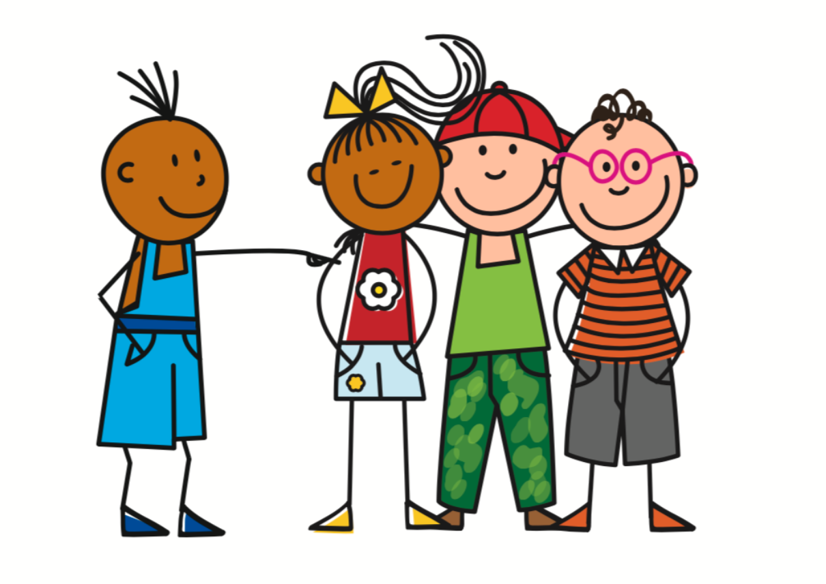
On
- You, we
= You
Tu
On
= You, we
To refer to one specific person
Vous
= You
To refer to a group of specific people
To refer to people in general

Slide 10
The perfect tense - a completed action in the past
I went / I have been
We went / we have been
Je
suis
allé(e)
On
est
allé(e)s
I went out / I have been out
We went out / we have been out
Je
suis
sorti(e)
On
est
sorti(e)s
N.B. past participles agree with être verbs, i.e. if the subject is feminine or plural

Slide 11
The Perfect Tense - The Auxiliary
1. | I went out = | Je ___ sorti(e)
2. | We went = | On ___ allé(e)s
3. | I returned = | Je ___ rentré(e)
4. | We went out = | On ___ sorti(e)s
5. | I went = | Je ___ allé(e)
suis
est
suis
est
suis

Slide 12
The perfect tense
1. The Subject Pronoun
2. The Auxiliary Verb
(être - Present Tense)
3. Past Participle (with agreement)
Je | suis | allER - allé(e)(s)
 |  | sortIR - sorti(e)(s)
 |  | descendRE - descendu(e)(s)
On | est | Irregular Past Participles, e.g. né - born, mort - died
= I
= We

Slide 13
Negatives in the perfect tense
A positive sentence
A negative sentence
On est allés à un concert = We went to a concert
On n’est pas allés à un concert = We didn’t go to a concert
Note - ne changes to n’ when used before a vowel.
E.g. On n’aime pas

Slide 14
A night out with friends
The perfect tense refers to a completed action in the...
2. Aller takes …. as an auxiliary verb.
3. Verbs that have être as an auxiliary verb have to …..
4. On est allés =
5. On est sortis =
6. C’était =
past
être
agree
we went
we went out
it was

