Slide 1
Numbers to 50
Mathematics
Independent Task
Miss Robson

Slide 2
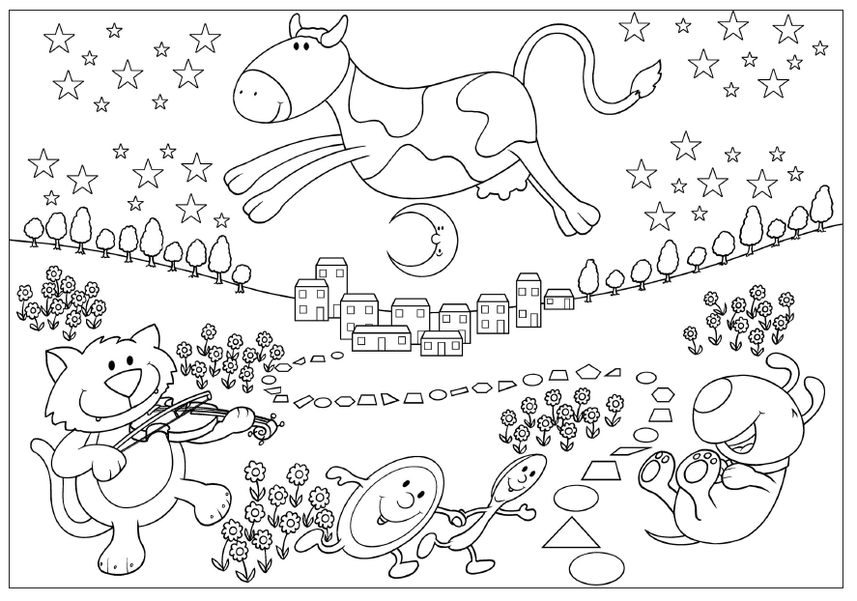
Activity

