Slide 1
Numbers within 15
Applying knowledge of one more and one fewer
Mathematics
Independent Task
Mrs Khaira

Slide 2
Activity 1
Source: Amisha Khaira images

Slide 3
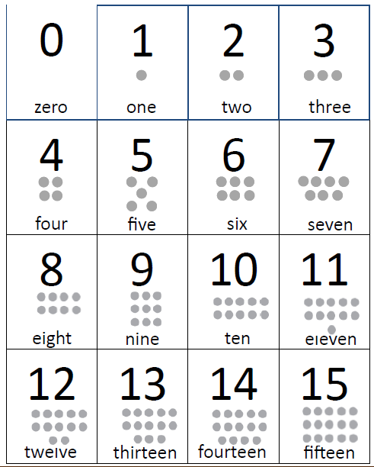
Activity 2

