Slide 1
Congratulations [1 / 2]
using venir de + infinitive
French
Mademoiselle Martin

Slide 2
Phonétique

Slide 3
[ ç / c ]
français

Slide 4
[ ç / c ]
français
garçon
cinéma

Slide 5
[ au / eau / o ]
gauche

Slide 6
[ au / eau / o ]
beau
photo
aussi
[also]

Slide 7
Vocabulaire

Slide 8
venir de | to have just done
fêter | to celebrate
se pacser | to become civil partners
offrir un cadeau à | to offer a present to
anniversaire | birthday/anniversary
félicitations | congratulations
j’ai reçu | I received
je suis né(e) | I was born
une fête | a party/celebration
un cadeau | a present

Slide 9
Grammaire - Using venir de + infinitive

Slide 10
Using venir de + infinitive
Je viens de fêter
Je viens de célébrer
= I have just celebrated
= I have just celebrated
We can use the structure venir de + infinitive to explain what has just happened in the recent past.

Slide 11
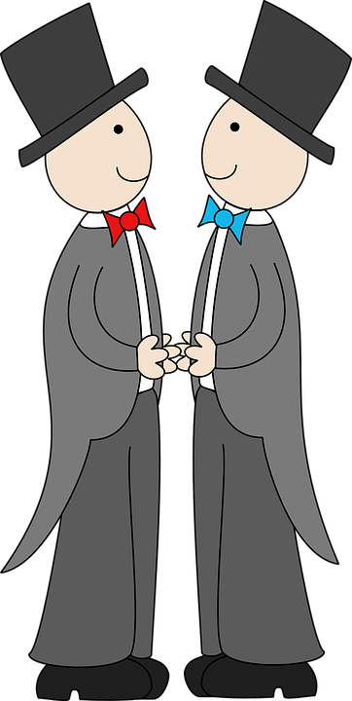
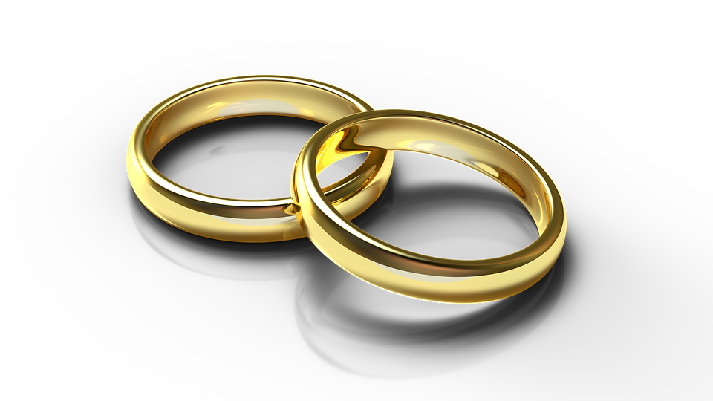
Using venir de + infinitive
Je viens de me pacser
Je viens de me marier
= I have just entered a civil partnership
= I have just got married
Je viens is the first person present tense conjugation of the verb venir

Slide 12
Using venir de + infinitive
We can use the structure venir de + infinitive to explain what has just happened in the recent past.
venir de + infinitive
Don’t forget to conjugate the infinitive venir in the present tense.
Je viens
Il / Elle / On vient
= to have just + action
Je viens de + infinitive
I have just + action

Slide 13
Congratulations [1 /2]
Using venir de + infinitive, you can explain...
2. To use the recent past, you need to …… venir according to the …...
3. I have just celebrated =
4. I have just got married =
5. I have just entered a civil partnership =
What has just happened in the recent past
Conjugate venir according to the subject
Je viens de fêter/célébrer
Je viens de me marier
Je viens de me pacser

