Slide 1
How can we separate river water into separate substances?
Worksheet
Science
Miss Couves

Slide 2
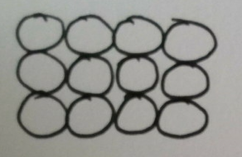
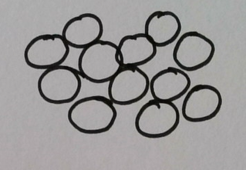
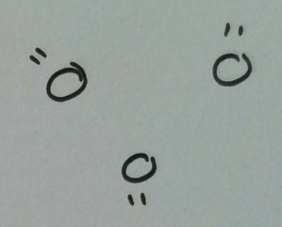
Which state of matter does each diagram represent?

Slide 3
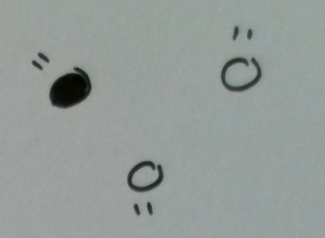
Which diagram shows a pure gas?

Slide 4
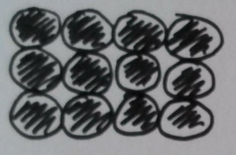
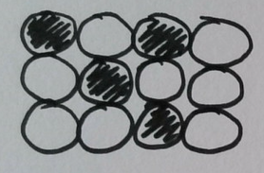
Pure metal or alloy?

Slide 5
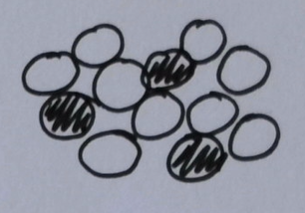
Label the diagram: solution, solvent, solute.
Water
Salt
Salty water

Slide 6
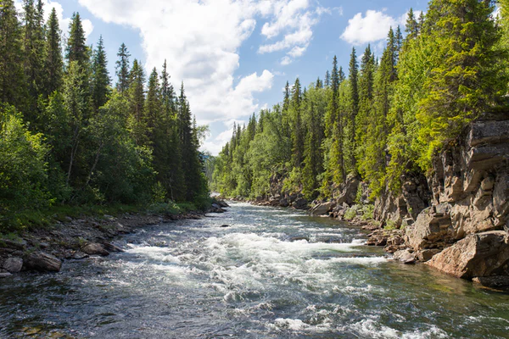
What is in river water?
River water is made up of soil, gravel and water.
What state of matter are the three substances in?
Is this sample pure or impure?
Are the solids soluble or insoluble?
Image from Unsplash

Slide 7
How can we separate the substances in river water?
River water is made up of soil, gravel and water.
How do we separate insoluble solids from a liquid?
What do you notice about the difference in the size of gravel and soil particles?
Image from Unsplash

Slide 8
Writing a method:
Write a list of the equipment that you would need.
Number the steps in your method.
Start each step with a verb.
Image from Unsplash

Slide 9
Writing a method:
Write a list of the equipment that you would need.
Number the steps in your method.
Start each step with a verb.
E.g. 1. Place the filter paper in the funnel and place the funnel into a cup.
Image from Unsplash

Slide 10
Evaluating a method:
Evaluation:
Two things that went well are…
One thing we could have done better is…
Redraft your method to make it better.
Place the filter paper in the funnel and place the funnel into a cup.
Pour the river water sample into the filter paper.
Place the insoluble solids into a sieve.
Shake the sieve until the sand particles and gravel particles are separated.

