Slide 1
Expressions, equations and inequalities Collecting like terms
Independent Task
Mathematics
Ms Jones

Slide 2
What is the same and what is different about the expressions below?
Which expression do you think is written the simplest?
How could I represent the expressions?

Slide 3
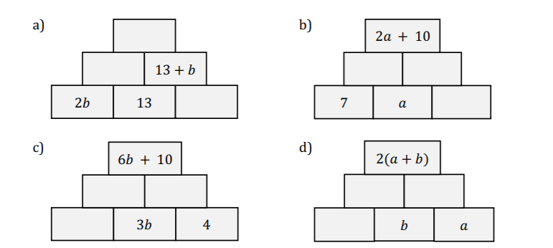
Independent task
2. Each brick in the pyramids to the right is completed by summing the values in the two bricks beneath. Copy and complete the pyramids.

Slide 4
Explore
How can you complete the addition pyramids?
What could the values of the missing bricks be in this addition pyramid?
How many different possibilities can you find for the bottom row?

