Slide 1
Talk about school life [1 / 3]
Present tense verbs “he/she”
German
Herr Jones

Slide 2
a
[a:]
sagen
Steve Clarke / Rachel Hawkes

Slide 3
a
Paar
haben
sagen
fahren
Tag
klar
Rachel Hawkes

Slide 4
ä
[ɛ]
lächeln
Steve Clarke / Rachel Hawkes

Slide 5
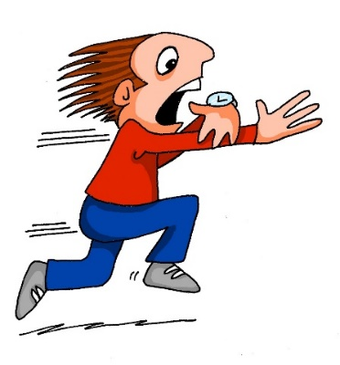
ä
zählen
ähnlich
1, 2, 3, …100
spät
Nähe
wählen
Berlin 1KM
erklären
[to explain]
Rachel Hawkes

Slide 6
heißen | to be called
gehen | to go, walk
fahren | to go, travel
lernen | to learn
tragen | to wear
sehen | to see

Slide 7
What is a weak verb?
Reminder: the present tense is talking about what’s happening now or what usually happens.
A weak verb is also known as a regular verb.
This is because the conjugations follow the same pattern.
Conjugation is when the ending on the verb changes depending on who or what is doing the verb
I play
he/she plays

Slide 8
Infinitive verb
er/sie conjugation
Means “to something”
er/sie means “he/she”
In German, end in -en
Take the -en off the infinitive
Add the conjugation which is -t
lernen
heißen
gehen
er/sie lernt
er/sie heißt
er/sie geht

Slide 9
What is a strong verb?
A strong verb is also known as an irregular verb.
W
H
Y
?
The conjugations are a bit different.

Slide 10
Infinitive verb
er/sie conjugation
Means “to something”
er/sie means “he/she”
In German, end in -en
Take the -en off the infinitive
Add the conjugation which is -t
fahren
tragen
sehen
Add an umlaut to the [ä]
er/sie fährt
er/sie trägt
Or there is a vowel change
er/sie sieht

Slide 11
haben - to have
sein - to be
Both very irregular verb conjugations
haben to have
er/sie hat he/she has
sein to be
er/sie ist he/she is

Slide 12
The present tense:
The present tense is used for ………………………... and ……………………………………
Weak verbs are also known as ………………. verbs.
The er/sie conjugation ends in the letter ………. .
Verbs like fahren and tragen are known as ……………… . Verbs.
The verbs haben and sein mean to have and ……………...
what is happening now
what usually happens
regular
-t
strong
to be

Slide 13
References:
Pictures are from Pixabay or NCELP resources, which are available under a Creative Common license; no attribution required.

