Slide 1
Unit 10: Measure and Money Problems
Converting Lengths
Independent Task
Mathematics
Lesson 3 of 15
Mr Whitehead

Slide 2
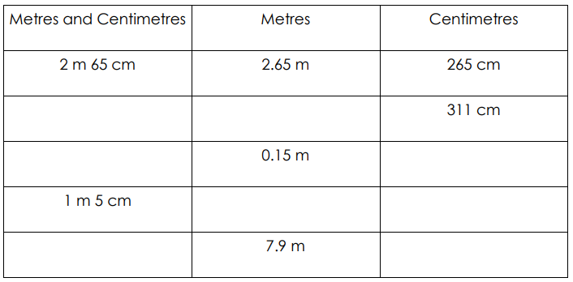
Fill in the missing values

