Slide 1
Mathematics
Comparing numbers within 100 on a number line
Miss Hughes

Slide 2
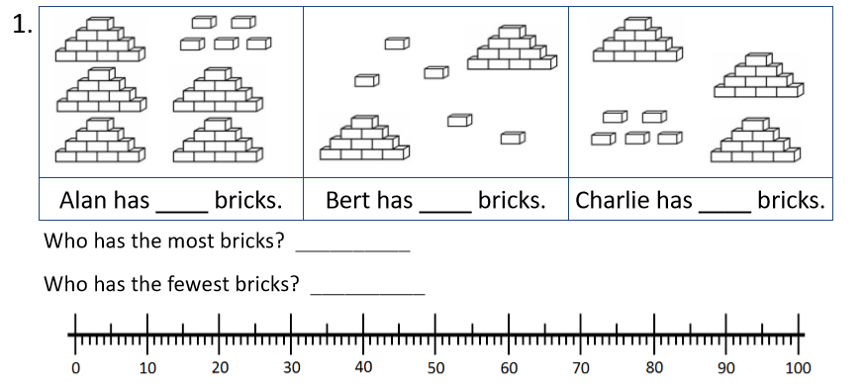
Independent Task
Solve the problems by
marking the numbers
on the number line.
Make the numbers using tens and ones to check!
Notes:
Right Team, it’s time for our independent task now! In this task you are going to.. (read on screen).
For the first two independent tasks, you will need to count the number of itens that each person has and write them in each black. Then for each, mark each of the three numbers on the number line to help you to decide who has the most or least of the given items. Check your answers on a bead string or by making each number out of tens and ones by making the smallest number, then the middle value,and finally the greatest value.

Slide 3
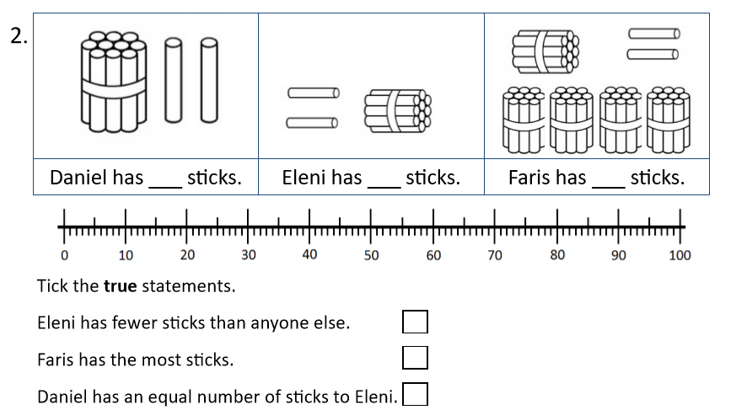
Independent Task
Solve the problems by
marking the numbers
on the number line.
Make the numbers using tens and ones to check!
Notes:
Right Team, it’s time for our independent task now!In this task, you are going to.. (read on screen).
For each mark each of the three numbers on the number line. In each case, they decide who has the most or least of the given items. They check their answers on a bead string by making the smallest number, then adding beads to make the middle value, then finally the greatest value.

Slide 4
Independent Task
Solve the problems by
marking the numbers
on the number line.
Make the numbers using tens and ones to check!
Look at the 5 numbers below:
6
1
3
7
9
Notes:
For the final task, using the digit card to create the smallest 2-digit number that you can and the greatest 2 digit number that you can.
Can you also make a number that is less than 50 or a number that is less that 30?

Slide 5
Independent Task - Answers
Solve the problems by
marking the numbers
on the number line.
Make the numbers using tens and ones to check!
55
25
35
Alan
Bert
25
35
55
Notes:
Right Team, it’s time for our independent task now! In this task you are going to.. (read on screen).
For the first two independent tasks, you will need to count the number of itens that each person has and write them in each black. Then for each, mark each of the three numbers on the number line to help you to decide who has the most or least of the given items. Check your answers on a bead string or by making each number out of tens and ones by making the smallest number, then the middle value,and finally the greatest value.

Slide 6
Independent Task - Answers
Solve the problems by
marking the numbers
on the number line.
Make the numbers using tens and ones to check!
12
12
52
12
52
Notes:
Right Team, it’s time for our independent task now!In this task, you are going to.. (read on screen).
For each mark each of the three numbers on the number line. In each case, they decide who has the most or least of the given items. They check their answers on a bead string by making the smallest number, then adding beads to make the middle value, then finally the greatest value.

Slide 7
Independent Task - Answers
Solve the problems by
marking the numbers
on the number line.
Make the numbers using tens and ones to check!
Look at the 5 numbers below:
6
1
3
7
9
13
13, 16, 17, 19
13, 16, 17, 19, 31, 36, 37, 39
97
Notes:
For the final task, using the digit card to create the smallest 2-digit number that you can and the greatest 2 digit number that you can.
Can you also make a number that is less than 50 or a number that is less that 30?

