Slide 1
Choosing the right graph
Mathematics
Mr Millar

Slide 2
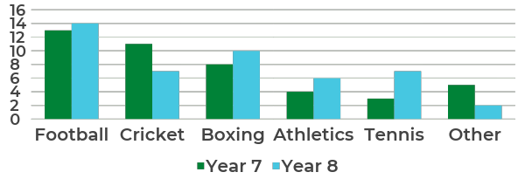
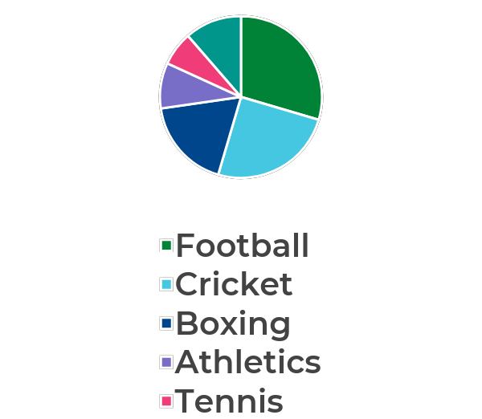
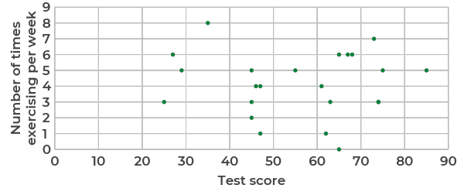
What’s the same and what’s different about these graphs?

Slide 3
What data had to be collected for each graph?

Slide 4
Country | Continent | Life Expectancy | GDP
Belgium | Western Europe | 81 | 40,000
France | Western Europe | 82 | 38,000
Germany | Western Europe | 81 | 46,000
UK | Western Europe | 81 | 38,000
Spain | Western Europe | 83 | 33,000
Sweden | Western Europe | 82 | 43,000
Bangladesh | Asia | 72 | 3,000
China | Asia | 76 | 21,000
Afghanistan | Asia | 64 | 1,900
Japan | Asia | 84 | 36,000
Thailand | Asia | 76 | 14,000
South Korea | Asia | 82 | 35,000
Pakistan | Asia | 67 | 5,000
Ethiopia | Africa | 65 | 1,600
Chad | Africa | 53 | 2,400
South Africa | Africa | 63 | 12,000
Nigeria | Africa | 53 | 6,000
Morocco | Africa | 76 | 7,600
Swaziland | Africa | 55 | 7,700
The table on the right shows data collected on life expectancy and GDP per capita ($) for different countries.
Complete the summary statistics for the following
 | Sum Life Expectancy | Mean Life Expectancy | Range Life Expectancy | Sum GDP | Mean GDP | Range GDP
Western Europe
Asia
Africa

Slide 5
Which data would you display, and in which graph, to test the following hypotheses?
Western Europe has a higher average life expectancy than Africa or Asia
Asia has a wider of spread of GDP per capita than Western Europe or Asia
Western Europe has a higher average life expectancy AND GDP per capita than Africa or Asia
There is a positive correlation between life expectancy and GDP per capita

Slide 6
Answers

Slide 7
What data had to be collected for each graph?
Favourite Sport AND year group
Favourite Sport
Favourite Sport
Test score and number of times exercising per week

Slide 8
Country | Continent | Life Expectancy | GDP
Belgium | Western Europe | 81 | 40,000
France | Western Europe | 82 | 38,000
Germany | Western Europe | 81 | 46,000
UK | Western Europe | 81 | 38,000
Spain | Western Europe | 83 | 33,000
Sweden | Western Europe | 82 | 43,000
Bangladesh | Asia | 72 | 3,000
China | Asia | 76 | 21,000
Afghanistan | Asia | 64 | 1,900
Japan | Asia | 84 | 36,000
Thailand | Asia | 76 | 14,000
South Korea | Asia | 82 | 35,000
Pakistan | Asia | 67 | 5,000
Ethiopia | Africa | 65 | 1,600
Chad | Africa | 53 | 2,400
South Africa | Africa | 63 | 12,000
Nigeria | Africa | 53 | 6,000
Morocco | Africa | 76 | 7,600
Swaziland | Africa | 55 | 7,700
The table on the right shows data collected on life expectancy and GDP per capita ($) for different countries.
Complete the summary statistics for the following
 | Sum Life Expectancy | Mean Life Expectancy | Range Life Expectancy | Sum GDP | Mean GDP | Range GDP
Western Europe | 490 | 82 | 2 | 238,000 | 39,667 | 13,000
Asia | 521 | 74 | 20 | 115,900 | 16,557 | 34,100
Africa | 365 | 61 | 23 | 37,300 | 6,217 | 10,400

Slide 9
Which data would you display, and in which graph, to test the following hypotheses?
Bar chart of mean life expectancy
Bar chart of range of GDP
Western Europe has a higher average life expectancy than Africa or Asia
Asia has a wider of spread of GDP per capita than Western Europe or Asia
Comparative bar chart of mean life expectancy and mean GDP
Scatter diagram, life expectancy vs GDP
Western Europe has a higher average life expectancy AND GDP per capita than Africa or Asia
There is a positive correlation between life expectancy and GDP per capita

Slide 10
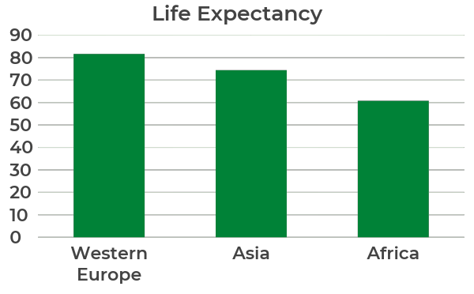
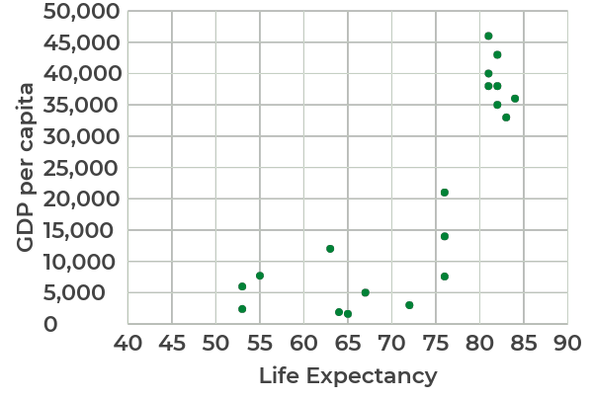
Example charts
Western Europe has a higher average life expectancy than Africa or Asia
There is a positive correlation between life expectancy and GDP per capita

