Slide 1
Understand what a percentage is and its connection to fractions
Mathematics
Miss Parsons

Slide 2
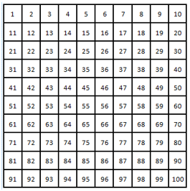
Question 1
What percentage of numbers up to 100 are:
Multiples of 4
Multiples of 6
Multiples of 8
Prime numbers

Slide 3
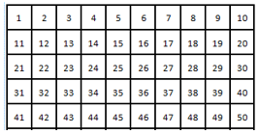
Question 2
This rectangle contains the numbers 1 – 50.
How many squares would be covered if 50% of the squares were covered?
How many squares would be covered if 10% of the squares were covered?

Slide 4
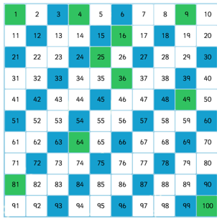
Question 3
Use the hundred square to find:
What percentage of numbers up to 100 are square numbers?
What percentage of numbers up to 100 are multiples of 3?
What percentage of numbers up to 100 are both a square number and multiple of 3?
What percentage of numbers up to 100 are neither a square number or multiple of 3?

