Slide 1
3D Co-ordinates
Mathematics
Mr Millar

Slide 2
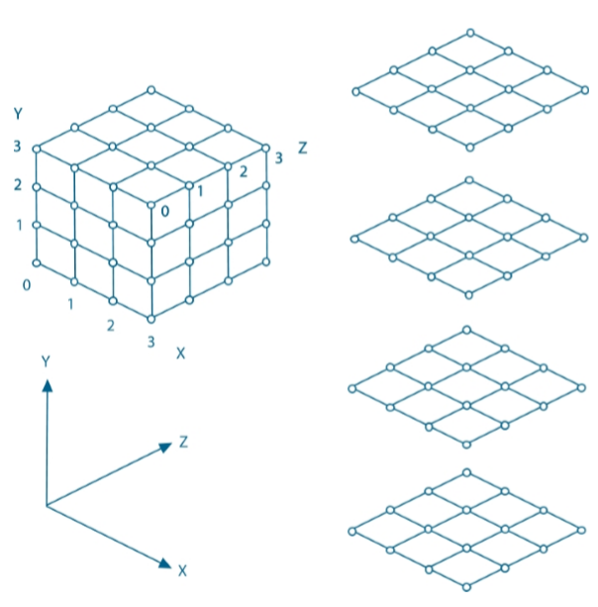
A 3x3x3 cube has an x, y and z co-ordinate.
For example, the dot has co-ordinates (1, 3, 1).
Write down the co-ordinates of the other dots

Slide 3
Copy the cube and plot the co-ordinates:
(0, 3, 0)
(3, 0, 0)
Write the co-ordinates of a point you can’t see on the grid.
(1, 1, 0)
(3, 3, 2)

Slide 4
x | y | z
0 | 0 | 0
0 | 0 | 1
0 | 0 | 2
0 | 0 | 3
0 | 1 | 0
0 | 1 | 1
0 | 1 | 2
0 | 1 | 3
0 | 2 | 0
0 | 2 | 1
0 | 2 | 2
0 | 2 | 3
0 | 3 | 0
0 | 3 | 1
0 | 3 | 2
0 | 3 | 3
1 | 0 | 0
1 | 0 | 1
1 | 0 | 2
1 | 0 | 3
1 | 1 | 0
1 | 1 | 1
1 | 1 | 2
1 | 1 | 3
x | y | z
1 | 2 | 0
1 | 2 | 1
1 | 2 | 2
1 | 2 | 3
1 | 3 | 0
1 | 3 | 1
1 | 3 | 2
1 | 3 | 3
2 | 0 | 0
2 | 0 | 1
2 | 0 | 2
2 | 0 | 3
2 | 1 | 0
2 | 1 | 1
2 | 1 | 2
2 | 1 | 3
2 | 2 | 0
2 | 2 | 1
2 | 2 | 2
2 | 2 | 3
2 | 3 | 0
2 | 3 | 1
2 | 3 | 2
2 | 3 | 3
x | y | z
3 | 0 | 0
3 | 0 | 1
3 | 0 | 2
3 | 0 | 3
3 | 1 | 0
3 | 1 | 1
3 | 1 | 2
3 | 1 | 3
3 | 2 | 0
3 | 2 | 1
3 | 2 | 2
3 | 2 | 3
3 | 3 | 0
3 | 3 | 1
3 | 3 | 2
3 | 3 | 3
Somewhere in the grid a piece of treasure is hidden! You will get a series of clues which will lead to the treasure.
Clue 1:
The x co-ordinate + z co-ordinate = y co-ordinate

Slide 5
These are the remaining possibilities after the Independent Task
x | y | z
0 | 0 | 0
0 | 0 | 1
0 | 0 | 2
0 | 0 | 3
0 | 1 | 0
0 | 1 | 1
0 | 1 | 2
0 | 1 | 3
0 | 2 | 0
0 | 2 | 1
0 | 2 | 2
0 | 2 | 3
0 | 3 | 0
0 | 3 | 1
0 | 3 | 2
0 | 3 | 3
1 | 0 | 0
1 | 0 | 1
1 | 0 | 2
1 | 0 | 3
1 | 1 | 0
1 | 1 | 1
1 | 1 | 2
1 | 1 | 3
x | y | z
1 | 2 | 0
1 | 2 | 1
1 | 2 | 2
1 | 2 | 3
1 | 3 | 0
1 | 3 | 1
1 | 3 | 2
1 | 3 | 3
2 | 0 | 0
2 | 0 | 1
2 | 0 | 2
2 | 0 | 3
2 | 1 | 0
2 | 1 | 1
2 | 1 | 2
2 | 1 | 3
2 | 2 | 0
2 | 2 | 1
2 | 2 | 2
2 | 2 | 3
2 | 3 | 0
2 | 3 | 1
2 | 3 | 2
2 | 3 | 3
x | y | z
3 | 0 | 0
3 | 0 | 1
3 | 0 | 2
3 | 0 | 3
3 | 1 | 0
3 | 1 | 1
3 | 1 | 2
3 | 1 | 3
3 | 2 | 0
3 | 2 | 1
3 | 2 | 2
3 | 2 | 3
3 | 3 | 0
3 | 3 | 1
3 | 3 | 2
3 | 3 | 3
Find the treasure with the other clues
Clue 2: The treasure is not to be found at any of the corners
Clue 3: The z co-ordinate < the y co-ordinate
Clue 4: The answer contains exactly 2 prime numbers
Clue 5: The x co-ordinate > the z co-ordinate
Clue 6: Only 1 of the co-ordinates is a square number (0 is not a square number)

Slide 6
Answers

Slide 7
A 3x3x3 cube has an x, y and z co-ordinate.
For example, the dot has co-ordinates (1, 3, 1).
Write down the co-ordinates of the other dots
(1, 2, 0)
(2, 3, 2)
(3, 1, 2)

Slide 8
Copy the cube and plot the co-ordinates:
(0, 3, 0)
(3, 0, 0)
Write the co-ordinates of a point you can’t see on the grid.
(1, 1, 0)
(3, 3, 2)
(eg 1, 1, 1)

Slide 9
x | y | z
0 | 0 | 0
0 | 0 | 1
0 | 0 | 2
0 | 0 | 3
0 | 1 | 0
0 | 1 | 1
0 | 1 | 2
0 | 1 | 3
0 | 2 | 0
0 | 2 | 1
0 | 2 | 2
0 | 2 | 3
0 | 3 | 0
0 | 3 | 1
0 | 3 | 2
0 | 3 | 3
1 | 0 | 0
1 | 0 | 1
1 | 0 | 2
1 | 0 | 3
1 | 1 | 0
1 | 1 | 1
1 | 1 | 2
1 | 1 | 3
x | y | z
1 | 2 | 0
1 | 2 | 1
1 | 2 | 2
1 | 2 | 3
1 | 3 | 0
1 | 3 | 1
1 | 3 | 2
1 | 3 | 3
2 | 0 | 0
2 | 0 | 1
2 | 0 | 2
2 | 0 | 3
2 | 1 | 0
2 | 1 | 1
2 | 1 | 2
2 | 1 | 3
2 | 2 | 0
2 | 2 | 1
2 | 2 | 2
2 | 2 | 3
2 | 3 | 0
2 | 3 | 1
2 | 3 | 2
2 | 3 | 3
x | y | z
3 | 0 | 0
3 | 0 | 1
3 | 0 | 2
3 | 0 | 3
3 | 1 | 0
3 | 1 | 1
3 | 1 | 2
3 | 1 | 3
3 | 2 | 0
3 | 2 | 1
3 | 2 | 2
3 | 2 | 3
3 | 3 | 0
3 | 3 | 1
3 | 3 | 2
3 | 3 | 3
Find the treasure with the other clues
Clue 2: The treasure is not to be found at any of the corners
Clue 3: The z co-ordinate < the y co-ordinate
Clue 4: The answer contains exactly 2 prime numbers
Clue 5: The x co-ordinate > the z co-ordinate
Clue 6: Only 1 of the co-ordinates is a square number (0 is not a square number)
The treasure is hidden in (2, 3, 1)

