Slide 1
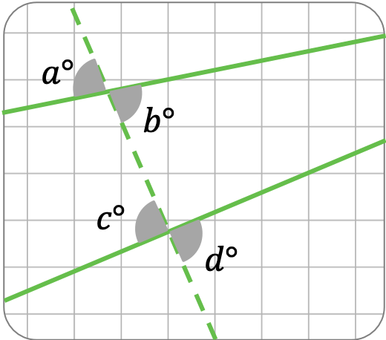
What is the relationship between angle b and and d is the lines intersect to the left of the dotted line?
What is the relationship between angle b and angle d if the lines do not intersect?
What is the relationship between angle b and angle c if the lines do not intersect?
When angle a is less than angle c the lines intersect on the right of the dotted line

Slide 2
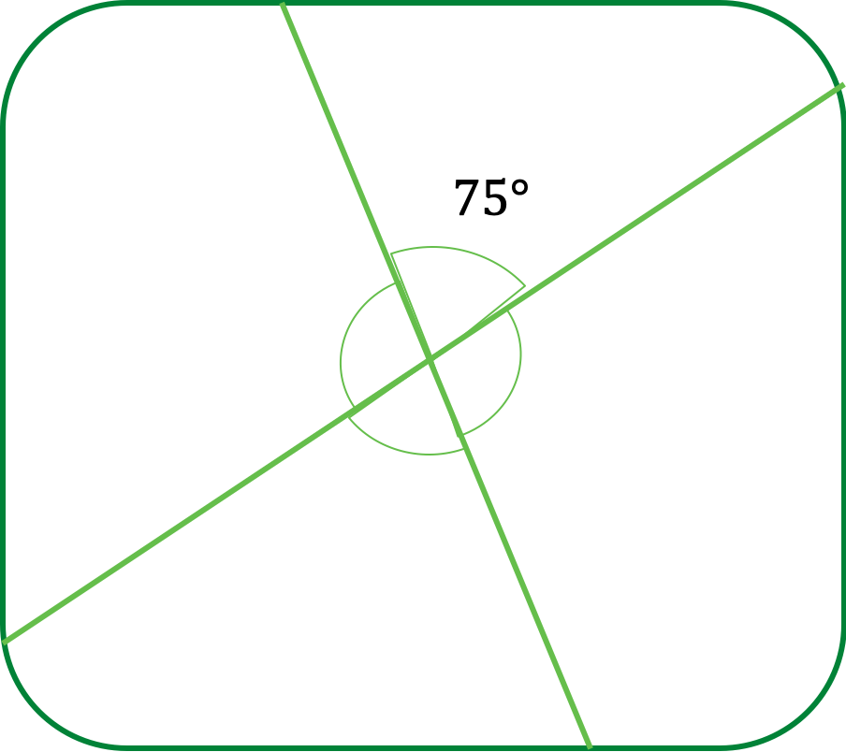
Can you state the size of all the missing angles in this diagram?
How did you find them?

Slide 3
What is the relationship between angle b and angle c if the lines do not intersect?

Slide 4
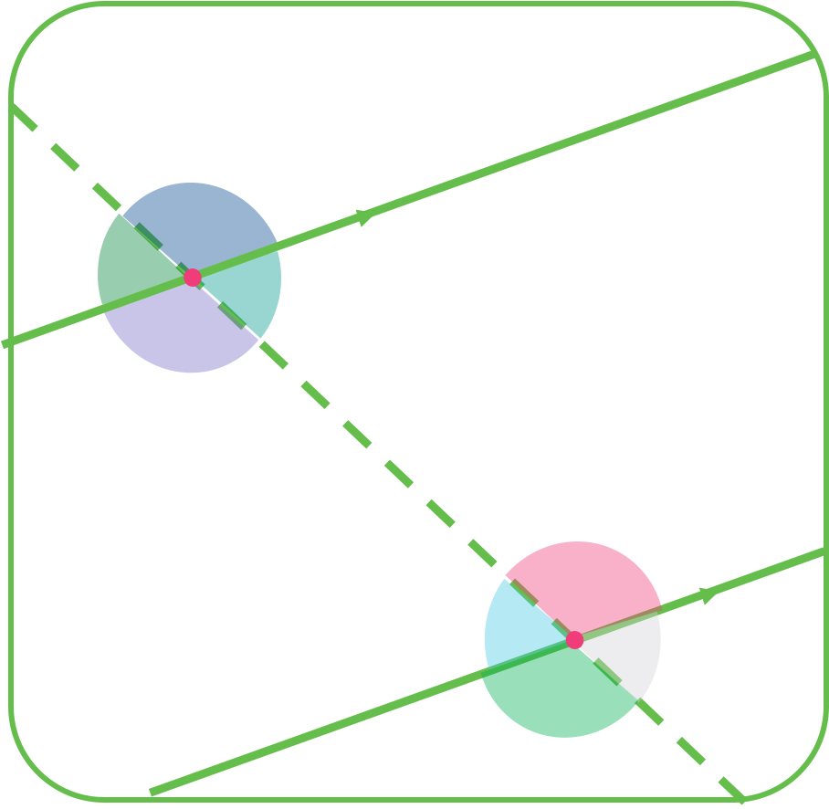
Angles are formed at each point of intersection with a transversal
f
g
e
Given that the bold lines are parallel, state a potential value for each of the given angles.
What do you notice?
h
d
c
a
b

Slide 5
f
Given that angle a = 30 degrees, work out the size of all the other angles on the diagram
g
e
h
d
c
a
b

Slide 6
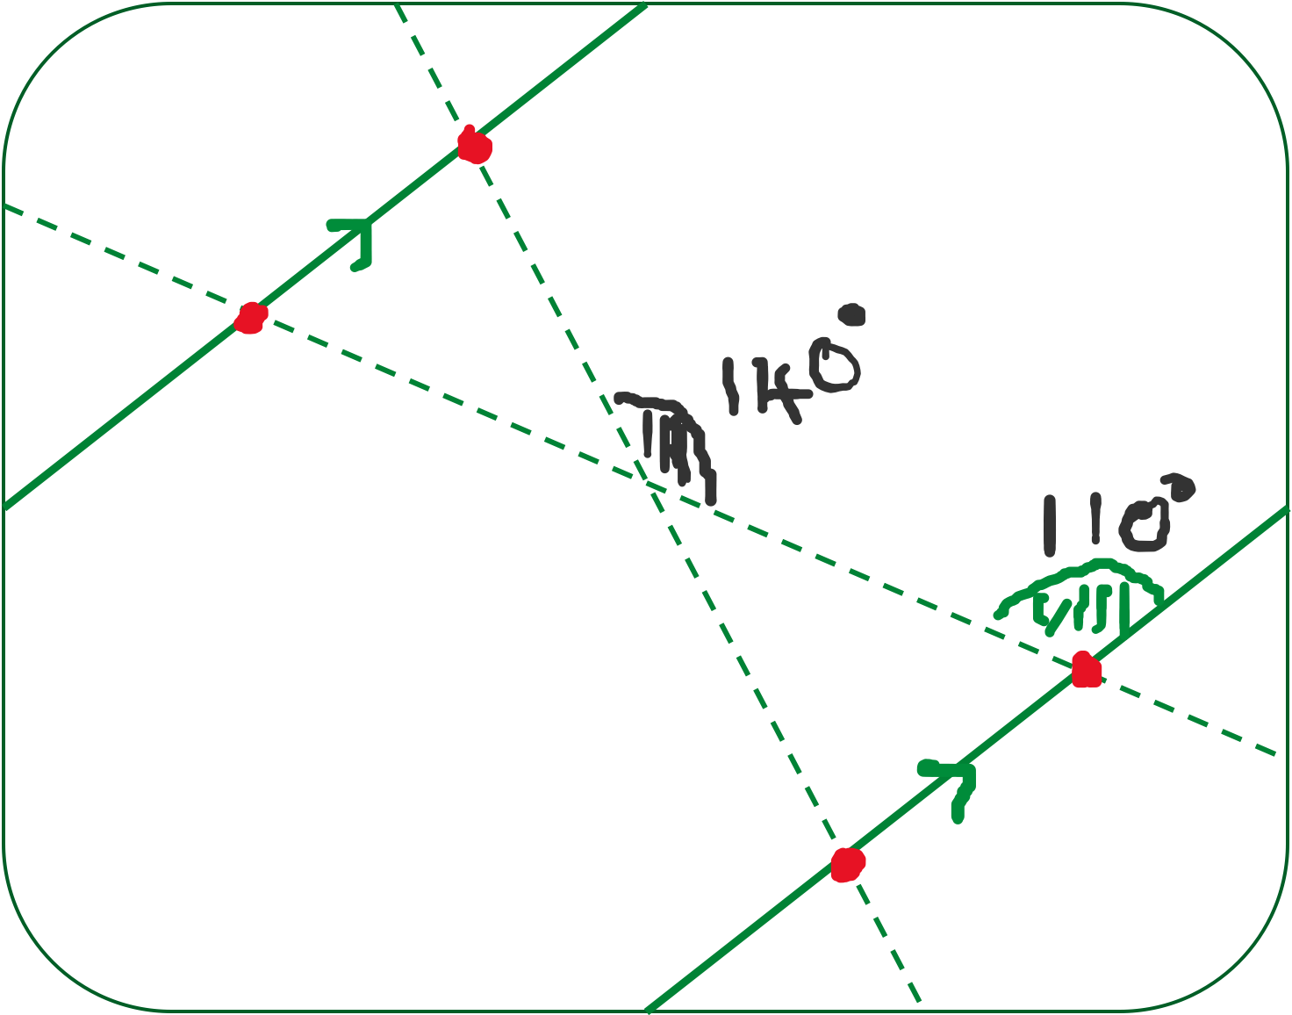
Work out as many angles as you can.
The bold lines are parallel

