Slide 1
Lesson 4: Sequencing meals throughout the day
Lesson 4 of 4
Numeracy: Time - Building Understanding
Simon

Slide 2
Do you remember the mealtimes we learned about in lesson 3?
What did you have for each of these meals yesterday? Write, say or sign what you had yesterday for breakfast, lunch, tea/ dinner and supper.

Slide 3
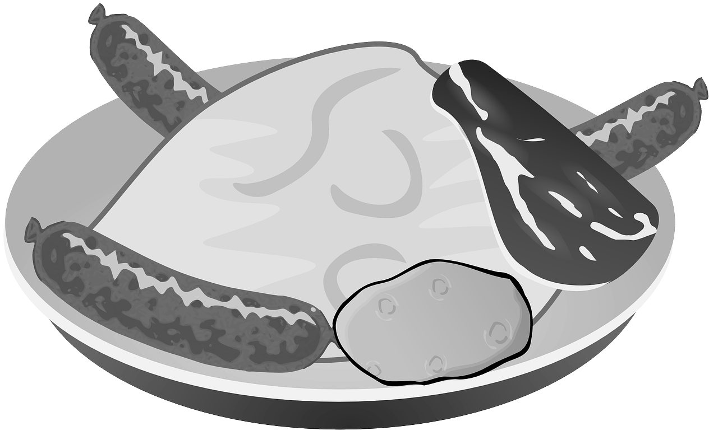
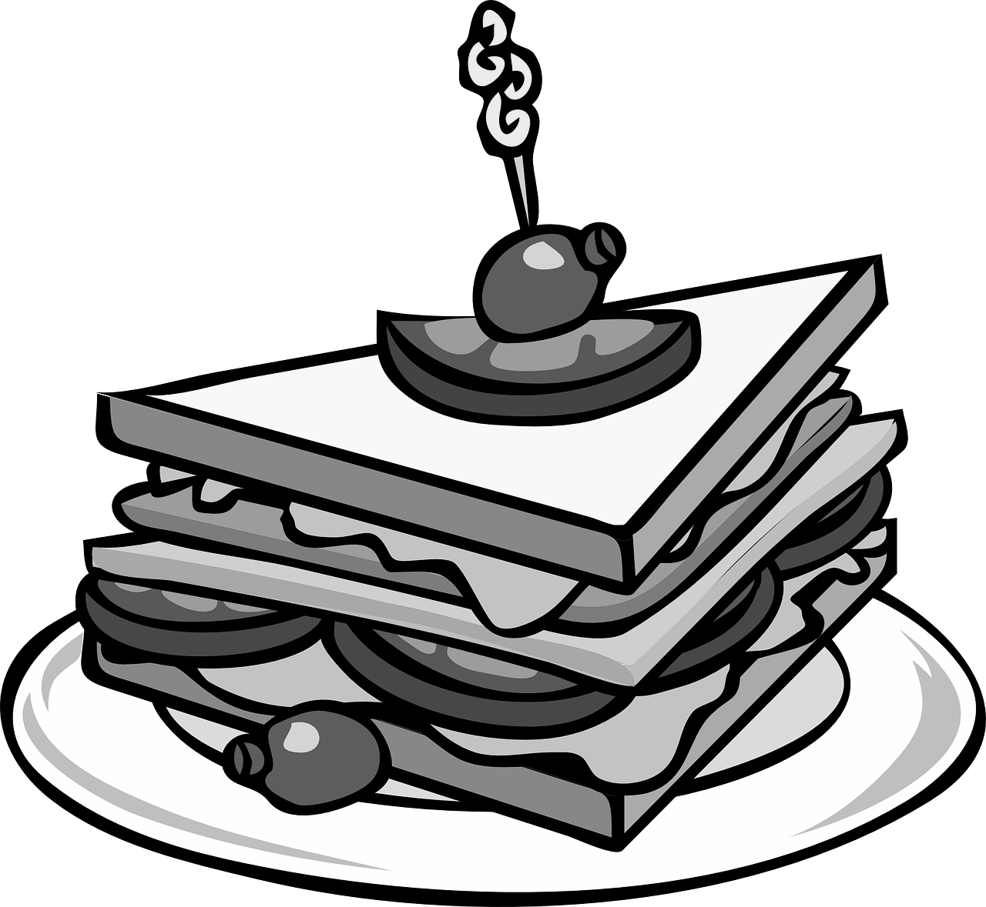
Sorting meals by mealtimes
Use the images which show meals or draw your own. Sort them by matching the meals with the time that they are usually eaten.
breakfast lunchtime teatime supper
See the next slide for an example.

Slide 4
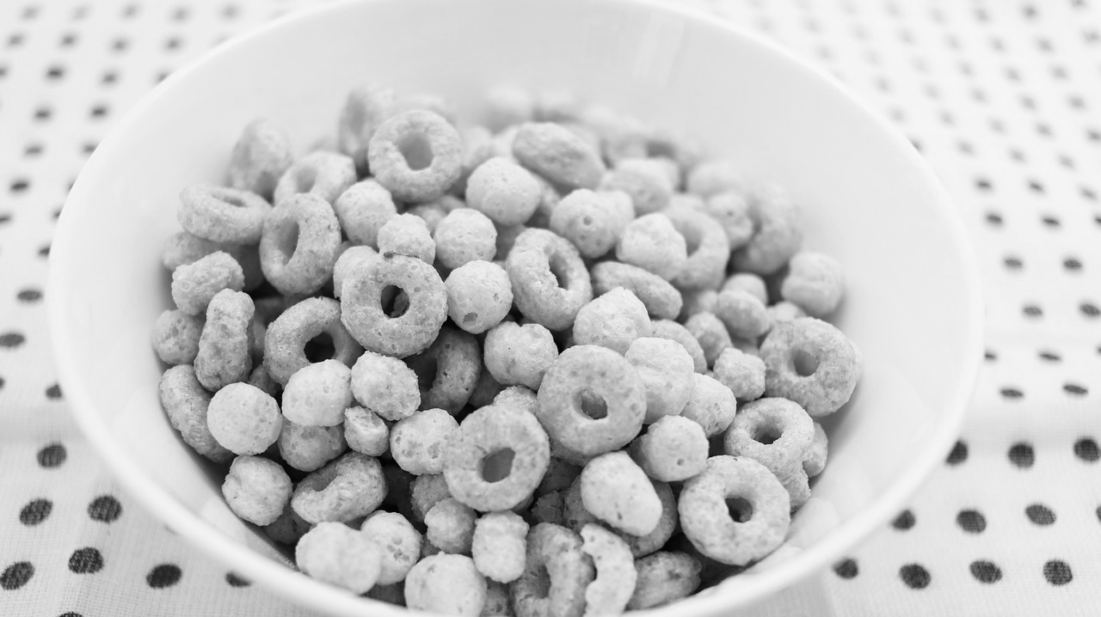
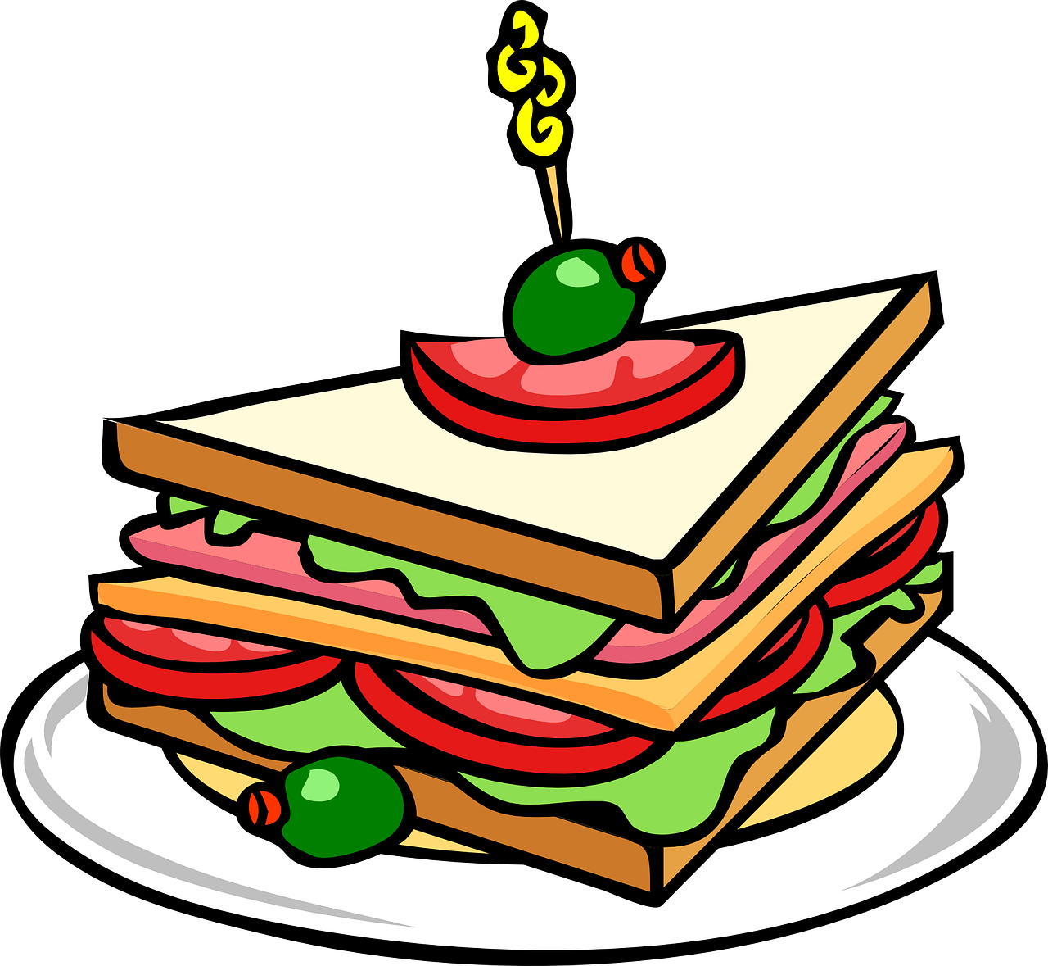
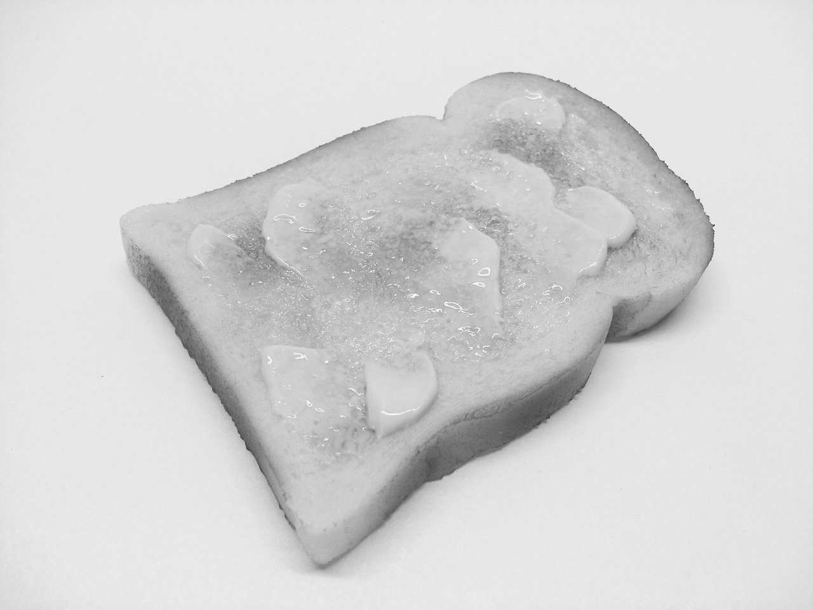
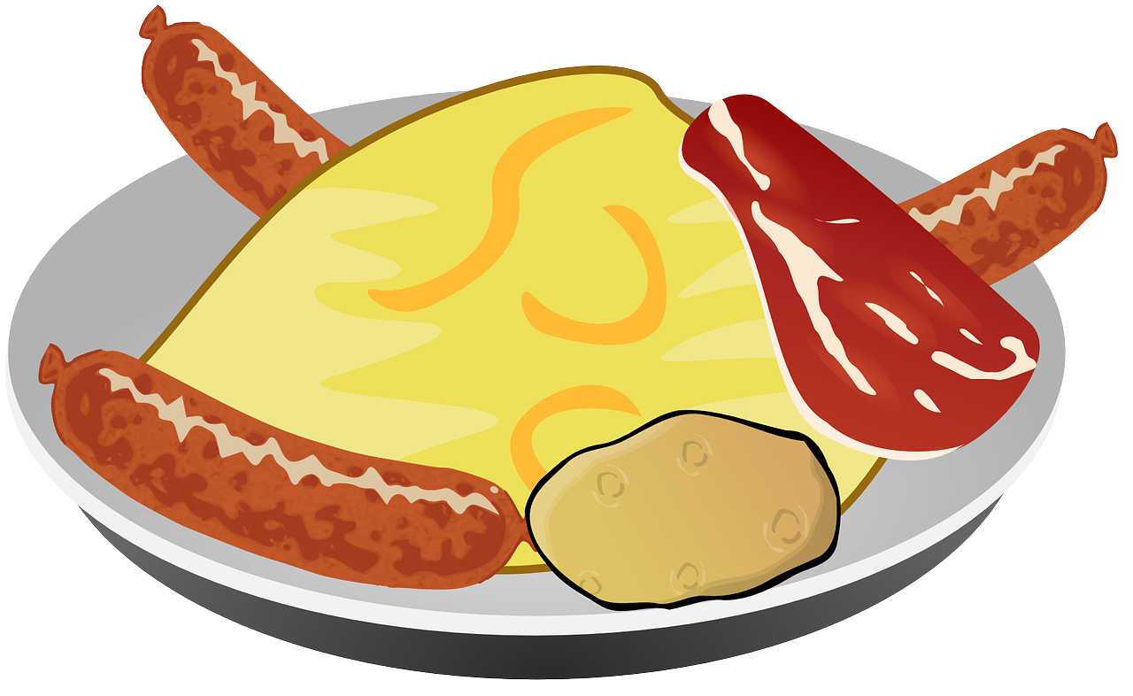
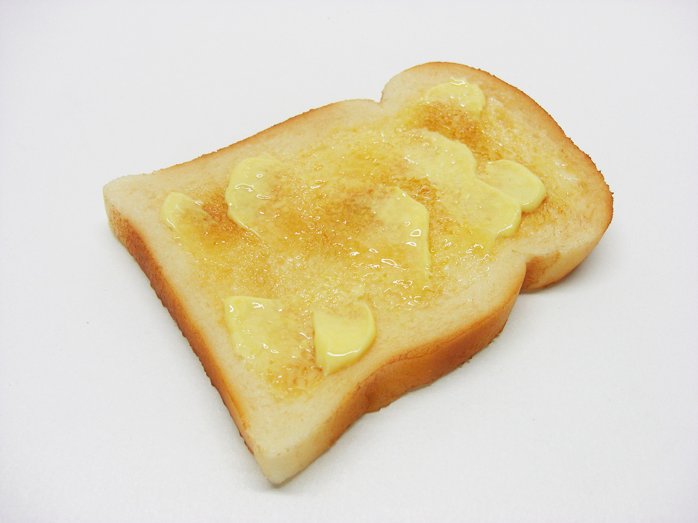
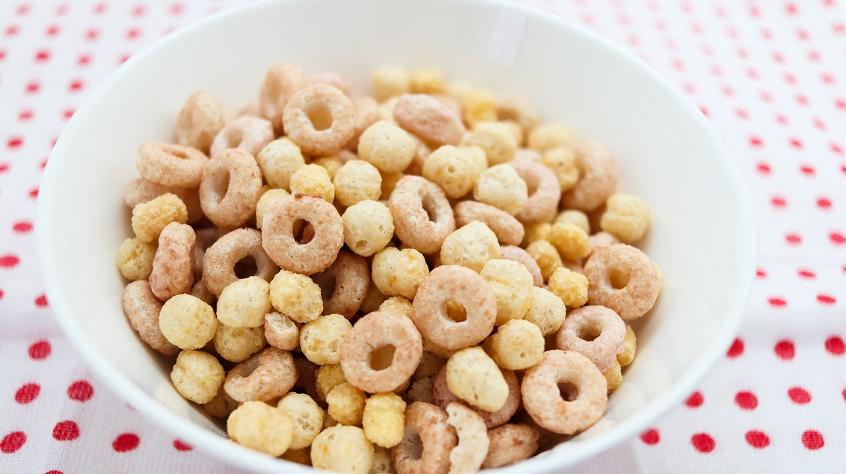
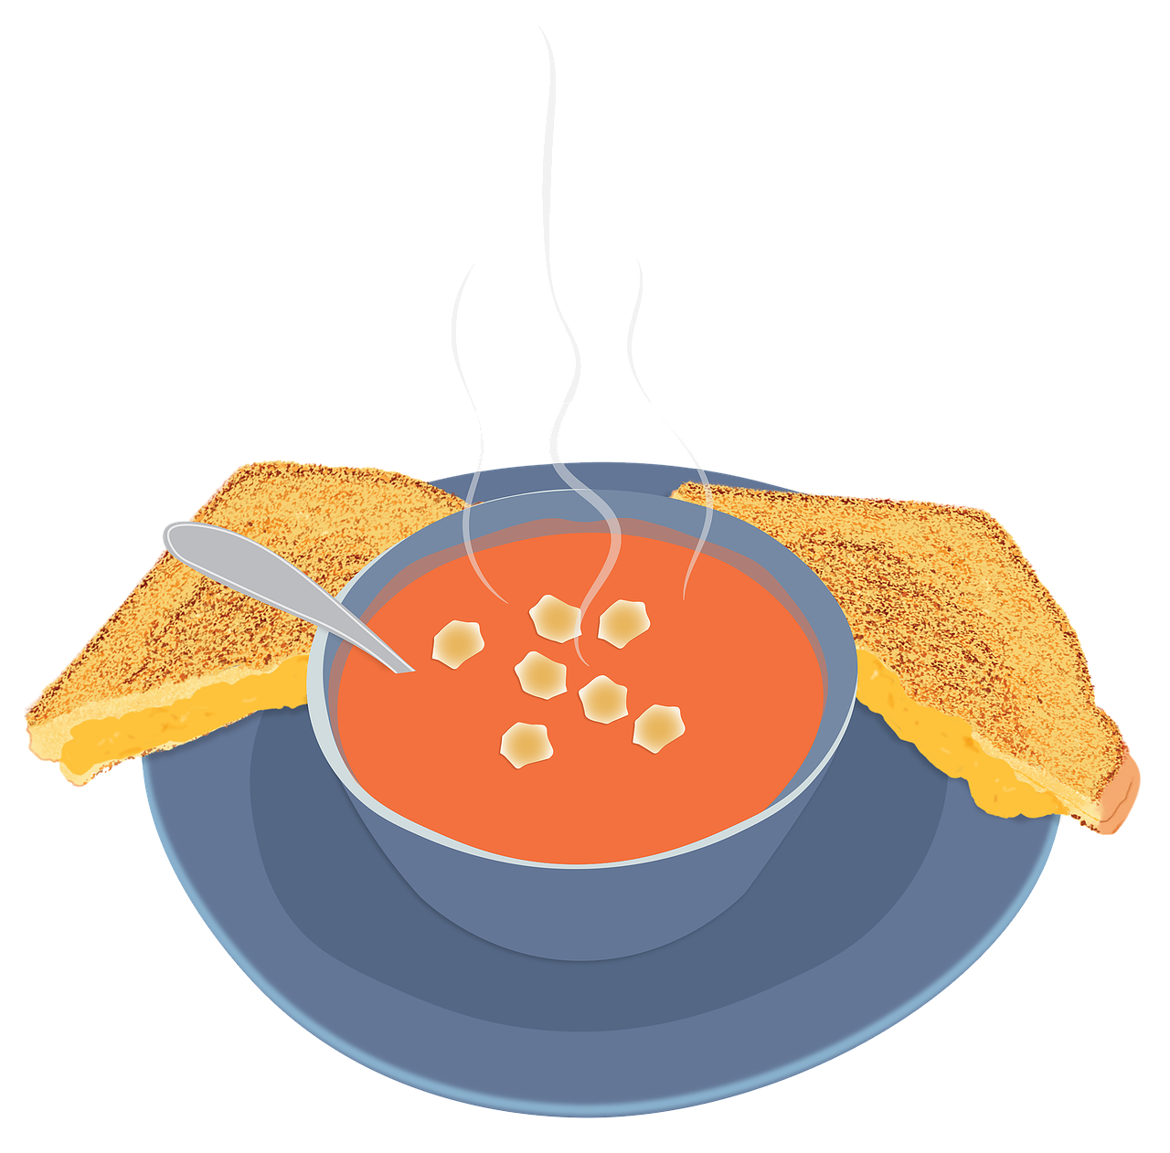
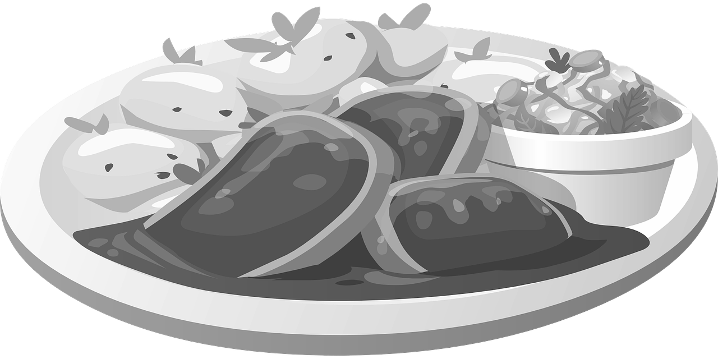
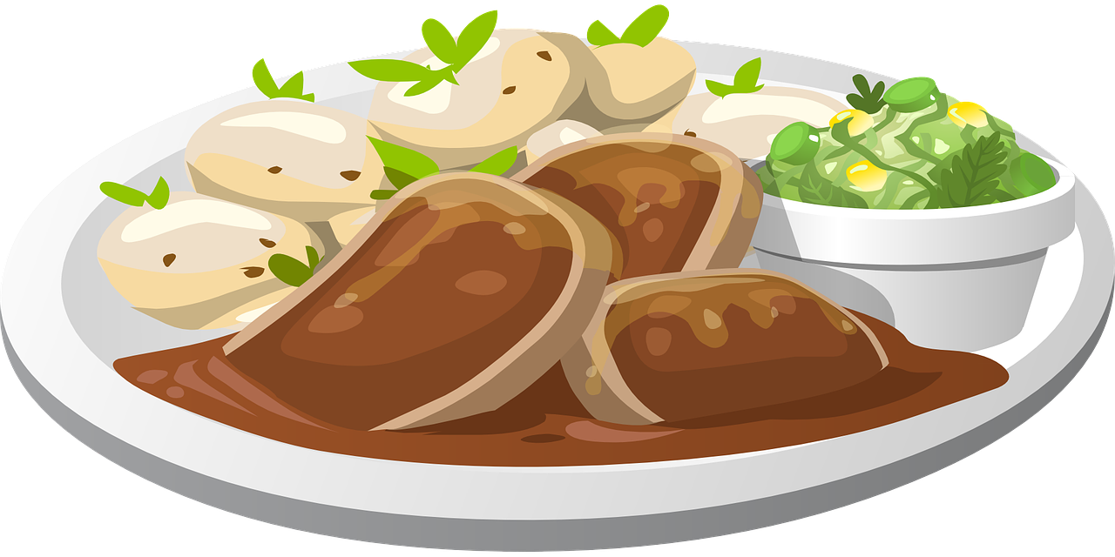
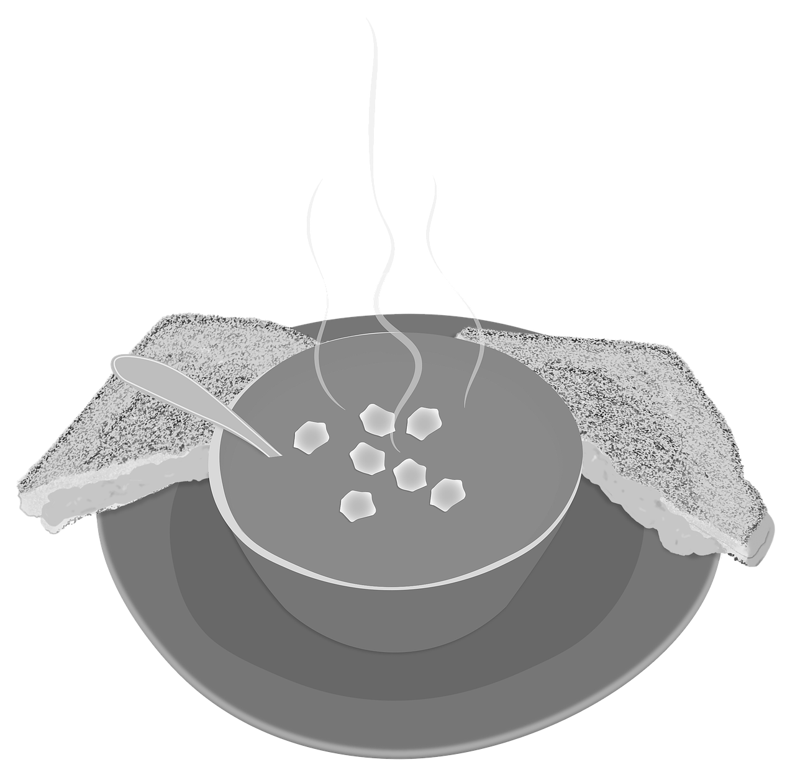
Sorting meals by mealtimes
Example:
breakfast | lunchtime | teatime | supper

Slide 5
Table 1
breakfast | lunchtime | teatime | supper

Slide 6
Planning your own meals
During this activity, you will use your knowledge of which meals happen at which times, and focus on the types of foods you eat for different meals.
breakfast | lunchtime | teatime | supper
Choose a meal that you would like to go in each of the columns.

Slide 7
Planning your own meals
Now choose the foods that will make up each meal.
breakfast | lunchtime | teatime | supper
 |  | Pork chops, potatoes, lettuce, cucumber, tomatoes
For example, for my hot meal I would like pork chops, potatoes and a salad.
I am thinking about making healthy choices too.

Slide 8
Planning your own meals
Let’s have another go. This time I am going to choose breakfast.
breakfast | lunchtime | teatime | supper
Cereal, milk |  | Pork chops, potatoes, lettuce, cucumber, tomatoes
I have chosen to have cereal with milk.

Slide 9
Table 2
breakfast | lunchtime | teatime | supper

Slide 10
Task - Planning your own meals
Instruction
Choose the meals you like for each of the mealtimes. Decide what foods will make up those particular meals.
Suggestions
You should think about which foods are usually eaten at each of the mealtimes and what foods make up each meal. You should think about the foods you like as well as which ones will make up a healthy, balanced meal.
If you need to, do this activity for yesterday’s meals instead of making up your own meals.

Slide 11
Unit 4 Lesson 4: Sequencing meals throughout the day
Make it easier
Make it harder
Other ideas
Return to the first activity and sort meals. Which foods do we eat for breakfast? Which foods do we eat for supper?
You could add snacks and drinks. What drinks do you have at different times of day? What is a suitable snack for the morning? Are there any meals that have puddings?
Plan out the meals for a week. Over the course of the week, how healthy is your diet?
You could keep a food diary showing all your meals in order throughout the day.

