Slide 1
Find quartiles from a list of data
Maths
Miss Parnham

Slide 2
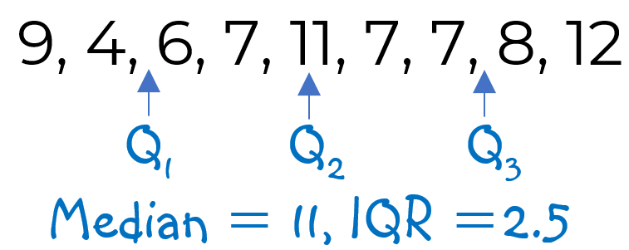
Find quartiles from a list of data
1. Find the median, upper and lower quartiles and the interquartile range for each data set.
a) 4, 5, 5, 7, 10, 11, 11
b) 15, 9, 16, 19, 7, 9, 11
c) 8, 11, 14, 4, 6, 10, 18, 11, 15, 3, 7
d) 2.7, 8.9, 4.35, 1.08, 4.8, 3, 6.12
2. Jack is finding the median and interquartile range for this data set.
What mistake has he made?
Find the correct answers.

Slide 3
Find quartiles from a list of data
3. Find the median, upper and lower quartiles and the interquartile range for each data set.
a) 3, 6, 8, 9
b) 7, 4, 1, 10, 3, 5, 4, 9
c) 2.6, 4, 3.12, 5.5, 2.03, 4.3, 3.6, 5.9
4. These cards have been ordered.
The range is double the median.
The interquartile range is 6
Use this information to find a and b.
2
4
5
8
9
b
12
a

Slide 4
Answers

Slide 5
Find quartiles from a list of data
1. Find the median, upper and lower quartiles and the interquartile range for each data set.
a) 4, 5, 5, 7, 10, 11, 11
b) 15, 9, 16, 19, 7, 9, 11
c) 8, 11, 14, 4, 6, 10, 18, 11, 15, 3, 7
d) 2.7, 8.9, 4.35, 1.08, 4.8, 3, 6.12
2. Jack is finding the median and interquartile range for this data set.
What mistake has he made?
Find the correct answers.
Median 7, UQ 11, LQ 5, IQR 6
7, 9, 9, 11, 15, 16, 19
Median 11, UQ 16, LQ 9, IQR 7
He has not ordered the data first
3, 4, 6, 7, 8, 10, 11, 11, 14, 15, 18
Median 10, UQ 14, LQ 6, IQR 8
4, 6, 7, 7, 7, 8, 9, 11, 12
Median 7, UQ 10,
LQ 6.5, IQR 3.5
1.08, 2.7, 3, 4.35, 4.8, 6.12, 8.9
Q₁ Q₂ Q₃
Median 4.35, UQ 6.12, LQ 2.7, IQR 3.42

Slide 6
Find quartiles from a list of data
3. Find the median, upper and lower quartiles and the interquartile range for each data set.
a) 3, 6, 8, 9
b) 7, 4, 1, 10, 3, 5, 4, 9
c) 2.6, 4, 3.12, 5.5, 2.03, 4.3, 3.6, 5.9
4. These cards have been ordered.
The range is double the median.
The interquartile range is 6
Use this information to find a and b.
2
4
5
8
9
b
12
a
Median 7, UQ 8.5, LQ 4.5, IQR 4
1, 3, 4, 4, 5, 7, 9, 10
Median 4.5, UQ 8, LQ 3.5, IQR 4.5
Median is 8.5
Range is 17
a = 2 + 17 = 19
LQ is 4.5
UQ is 10.5
b = 2(10.5) - 12 = 9
2.03, 2.6, 3.12, 3.6, 4, 4.3, 5.5, 5.9
Median 3.8, UQ 4.9, LQ 2.86, IQR 2.04

