Slide 1
Shopping for clothes [2 / 2]
Using ce, cette, ces
French
Mademoiselle Martin

Slide 2
Phonétique

Slide 3
[ ch ]
chercher

Slide 4
[ ch ]
chat
bouche
dimanche

Slide 5
[ SFC ]
dans
X

Slide 6
[ SFC ]
c r f l
Be c a r e f u l with these!

Slide 7
Vocabulaire

Slide 8
je voudrais | I would like
échanger | to exchange
un remboursement | a refund
un trou | a hole
une tache | a stain
essayer | to try
un pantalon | trousers
une jupe | a skirt
des chaussettes | socks
des chaussures | shoes

Slide 9
Grammaire - Using demonstrative adjectives

Slide 10
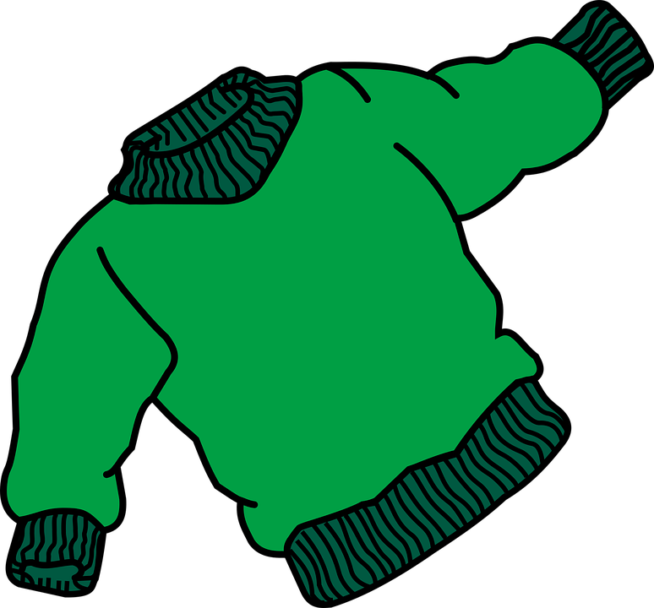
Demonstrative adjectives - this / that
le pull
ce pull
= jumper
= this jumper

Slide 11
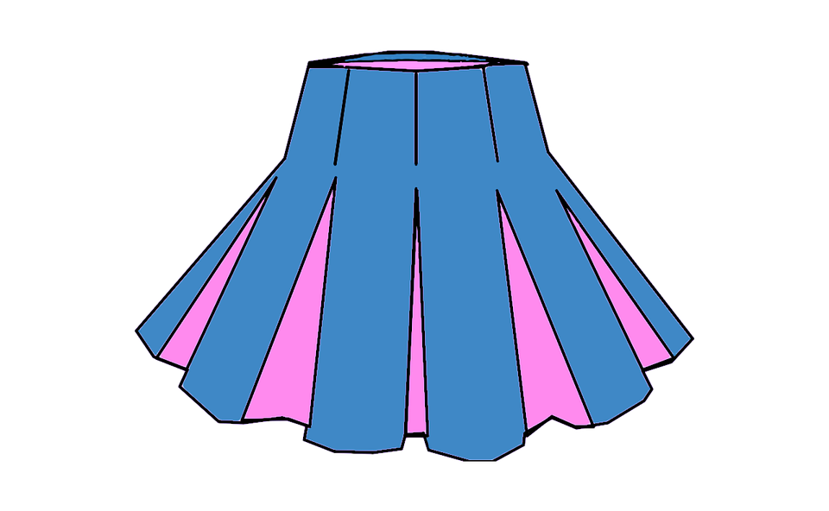
Demonstrative adjectives
la jupe
cette jupe
= skirt
= this skirt

Slide 12
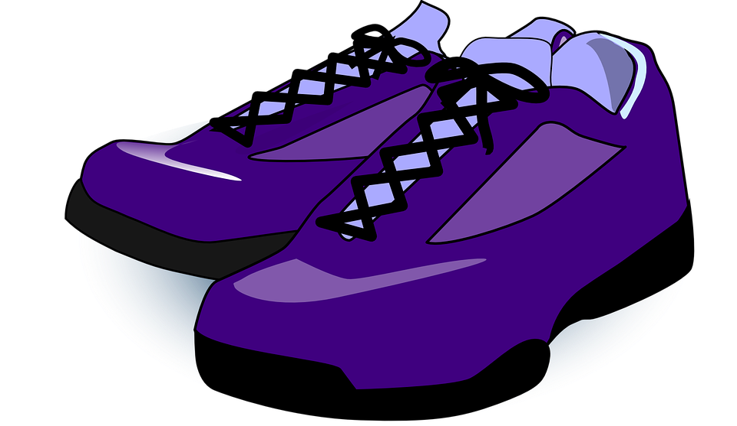
Demonstrative adjectives
des tennis
ces tennis
= trainers
= these trainers

Slide 13
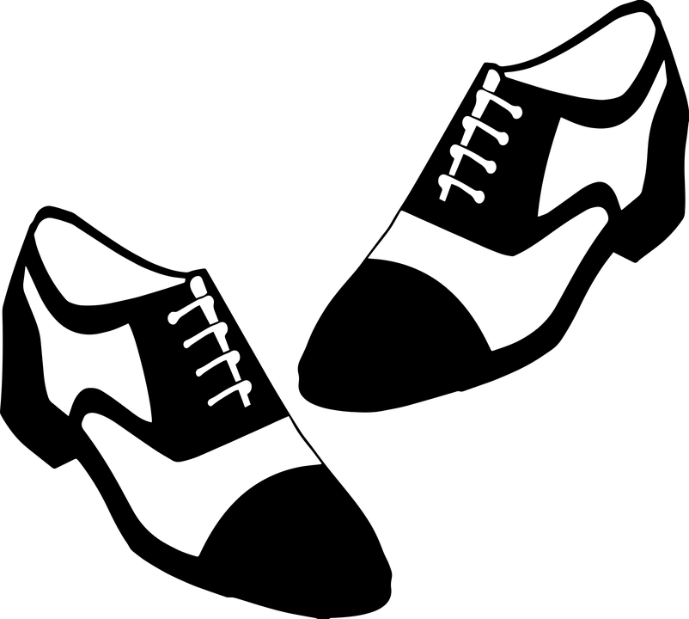
Demonstrative adjectives
des chaussures
ces chaussures
= shoes
= these shoes

Slide 14
Demonstrative adjectives
l’impérmeable
cet impérmeable
= raincoat
= this raincoat

Slide 15
Demonstrative adjectives - this or that
Demonstrative adjectives are used to point out a specific thing or person or to emphasise something.
They come before a noun and agree with the noun.
 | Singular | Plural
Masculine | Ce | Ces
Feminine | Cette | Ces
Ce changes to cet before a masculine singular noun that begins with a vowel or a silent -h

Slide 16
Shopping for clothes [2 /2]
The French words for this or that are
2. These words come ……… the noun
3. This jumper =
4. I would like =
5. I would like a refund =
Ce (m), cette (f), ces (pl)
5
4
before
3
ce pull
2
Je voudrais
1
Je voudrais un remboursement

