Slide 1
To illustrate and name parts of a circle
Worksheet
Maths
Miss Miles

Slide 2
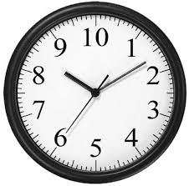
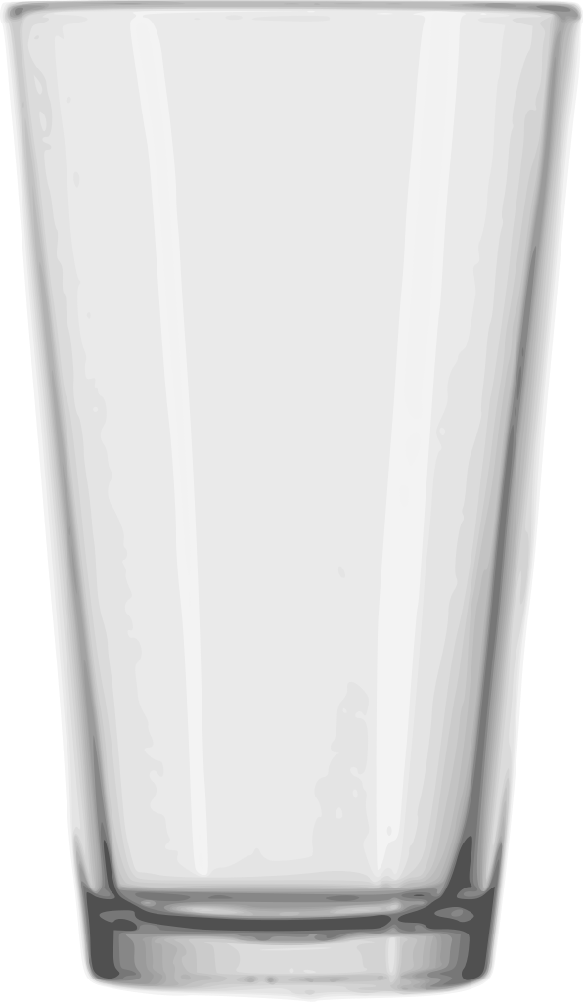
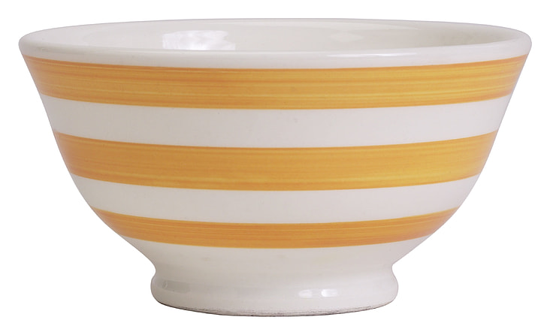
Independent Task
Find three objects in your house which have a circular face.
Use a piece of string or tape measure, and a ruler to find the radius, diameter and circumference of these circles. Here are some examples you could find around your house:

