Slide 1
Plot a histogram
Maths
Miss Parnham

Slide 2
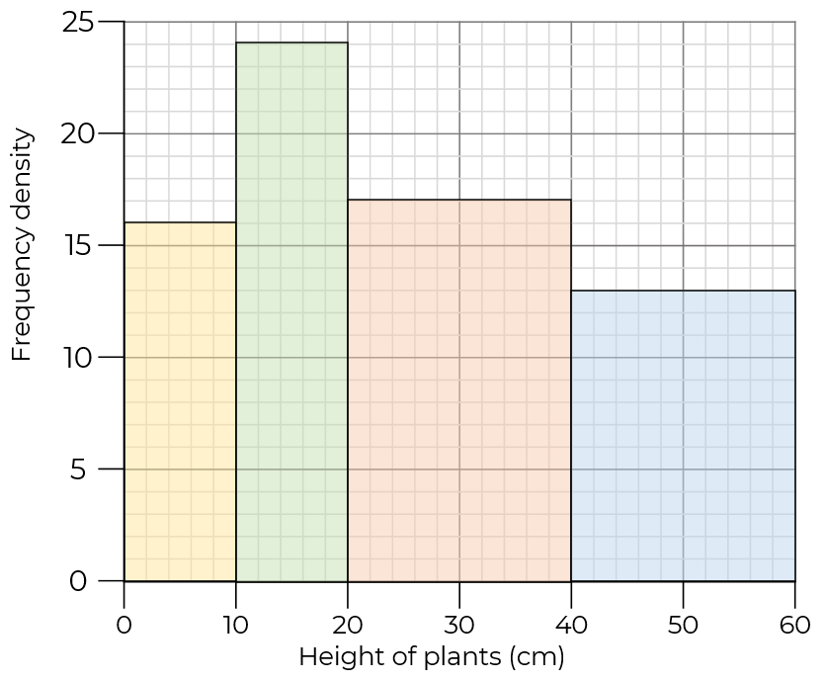
Plot a histogram
1. The table shows the time taken by students to walk to school.
Complete the table.
What is the modal class interval?
2. Mo has drawn a histogram from this data.
What mistake
has he made?
Height (cm) | Frequency | Class width | F.D
0 < t ≤ 10 | 16 | 10 | 1.6
10 < t ≤ 20 | 24 | 10 | 2.4
20 < t ≤ 40 | 17 | 20 | 0.85
40 < t ≤ 60 | 13 | 20 | 0.65
Time (minutes) | Frequency | Class width | Frequency density
0 < t ≤ 10 | 9
10 < t ≤ 15 | 12
15 < t ≤ 20 | 15
20 < t ≤ 30 | 8
30 < t ≤ 60 | 6

Slide 3
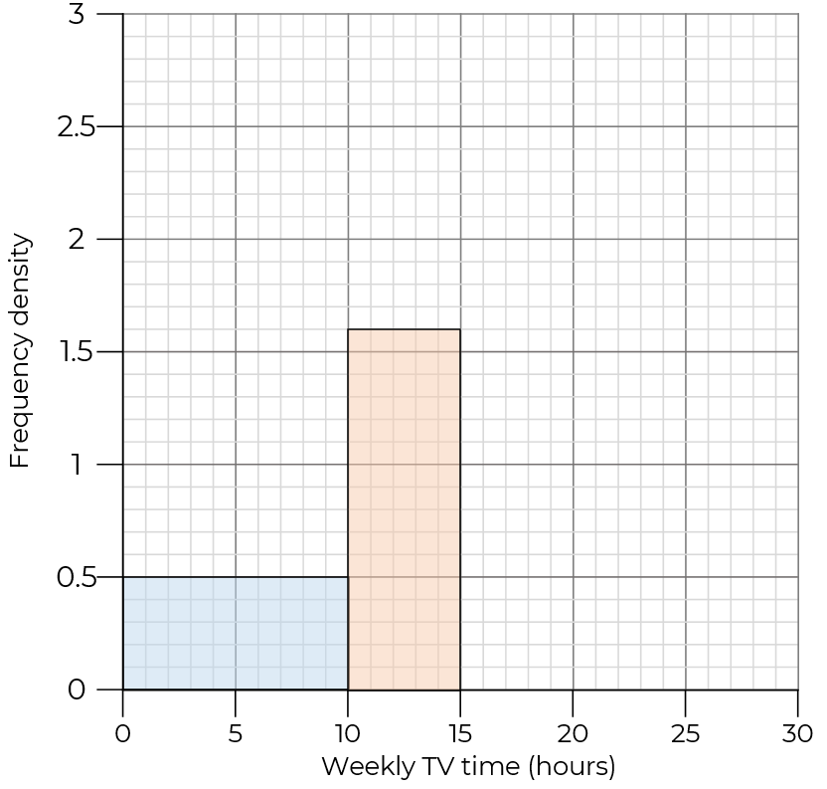
Plot a histogram
3. Complete the table and histogram.
Weekly TV time (hours) | Frequency | Class width | Frequency density
0 < t ≤ 10 | 5 | 10 | 0.5
10 < t ≤ 15 | 8 | 5 | 1.6
15 < t ≤ 20 | 15
20 < t ≤ 30 | 2

Slide 4
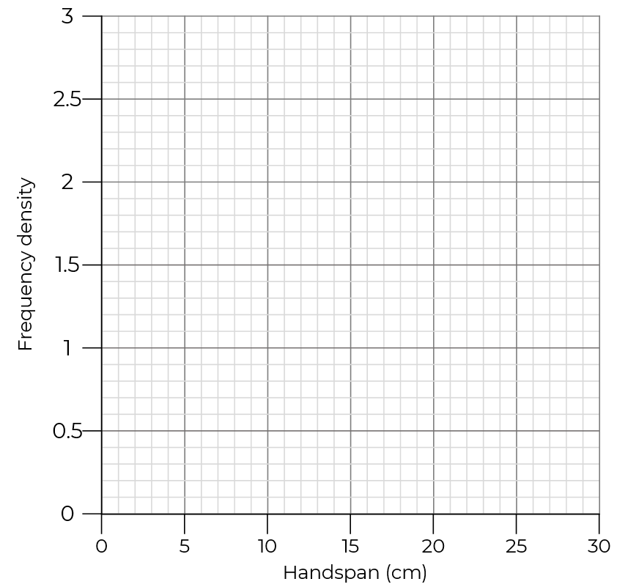
Plot a histogram
4. Complete the table and draw a histogram to represent the data.
Handspan (cm) | Frequency | Class width | Frequency density
0 < t ≤ 10 | 2
10 < t ≤ 20 | 9
20 < t ≤ 25 | 13
25 < t ≤ 30 | 6

Slide 5
Answers

Slide 6
Plot a histogram
1. The table shows the time taken by students to walk to school.
Complete the table.
What is the modal class interval?
2. Mo has drawn a histogram from this data.
What mistake
has he made?
Height (cm) | Frequency | Class width | F.D
0 < t ≤ 10 | 16 | 10 | 1.6
10 < t ≤ 20 | 24 | 10 | 2.4
20 < t ≤ 40 | 17 | 20 | 0.85
40 < t ≤ 60 | 13 | 20 | 0.65
Time (minutes) | Frequency | Class width | Frequency density
0 < t ≤ 10 | 9 | 10 | 0.9
10 < t ≤ 15 | 12 | 5 | 2.4
15 < t ≤ 20 | 15 | 5 | 3
20 < t ≤ 30 | 8 | 10 | 0.8
30 < t ≤ 60 | 6 | 30 | 0.2
He has plotted the height against the frequency rather than the frequency density.
15 < t ≤ 20

Slide 7
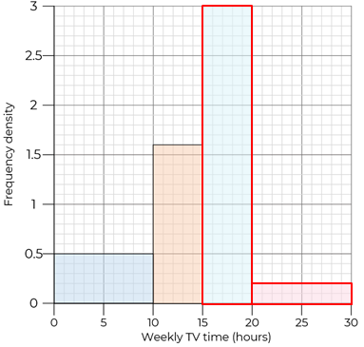
Plot a histogram
3. Complete the table and histogram.
Weekly TV time (hours) | Frequency | Class width | Frequency density
0 < t ≤ 10 | 5 | 10 | 0.5
10 < t ≤ 15 | 8 | 5 | 1.6
15 < t ≤ 20 | 15 | 5 | 3
20 < t ≤ 30 | 2 | 10 | 0.2

Slide 8
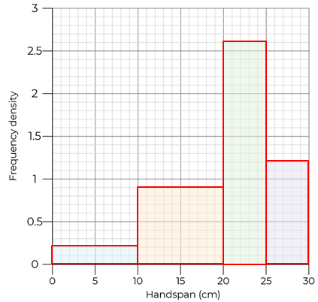
Plot a histogram
4. Complete the table and draw a histogram to represent the data.
Handspan (cm) | Frequency | Class width | Frequency density
0 < t ≤ 10 | 2 | 10 | 0.2
10 < t ≤ 20 | 9 | 10 | 0.9
20 < t ≤ 25 | 13 | 5 | 2.6
25 < t ≤ 30 | 6 | 5 | 1.2

