Slide 1
How do bands ensure they perform in time, and that all parts are heard?
Music
Miss Charatan

Slide 2
What is a typical song structure? Put the sections in order
bridge
verse 2
chorus
verse 1
outro
intro
chorus
chorus

Slide 3
Rhythm grid - Recapping notation
A | ​ | ​ | ​ | ​
B
C
D | ​ |  | ​ | ​

Slide 4
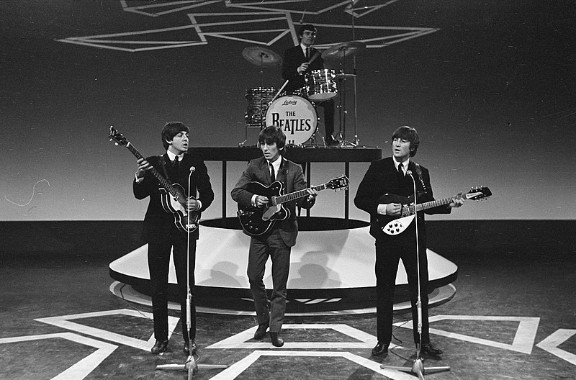
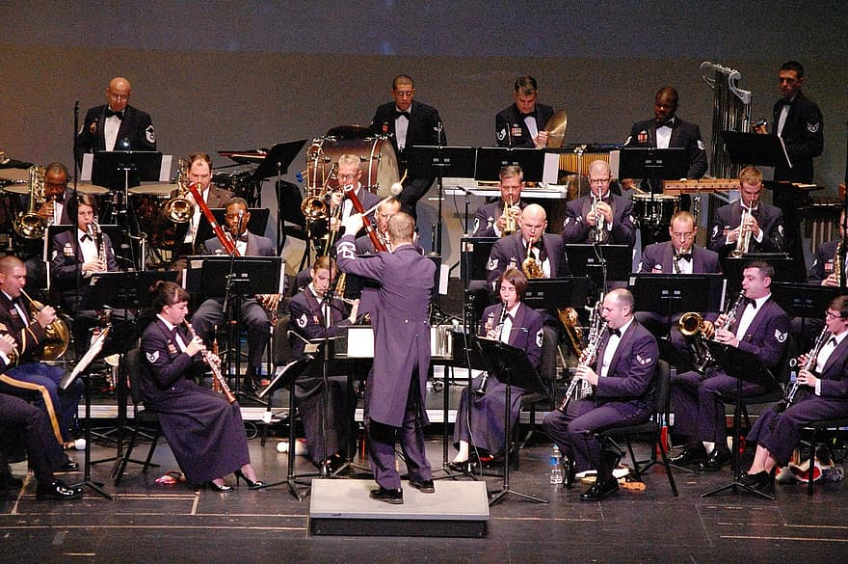
What’s the difference?
Notes:
Point out body language, playing in a band relies on knowling each other, interacting with each other, supporting each other - nerves!

Slide 5
How do musicians play in time together?
What are the 5 things you need to memorise when you play in a band?
How do musicians communicate with each other on stage?

Slide 6
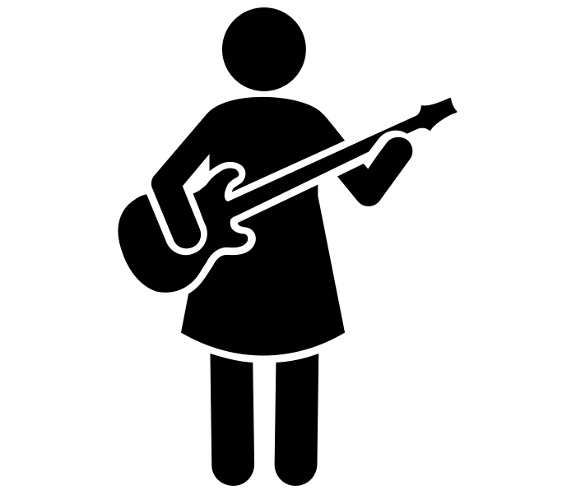
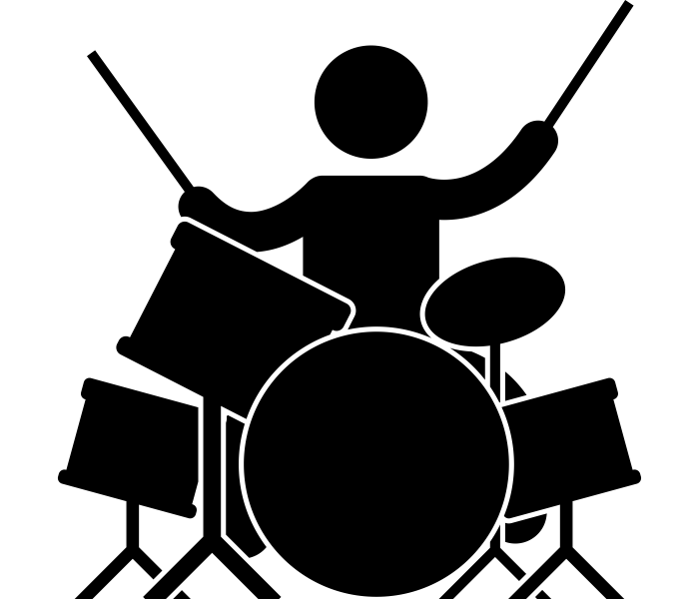
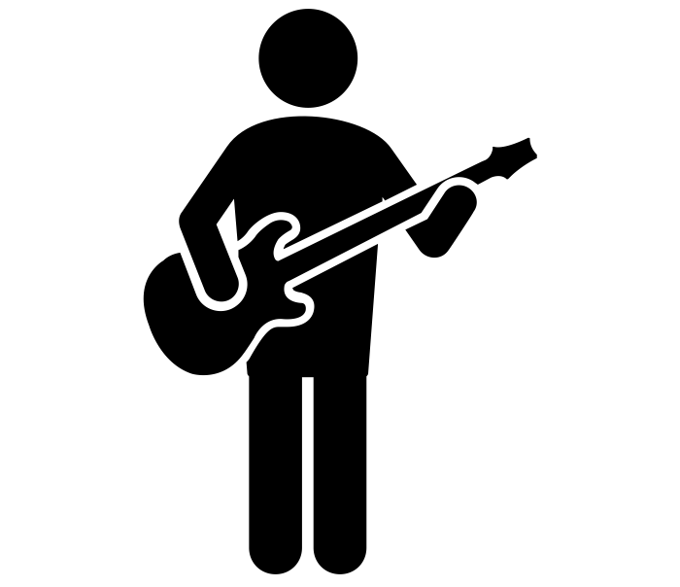
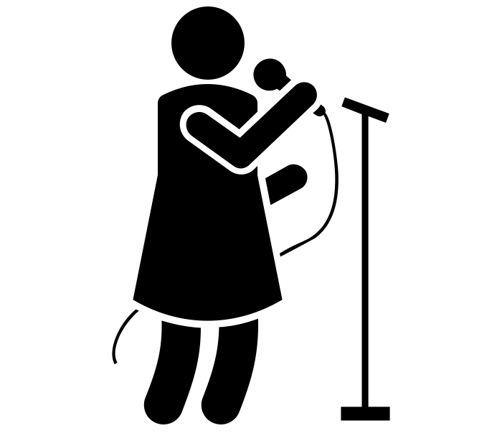
Which parts need to be heard more than others?
Is this going to be the same throughout the song?
bass line
rhythm
chords
melody

Slide 7
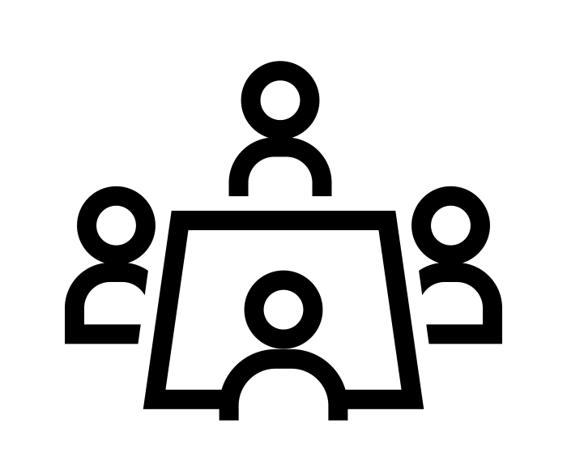
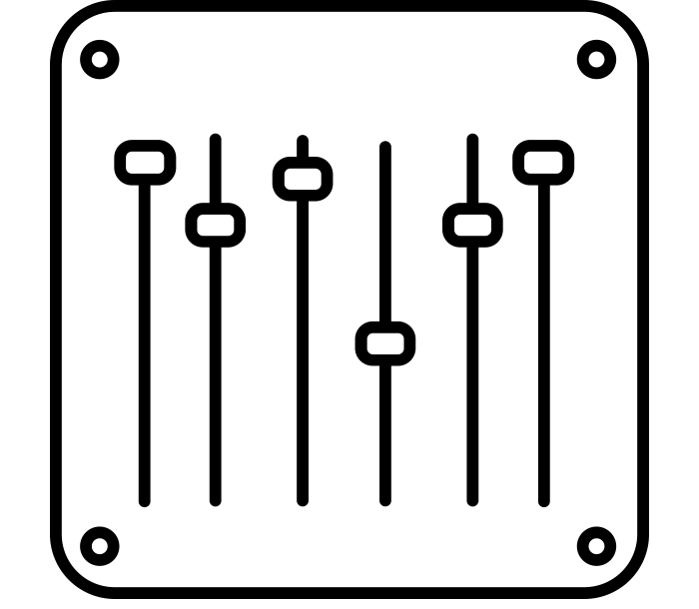
How are parts balanced in a live performance?
How are parts balanced on a recording?
During:
Before:
After:
Listening and adjusting
Sound check
Reflecting
Mixing
Notes:
Explain

Slide 8
Balance - listening
Listen to the track ‘Can’t Stop’ - Red Hot Chilli Peppers (you can find the clip on the worksheet)
What do you notice about the relative volume of the bass and drums?
What do you think will happen to the volume of the bass and drums when the vocals come in?
What do you think the drummer needs to be really careful about remembering?
Notes:
Talk through answers

Slide 9
On a piece of paper, answer the following questions...
What is balance?
How do musicians make sure that their sound is well balanced?
What are the three steps musicians take to ensure they have great balance in a performance?
How do bands ensure they perform in time?
What is balance?
How do live acts ensure they are balanced?
How can you change the balance on a DAW?
Resume once you’re finished

Slide 10
References
Slide [5] - [Wikimedia Commons] - [Eric Koch] - [Televisie-optreden van The Beatles in Treslong te Hillegom vlnr. Paul McCartney, Bestanddeelnr 916-5099]
Slide [5] - [Pikist] - [orchestra, military band, concert, uniform, music, instruments, event, performance, musicians, play, musical]
Slide [7] - [The noun project] - [Simphiwe Mangole] - [Mixer]
Slide [6,7] - [The noun project] - [Prosymbols] - [female vocalist]
Slide [6,7] - [The noun project] - [Prosymbols] - [guitarist]
Slide [6,7] - [The noun project] - [Prosymbols] - [female guitarist]
Slide [6,7] - [The noun project] - [Gan Khoon Lay] - [person playing drums]
Slide [7] - [Needpix] - [spotlight stage disco]

