Slide 1
Multiplication and Division
Problem Solving
Mathematics
Miss Thomas

Slide 2
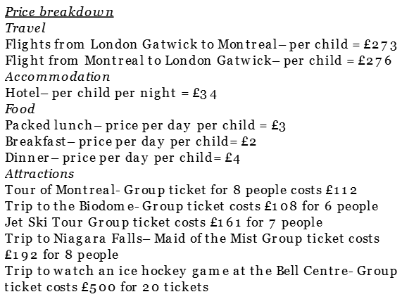
Question 1
The total cost of flights
The cost of accommodation for the week
The total cost of breakfast for the week
The cost of a Jet Ski Tour per person
Decide on the operation to find the answer.
- x ÷
Notes:
Katy's parents want to know how
much the trip will cost, so they
can make a decision over the
Weekend. Help Katy by deciding which operation she needs to use to find the costs of different parts of the trip.

