Slide 1
How does human anatomy compare to other animals?
Science - Human Anatomy
Miss Hummel
Notes:
Hi everyone! My name is Miss Hummel and together, we will be answering the question: How does human anatomy compare to other animals?
In this lesson we will learn about the differences between humans and other animals. We will first learn about vertebrates and invertebrates, followed by the differences of animals who use lungs and gills to breathe. Then, we will briefly compare brains of animals. Finally, we will complete some application questions.

Slide 2
Think back to previous knowledge. Draw a line to match the terms:
Endoskeleton | Vertebrate
Exoskeleton | Invertebrate
Notes:
Now it is your turn to answer these questions.
What is an organ?
What do you need to do to keep your organs healthy?
Pause the video to answer the question. You can resume once you are finished.

Slide 3
Thinking Task:
Do all invertebrates have an exoskeleton?
Notes:
Now it is your turn to answer these questions.
What is an organ?
What do you need to do to keep your organs healthy?
Pause the video to answer the question. You can resume once you are finished.

Slide 4
Vertebrates and invertebrates are divided into smaller groups. Sort these groups to show which are vertebrates and which are invertebrates.
insects reptiles crustaceans mammals arachnids
fish birds amphibians
Vertebrates | Invertebrates
Notes:
Now it is your turn to answer these questions.
What is an organ?
What do you need to do to keep your organs healthy?
Pause the video to answer the question. You can resume once you are finished.

Slide 5
Recap Task: For each of the animal groups below, describe the organs they use to breathe.
Mammals
Reptiles
Birds
Fish
Amphibians
Notes:
Now it is your turn to answer these questions.
What is an organ?
What do you need to do to keep your organs healthy?
Pause the video to answer the question. You can resume once you are finished.

Slide 6
Thinking Task:
What are some of the similarities between gills and lungs? What are some of the differences?

Slide 7
Write whether each statement describes the gills or lungs:
Descriptions | Lungs or gills?
Takes in oxygen from air
Takes in oxygen from water
Organs of fish
Organs of mammals (and other animals)
Located in chest of animal
Located in head of animal

Slide 8
Answer these questions:
What animal has an olfactory bulb that is five times the size of humans?
Name two animals that have a larger brain than humans.

Slide 9
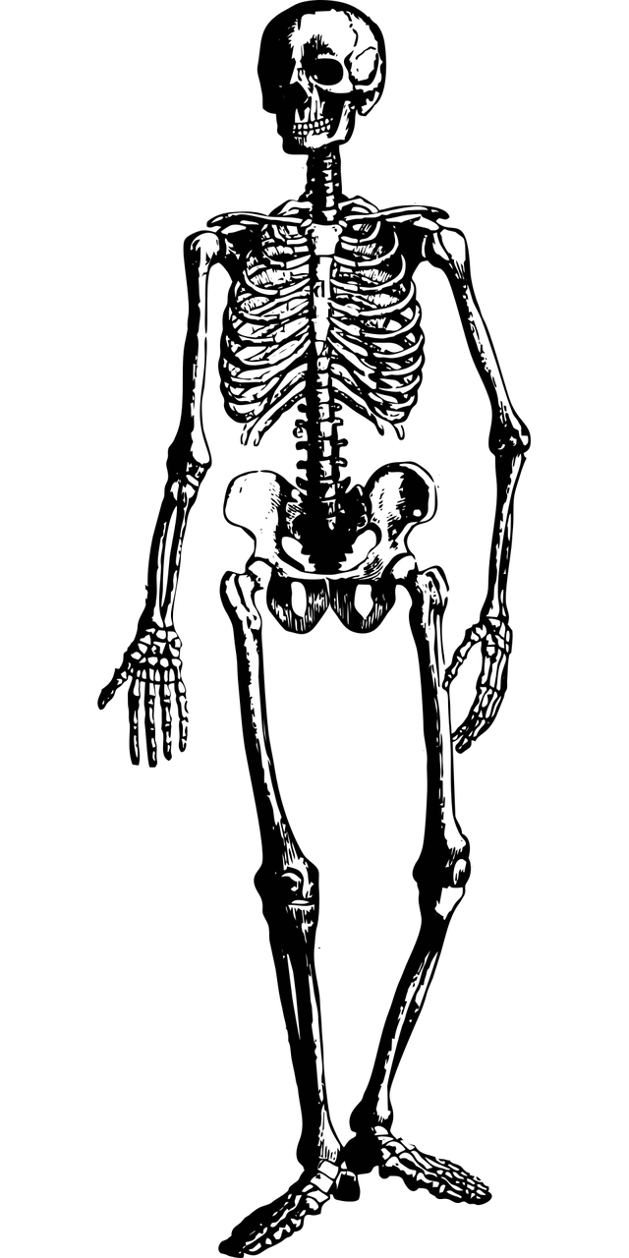
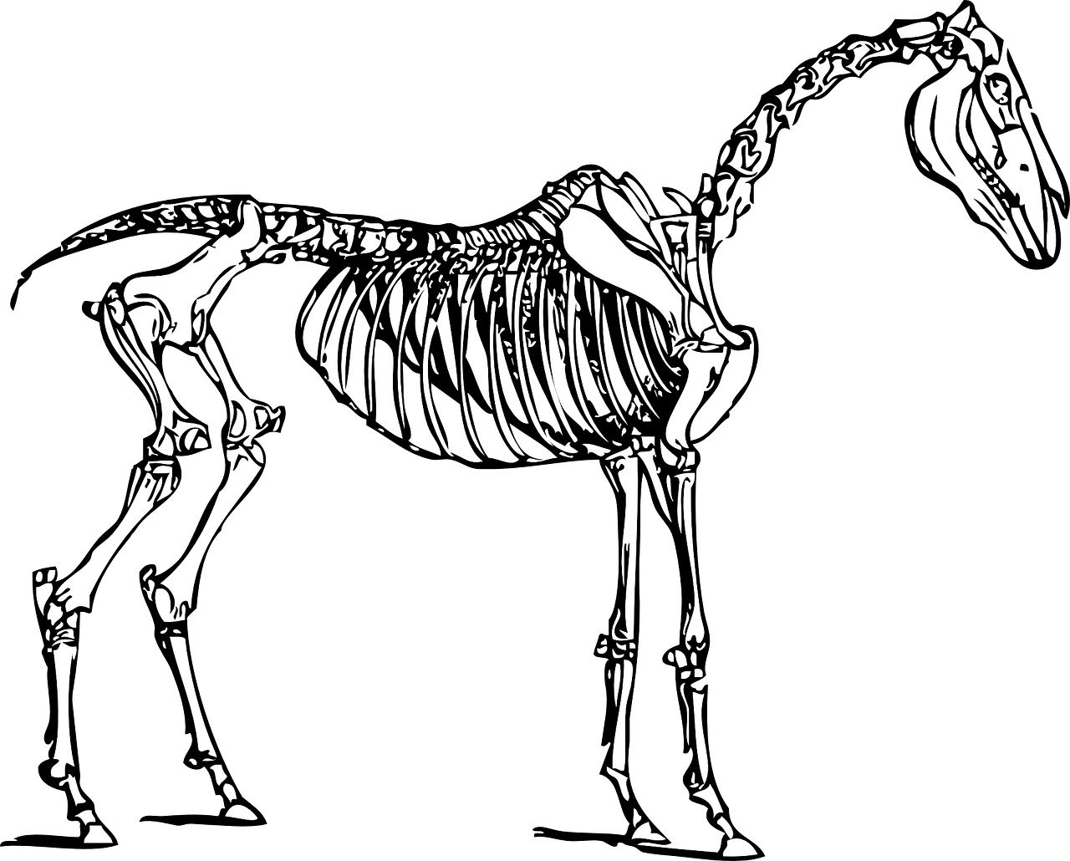
Look at the two skeletons below. Add the following labels to each:
Skull
Spine
Ribcage
Foot bones
Notes:
You are now going to pause the video to answer these questions:
What is astronomy?
Which is based on scientific evidence, astronomy or astrology?
Resume the video once you are finished,
To mark your work, astronomy is the study of all the object sin the universe outside of the Earth.
Astronomy is based on scientific evidence, astrology is not.

Slide 10
Now, with the help of those keywords, write at least one similarity and difference between humans and horses.
Skull
Spine
Ribcage
Foot bones
Notes:
You are now going to pause the video to answer these questions:
What is astronomy?
Which is based on scientific evidence, astronomy or astrology?
Resume the video once you are finished,
To mark your work, astronomy is the study of all the object sin the universe outside of the Earth.
Astronomy is based on scientific evidence, astrology is not.

Slide 11
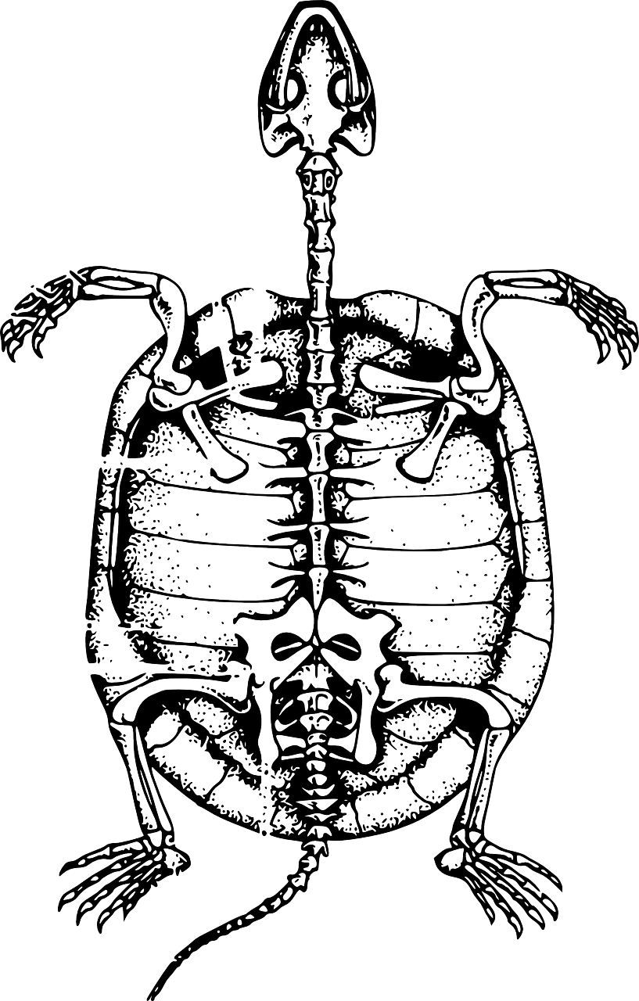
Look at the two skeletons below. Add the following labels:
Skull
Spine
Ribcage
Foot bones
Notes:
You are now going to pause the video to answer these questions:
What is astronomy?
Which is based on scientific evidence, astronomy or astrology?
Resume the video once you are finished,
To mark your work, astronomy is the study of all the object sin the universe outside of the Earth.
Astronomy is based on scientific evidence, astrology is not.

Slide 12
Now, with the help of those keywords, write at least one similarity and difference between birds and turtles.
Skull
Spine
Ribcage
Foot bones
Notes:
You are now going to pause the video to answer these questions:
What is astronomy?
Which is based on scientific evidence, astronomy or astrology?
Resume the video once you are finished,
To mark your work, astronomy is the study of all the object sin the universe outside of the Earth.
Astronomy is based on scientific evidence, astrology is not.

