Slide 1
Repeated percentage increase
Maths
Mr Clasper

Slide 2
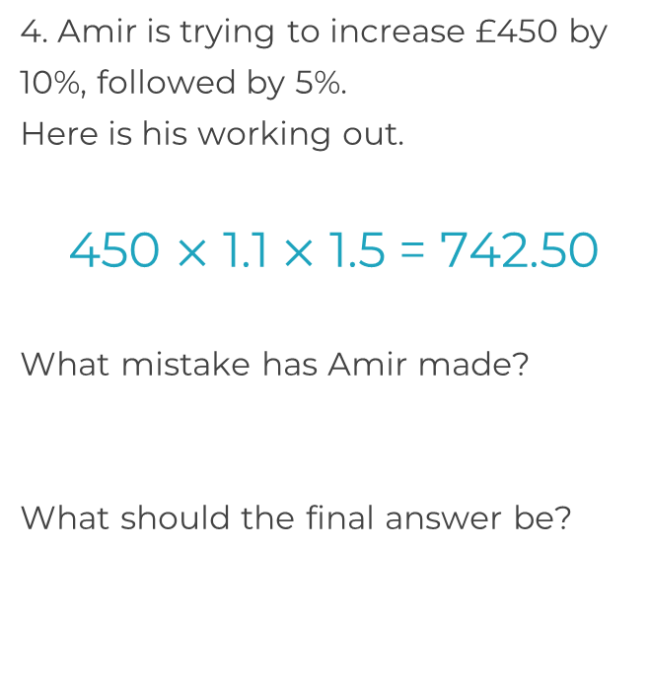
Repeated percentage increase
1. Write a single calculation which would increase 300 by 10%, then 20%
2. Increase 200 kg by 5%, then 2%
3. Which calculations will NOT increase 500 by 10%, followed by another 10%?

Slide 3
Repeated percentage increase
5. A town has a population of 40 000. The population increases by 15% each year.
What will the population be in 3 years?
6. Mark invests £7000 in a savings account which offers 6.2% interest per annum. How much will he have after 4 years? Give your answer to the nearest pound.
7. Alice wants to invest some money for 5 years. She compares the annual interest rates of two bank accounts.
Which bank account would gain the most interest over 5 years?
Standard account
2.3% for two years
1.6% every year after
Advance account
3.1% for one year
1.2% every year after

Slide 4
Answers

Slide 5
Repeated percentage increase
1. Write a single calculation which would increase 300 by 10%, then 20%
2. Increase 200 kg by 5%, then 2%
3. Which calculations will NOT increase 500 by 10%, followed by another 10%?
£519.75

Slide 6
Repeated percentage increase
5. A town has a population of 40 000. The population increases by 15% each year.
What will the population be in 3 years?
6. Mark invests £7000 in a savings account which offers 6.2% interest per annum. How much will he have after 4 years? Give your answer to the nearest pound.
7. Alice wants to invest some money for 5 years. She compares the annual interest rates of two bank accounts.
Which bank account would gain the most interest over 5 years?
Standard account
2.3% for two years
1.6% every year after
Advance account
3.1% for one year
1.2% every year after
Standard has most interest
£8 904

