Slide 1
Atomic structure review lesson
Combined Science - Chemistry - Key Stage 4
Atomic Structure & the Periodic Table
Dr Patel

Slide 2
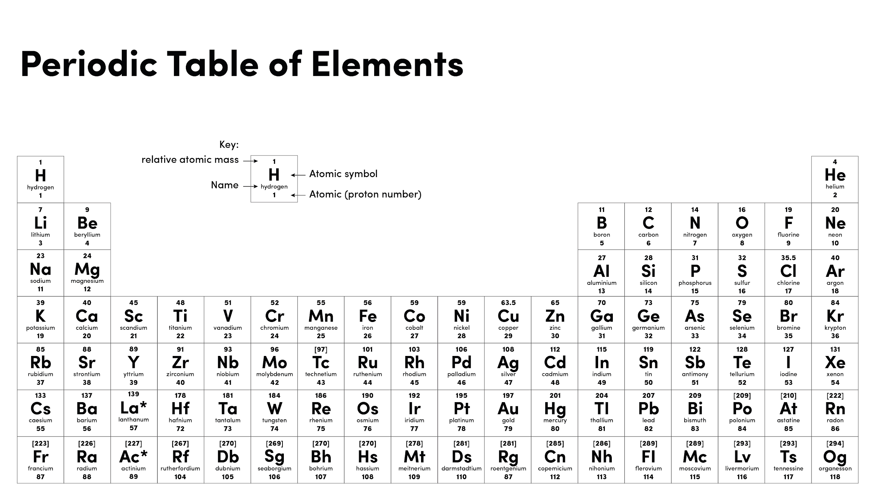

Slide 3
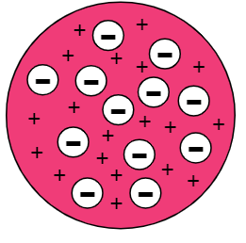
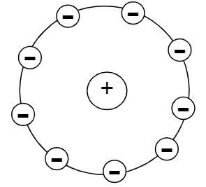
Atoms and Subatomic particle key facts
Elements are made of one type of atom
Protons: +1, mass 1, nucleus
Neutrons: 0, mass 1, nucleus
Electrons: -1, mass 1/2000, shells
Atomic mass = number of protons and neutrons
Atomic number = number of protons (same as electrons)
Isotope - same number of protons and a different number of neutrons
Relative atomic mass = (% of isotope 1 x mass₁) + (% of isotope 2 x mass₂)
100 100

Slide 4
Molecules and ions
Diatomic molecule = two atoms joined together
First electron shell = 2 electrons
Second and third electron shells = 8 electrons
Metals lose electrons from their outer shell
Non-metals gain electrons to their outer shell
Metals form positive ions
Non-metals form negative ions
Ion - an atom that has lost or gained outer shell electrons

Slide 5
Periodic table key facts
Metals on the left, non-metals on the right of the staircase
Groups = columns, elements have similar properties
Group = number represents the number of electrons on the outer shell
Periods = rows (represent number of electron shells)
Group 1 - reactivity increases as you go down the group
Group 7 - reactivity decreases as you go down the group
Noble gases - unreactive, full outer shell
Group 7 melting and boiling points - increase
Group 1 - low density

Slide 6
Independent task
Do:
Start with the key facts you don’t know!
Use images
Use colour
Use keywords
Keep it concise
Be precise
Make them neat
Use them!
Don’t
Use full sentences
Rush
Create at least 5 flashcards using the key facts shown at the start of today’s lesson. You must choose 5 facts you’d forgotten or find it difficult to remember.

Slide 7
Independent practice
1. Sulphur has 2 naturally occurring isotopes:
94.99% of mass number 32. 5.01% of mass number 34.
Calculate the relative atomic mass of Sulphur. Give your answer to 1 decimal place.
2. Copper has two naturally occurring isotopes.
69% of all Copper has a mass number of 63. 31% of all Copper has a mass number of 65
Calculate RAM to 3 significant figures.

Slide 8
Independent practice
3. Magnesium has three naturally occurring isotopes.
79% of all Magnesium is Mg²⁴
11% of all Magnesium is Mg²⁵
10% of all Magnesium is Mg²⁶
Calculate the RAM of Mg. Give your answer to 3 significant figures
4. Silicon has 3 naturally occurring isotopes. Calculate the RAM to 3 decimal places.
92% of Silicon is Si ²⁸
5.5% of all Silicon is Si²⁹
2.5% of the sample is Si³⁰

