Slide 1
Talking about school rules (Part 1/3)
Using devoir
Downloadable Resource
French
Madame Williams

Slide 2
[SFC]
petit
grand
mot

Slide 3
[ oi ]
trois
droite
Pourquoi ?
[why?]

Slide 4
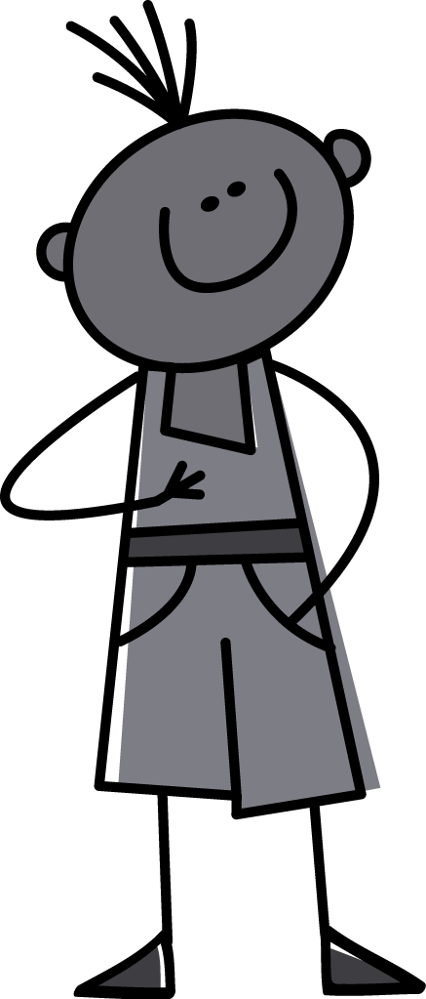
[ oi ]
[ SFC ]
je
dois

Slide 5
[ oi ]
[ SFC ]
On
doit

Slide 6
être à l’heure | to be on time
faire les devoirs | to do homework
porter l’uniforme scolaire | to wear school uniform
mâcher du chewing-gum | to chew gum
utiliser les portables | to use mobile phones
porter des bijoux | to wear jewellery
se maquiller | to wear makeup
avoir des piercings | to have body piercings
apprendre | to learn
enseigner | to teach
The infinitive can also be translated by the gerund.
Faire les devoirs - to do homework AND doing homework.

Slide 7
Devoir
- to have to / must (irregular verb)
On doit
= You must, you have to
To refer to people in general

Slide 8
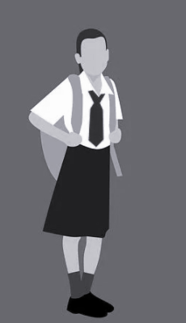
Devoir
- have to / must (irregular verb)
Use devoir with an infinitive to say what someone must do:
On doit porter l’uniforme scolaire
On doit porter des bijoux
ne
pas
You (general) must wear school uniform
You (general) must not wear jewellery

Slide 9
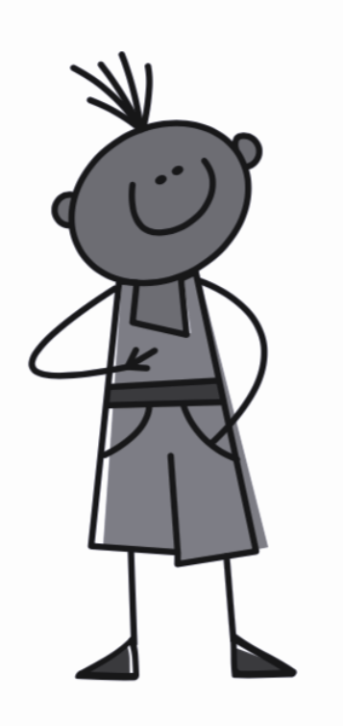
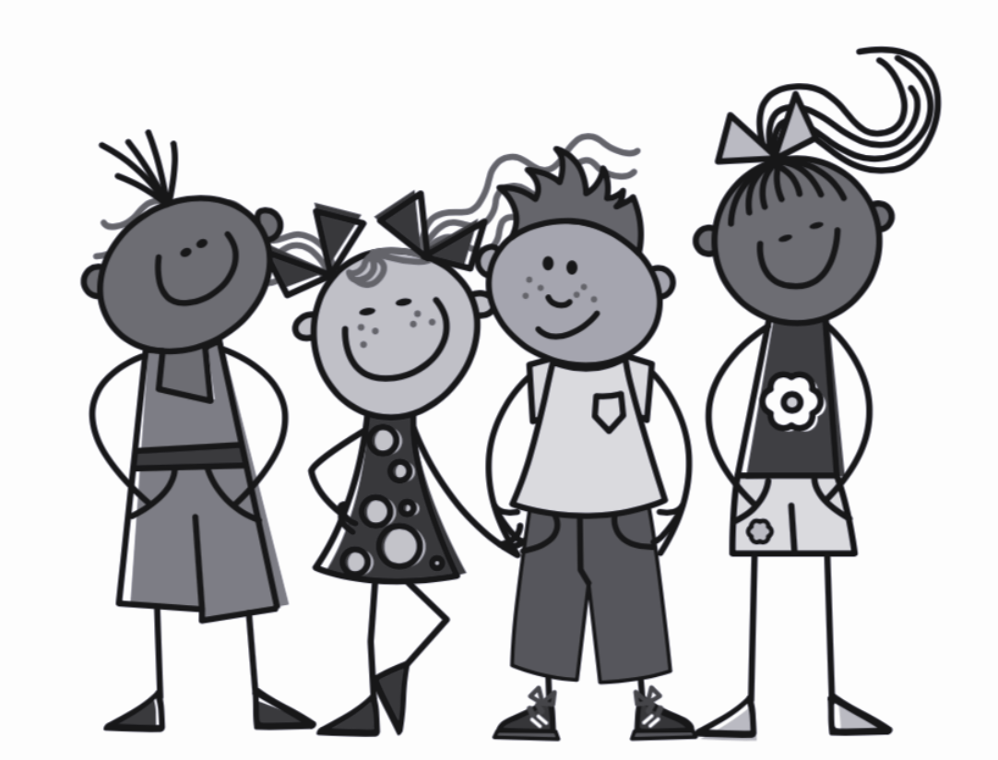
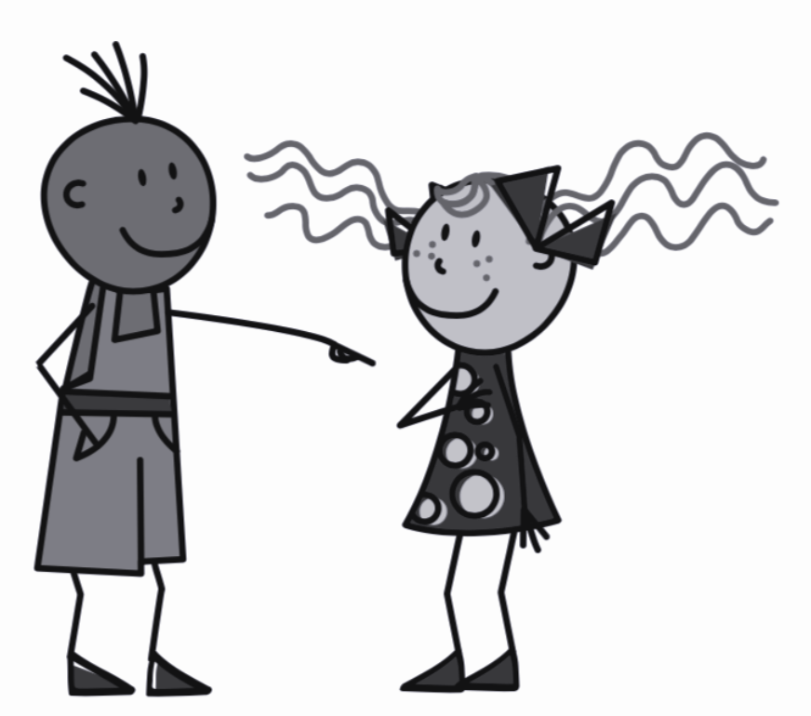
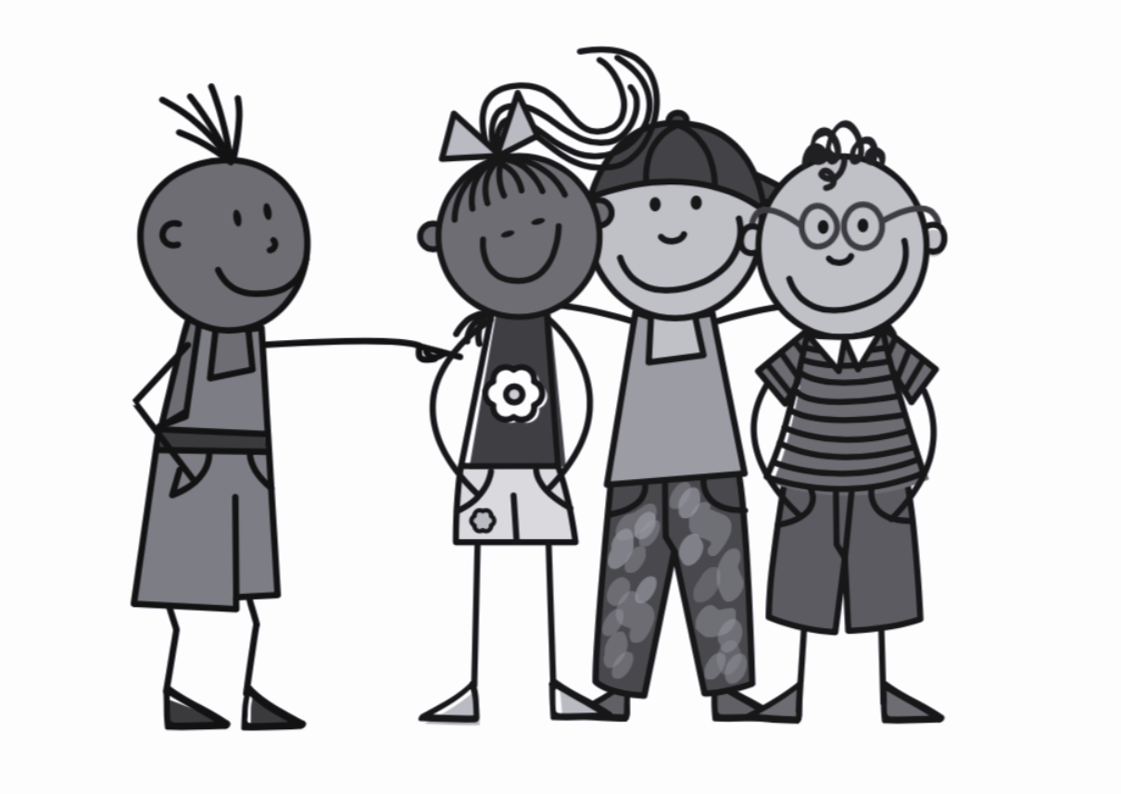
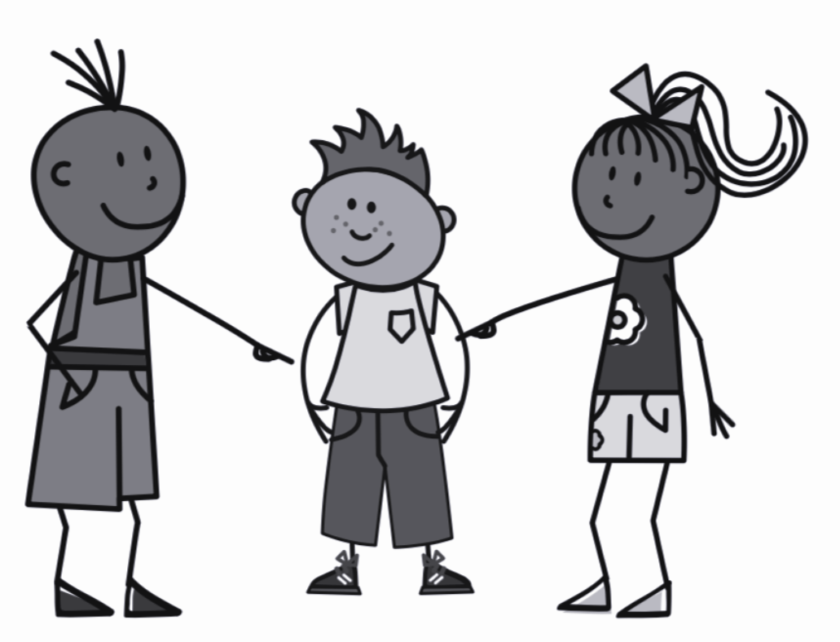
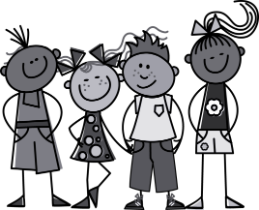
Devoir in the present tense
Je dois - I must
Nous devons - We must
Tu dois - You must
Vous devez - You (pl) must
Il/Elle doit - He/she must
Ils/Elles doivent - They must
On doit - You (general) must
Use the conjugated form of devoir with an infinitive to say what someone must do

Slide 10
Devoir
- have to / must (irregular verb)
Je dois porter l’uniforme scolaire
Nous devons porter des
ne
pas
bijoux
I must wear school uniform
We must not wear jewellery

Slide 11
Everyone must vs Students must
everyone
=
tout le monde
students
=
les étudiants
Everyone must
=
tout le monde doit
Students must
=
Les étudiants doivent

Slide 12
School rules - using devoir
You (general) must =
2. Everyone must =
3.. Students must =
4. The modal verb devoir is followed by the
5. Students must do their homework =
On doit
Tout le monde doit
Les étudiants doivent
infinitive
Les étudiants doivent faire les devoirs

