Slide 1
Listening and Understanding Cultural Dance
Communication and Language: Celebrations – Applying Learning
Leanne

Slide 2
Lesson Structure
Welcome!
Get your resources
Model
Activity

Slide 3
Cultural dance
Family celebrations may include specific dances.
Today we will learn the dance moves for Jai Ho, which is a Bollywood song.
Follow the step by step instructions, then ask a parent or carer to use a music service to dance along with the song.
Images from Pixabay.com

Slide 4
Let’s get ready.
Find a quiet space to work away from distractions
Make the area as large as possible so there is room to move.
Ask other family members to dance with you.

Slide 5
Move 1 - Bring hands together in front of your body.
hands

Slide 6
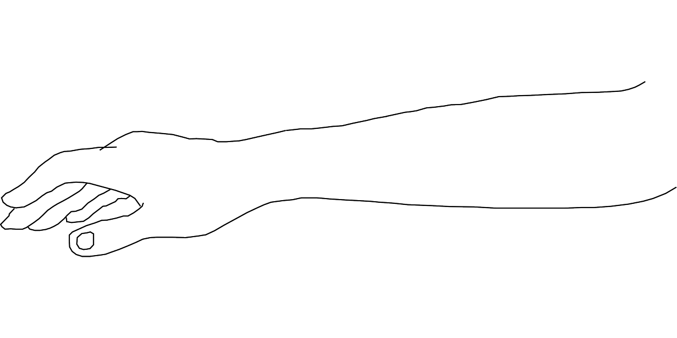
Move 2 - Bring hands/arms from the centre all the way to the ceiling and back down again
circle arms

Slide 7
Move 3 - Spin around and come back to centre.
spin

Slide 8
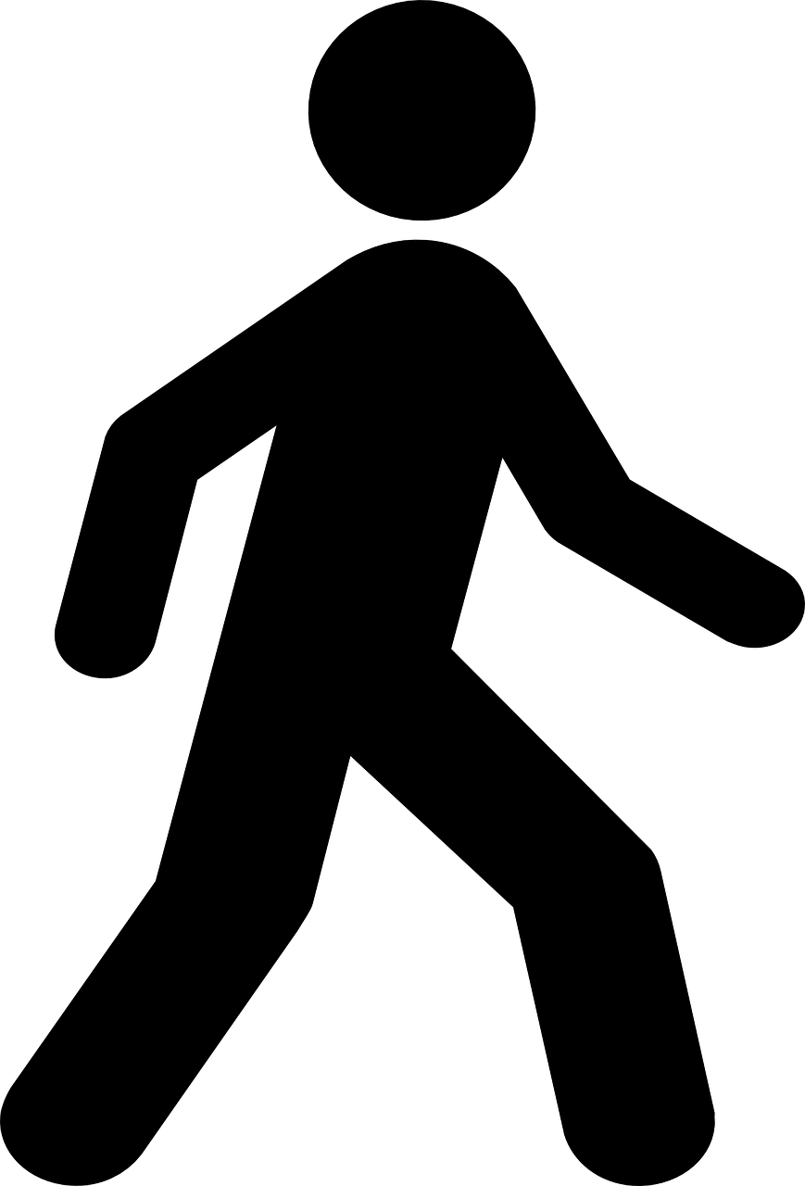
Move 4 - Lift hands up above head and back down again. Repeat movement and step from side to side.
arms
up and down
step
side to side

Slide 9
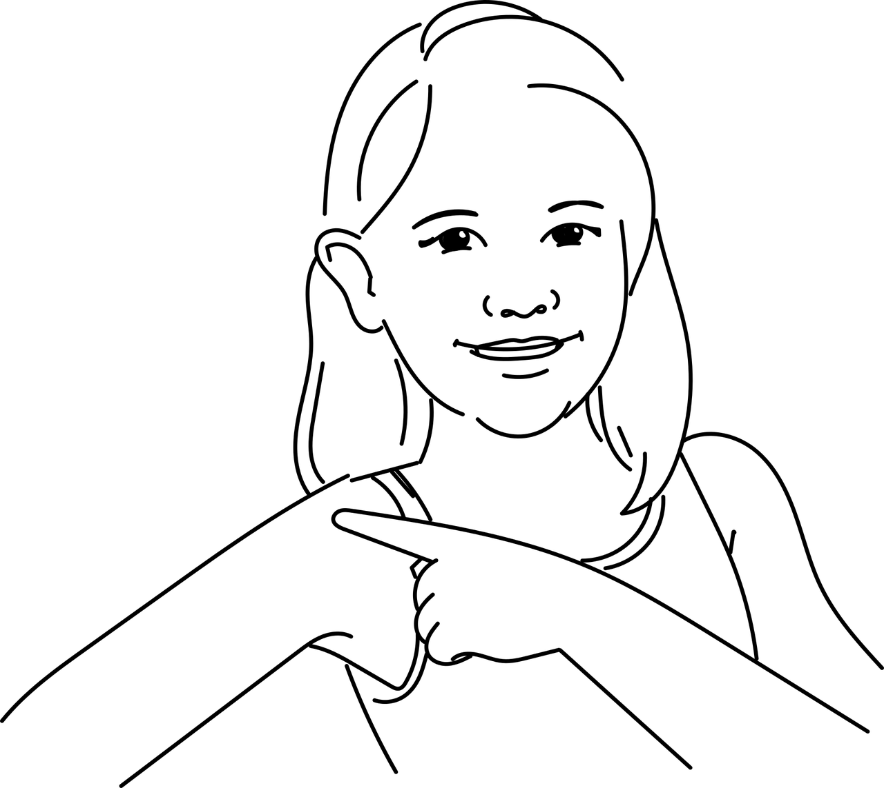
Move 5 - Lift shoulders up and down and then wave arms from side to side.
shoulders
up and down
wave arms
side to side

Slide 10
Move 6 - Bring arms to the front and back and wave arms to the sky.
arms
forward
wave arms
up to the sk

Slide 11
Now it’s time to complete the activity
Cultural Dance
Practise the 6 moves.
Find the song.
Dance to the song.
Images from Pixabay.com

Slide 12
Make it easier
Make it harder
More ideas
Use the first 3 moves and repeat these in a sequence.
Adult leads and the learner copies.
Once the sequence is learnt, repeat it 3 times to the music.
Adult to verbalise the movement and the learner shows the movement.
Use the symbols and rearrange them to make a different dance routine.
Create 6 different movements and draw them onto paper. Make a sequence and learn the dance.

