Slide 1
Fractions
Lesson 4: Compare fractions less than one.
Independent Task
Mathematics
Miss Parsons
Notes:
English
Year 3
Instructions Unit:
Reading Comprehension - Fact Retrieval

Slide 2
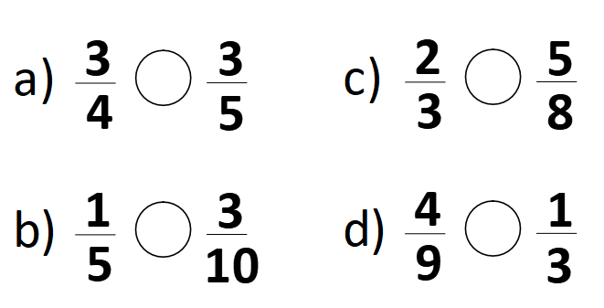
Question 1
Use the symbols < > or = to compare these fractions.

Slide 3
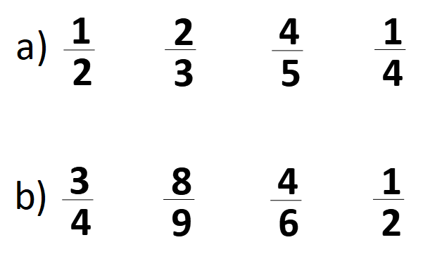
Question 2
Order these fractions from largest to smallest.

Slide 4
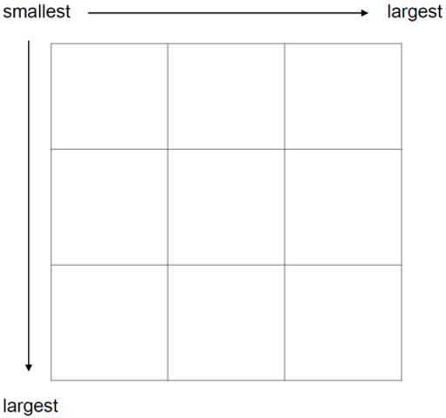
Question 3
Can you put all of the fractions into the grid so that every row and column is in ascending order?

