Slide 1
To develop understanding of halves and quarters of quantities
Maths
Miss Sidhu
Notes:
Hello everyone! In this lesson you will identify the parts and whole in the context of halves and quarters of quantities using objects and pictures.

Slide 2
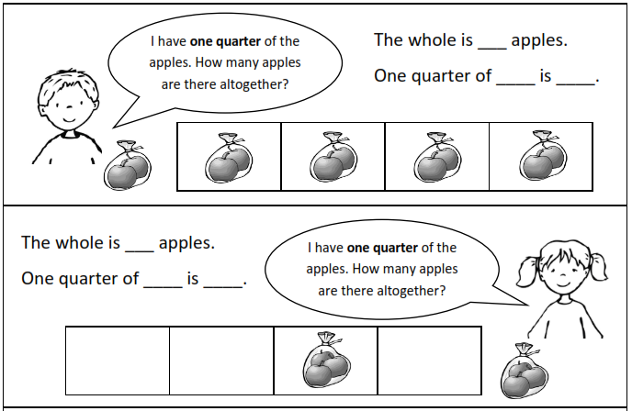
Independent Task

Slide 3
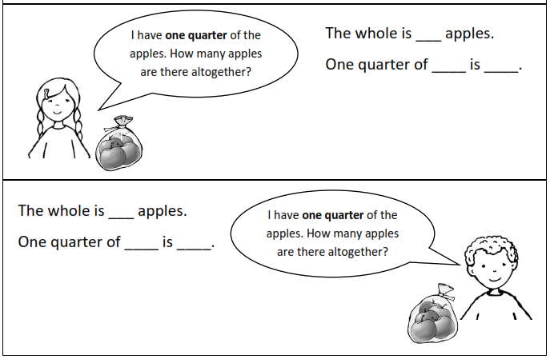
Challenge

Slide 4
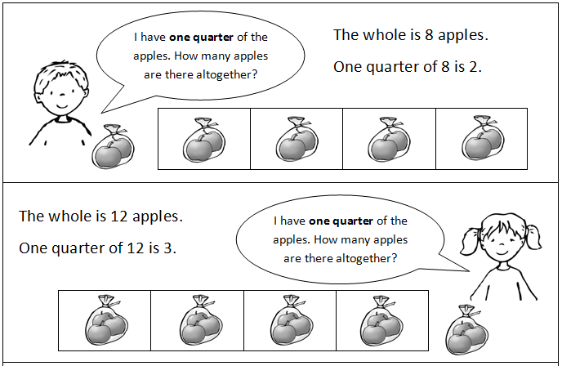
Answers

Slide 5
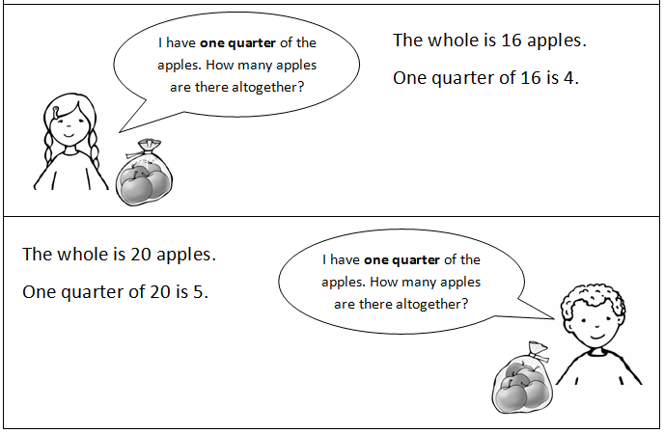
Challenge answers

