Slide 1
Circle Theorems: The perpendicular from the centre to a chord bisects the chord
Maths
Mr Chan

Slide 2
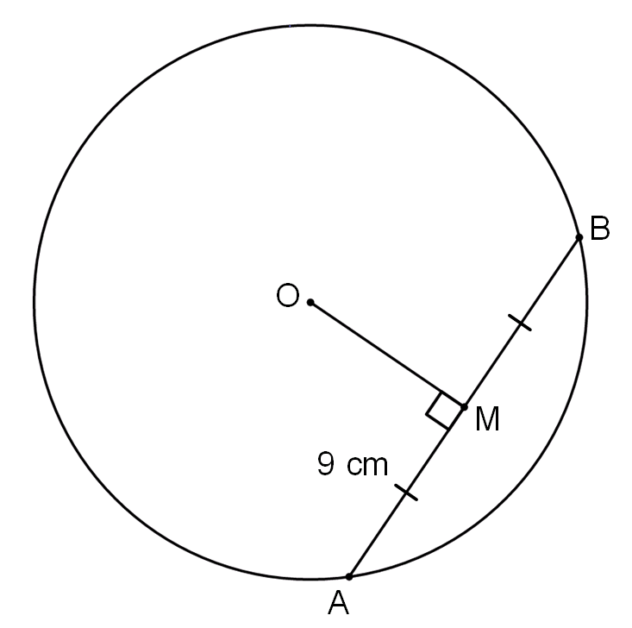
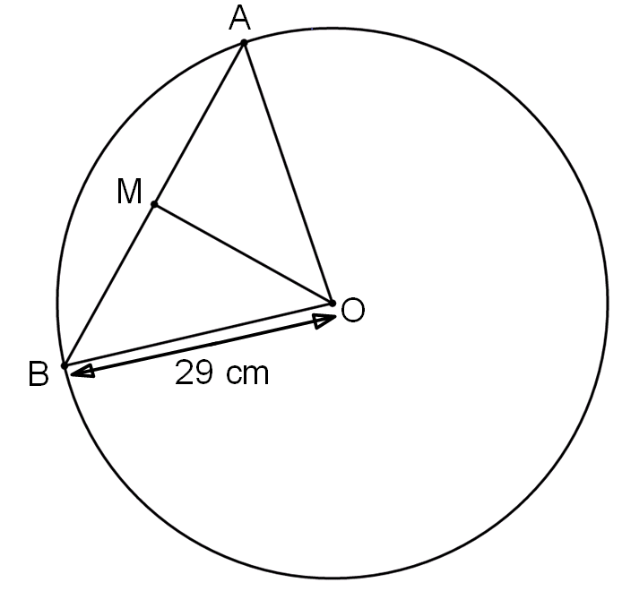
The perpendicular from the centre to a chord bisects the chord
1. OM is perpendicular to the chord AB.
Work out the length of BM.
Give a reason for your answer.
2. OM is perpendicular to the chord AB. AB = 42 cm.
Work out the side length OM.

Slide 3
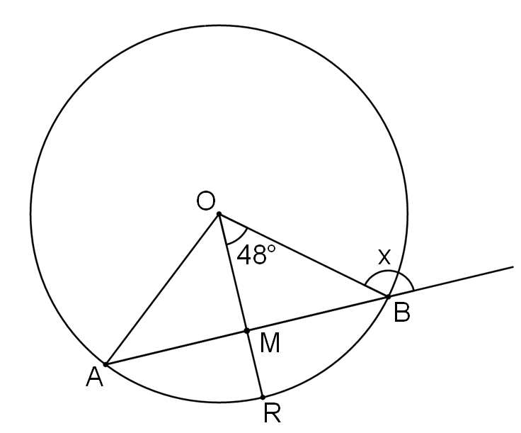
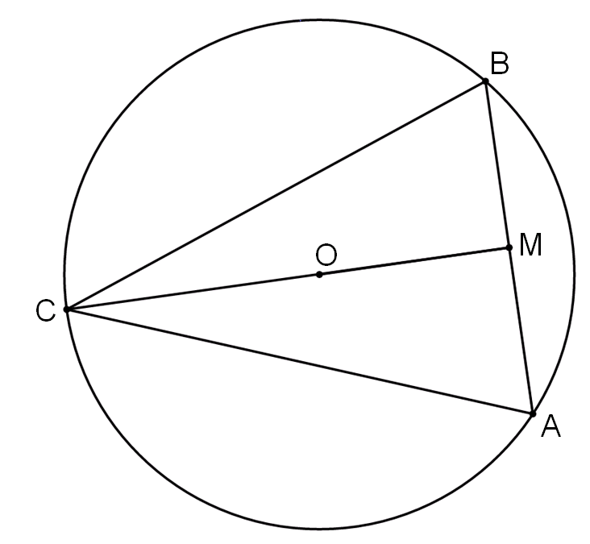
The perpendicular from the centre to a chord bisects the chord
3. The circle has centre O and OR is a radius to the circle. AB is a chord in the circle where AM=MB.
Work out the value of angle x.
4. OM is perpendicular to the chord AB. The circle has a radius of 9 cm.
CO:OM=3:2. Chord AB = 9 cm.
Work out side length AC. Give your answer to 1 decimal place.

Slide 4
Answers

Slide 5
The perpendicular from the centre to a chord bisects the chord
1. OM is perpendicular to the chord AB.
Work out the length of BM.
Give a reason for your answer.
2. OM is perpendicular to the chord AB. AB = 42 cm.
Work out the side length OM.
BM = 9 cm
OM = 20 cm
The perpendicular from the centre
bisects the chord

Slide 6
The perpendicular from the centre to a chord bisects the chord
3. The circle has centre O and OR is a radius to the circle. AB is a chord in the circle where AM=MB.
Work out the value of angle x.
4. OM is perpendicular to the chord AB. The circle has a radius of 9 cm.
CO:OM=3:2. Chord AB = 9 cm.
Work out side length AC. Give your answer to 1 decimal place.
x = 138º
AC = 15.7 cm

