Slide 1
Reactions of alkenes
GCSE Chemistry - Chemistry - Key Stage 4
Organic chemistry
Dr Patel

Slide 2
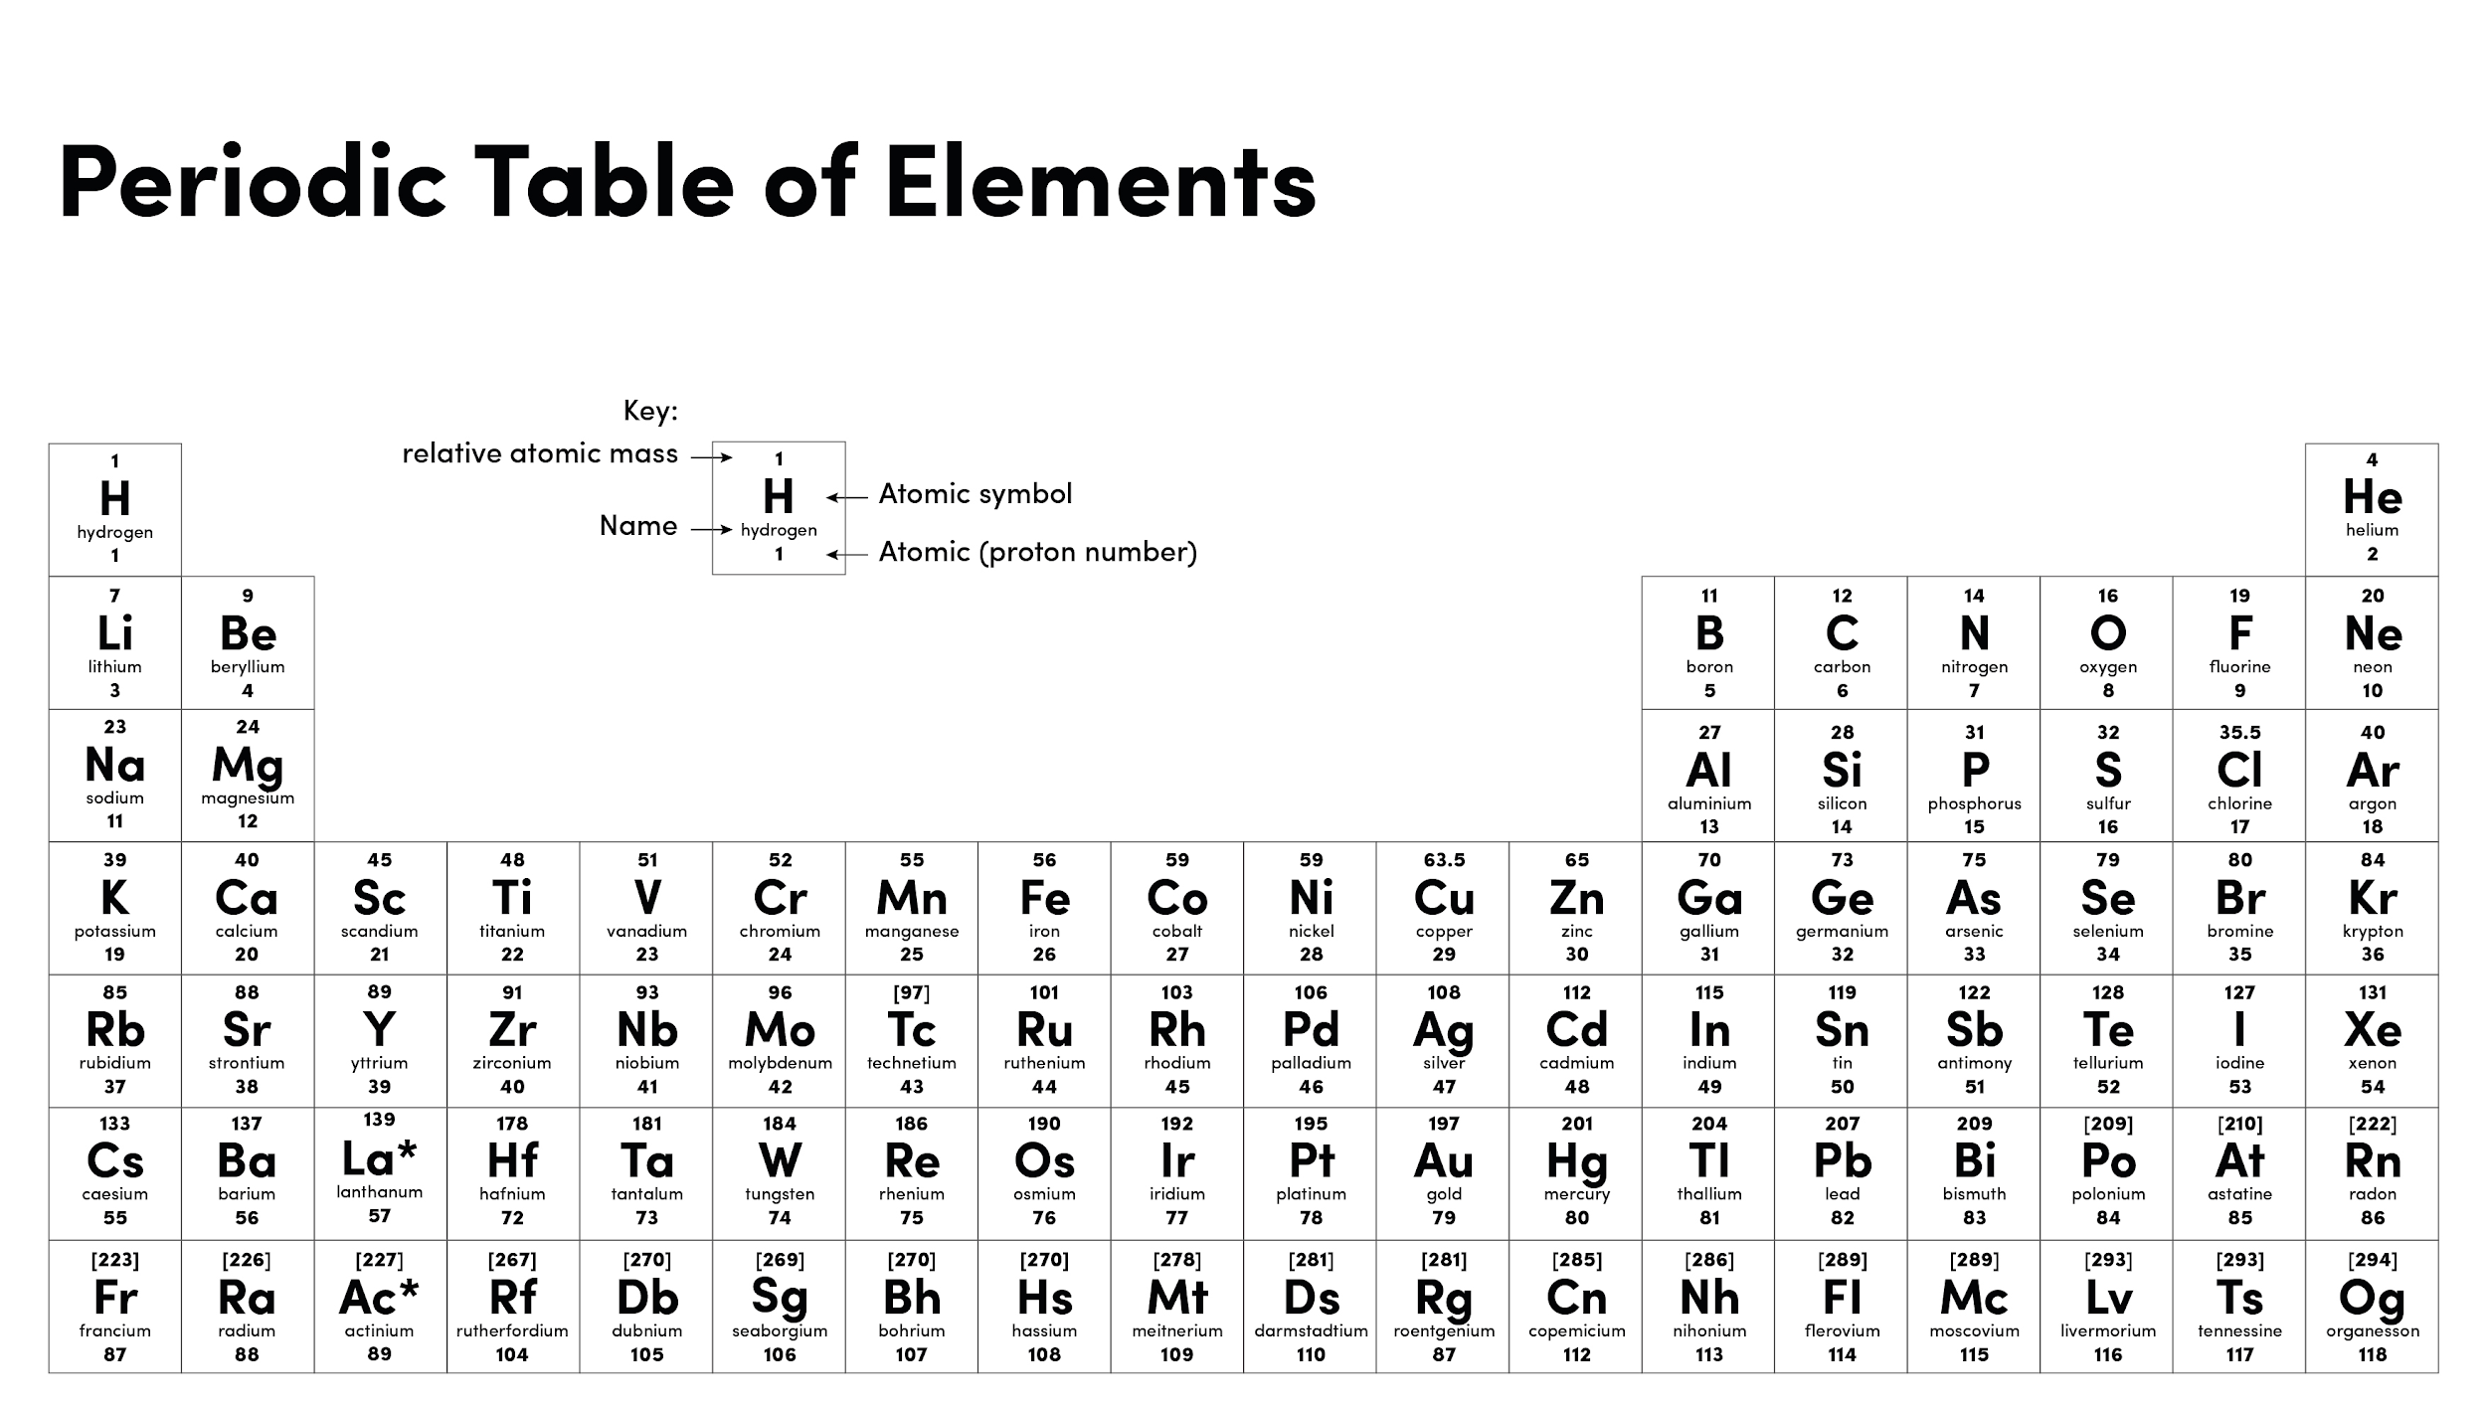
Source of image: Oak

Slide 3
Introducing alkenes
Alkene name | Molecular formula
Ethene | C₂H₄
Propene | C₃H₆
Butene | C₄H₈
Pentene | C₅H₁₀
Hexene | C₆H₁₂
Notes:
Ask pupils to pause the video and reflect on the table
They need to think about the answers on the table, but don’t need to write anything down.
Then I discuss the answers
Also remind pupils that these are unsaturated because there is a double bond
Remind pupils about the word homologous
Monkey eat peanut butter

Slide 4
Independent practice
What is the functional group found in alkenes?
What is a homologous series?
Name the first 4 alkenes.
What is the general formula for an alkene?
What do the names of all alkenes end in?
Challenge:
An alkene has 10 carbons. State it’s molecular formula and name it.

Slide 5
Drawing alkenes
Rules
Write out the number of carbons you need.
Add one double bond (between 2 Cs).
Then complete the other bonds, making sure all Cs have 4 bonds coming off them
Add all Hs.
H
H
H
H
C
C
C
C
H
Notes:
We do this one together

Slide 6
Independent practice
Draw the following alkenes onto your white boards:
Pentene C₅H₈
Hexene C₆H₁₂

Slide 7
Independent practice
Copy and complete the reaction below to show the addition of hydrogen to ethene:
H
H
+
H
C
C
H
H
H
Challenge: Name the product

Slide 8
Independent practice
Copy and complete the reaction below to show the addition of chlorine to ethene:
H
H
+
H
C
C
H
Cl
Cl
Challenge: Name the product

Slide 9
Independent practice
Copy and complete the reaction below to show the addition of water to ethene:
H
H
O
+
H
C
C
H
H
H
Challenge: Name the product

Slide 10
Independent practice
Balance the equation in reactions 1, 2 and 3, including the names of the reactants and products.
1. CH₄ + O₂ → CO₂ + H₂O
2. C₂H₆ + O₂ → CO₂ + H₂O
3. C₂H₄ + O₂ → C + CO + H₂O
4. What is the difference between reaction 2 and 3?
5. What difference would you see between reactions 2 and 3?

