Slide 1
Inherited Disorders - Part 2
Combined Science - Biology - Key Stage 4
Mrs Gibbs

Slide 2
Practice exam question
Ali and Mary do not have cystic fibrosis, but their baby does. What does this tell us about Ali and Mary's genes for this disorder? (1)
OCR- January 2013 -A161/01 Modules B1 B2 B3 - Foundation - Medium - AO1
Notes:
Please pause the lesson to complete the practice exam question. Go through answer using animations, explain what Ali’s and Mary’s genotypes must have been, introduce the word ‘carrier’ again

Slide 3
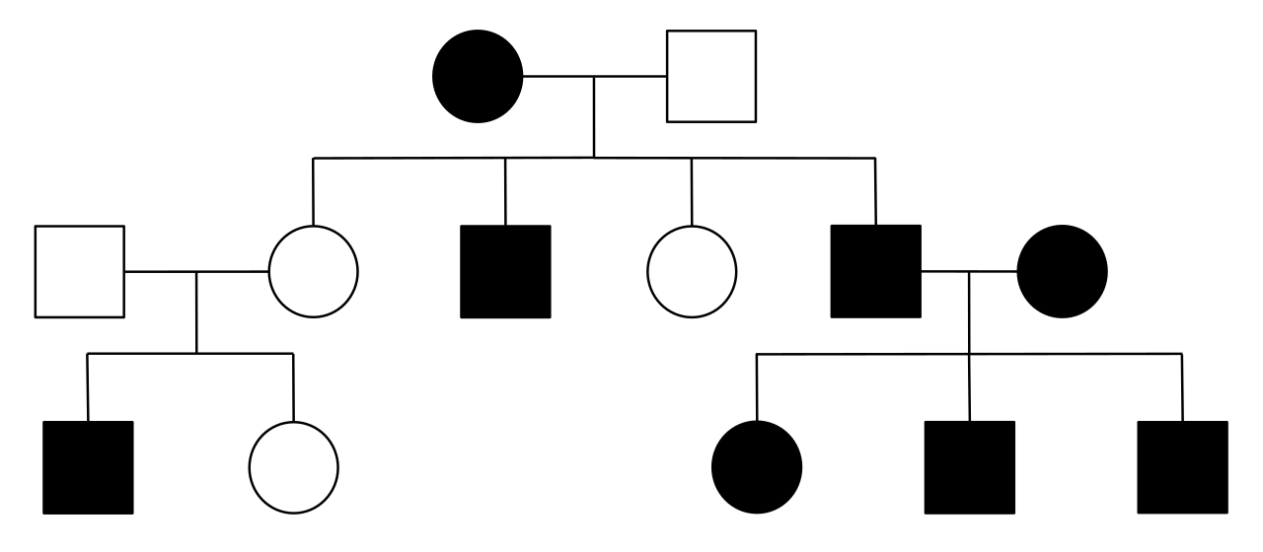
Independent task
Sickle cell anaemia (a) is a recessive condition. Explain how we can tell this from the family tree.
A
B
KEY
Affected male
Unaffected male
Affected female
Unaffected female
C
D
E
Image adapted from: Wikimedia - Madibc68 - Example of a Classic X-Linked Recessive Pedigree
Notes:
Tell them there are 2 options B, C, D. May need to support this one, should have realised from cf example earlier

Slide 4
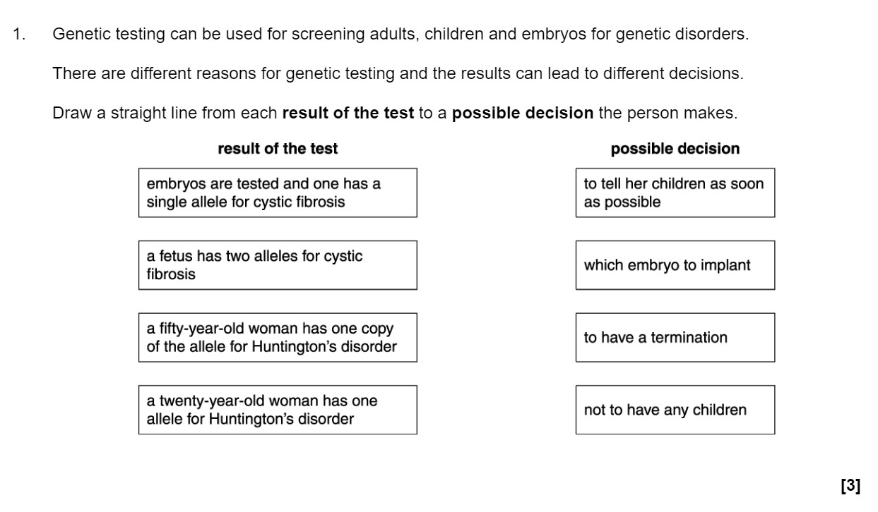
Exam question
OCR- June 2013 -A161/01 Modules B1 B2 B3 - Foundation - Low - AO1
Notes:
Please pause the lesson and resume once you are finished. To go through the answer, draw lines to match up with surface pro

Slide 5
Exam-style question
Huntington’s disease is a rare condition which can decrease life expectancy. A couple with a family history of Huntington’s disease are considering embryo screening before having a baby.
Describe the economical, social and ethical considerations the couple may discuss before choosing to screen for Huntington’s disease.
An economical issue is…
A social issue is
An ethical issue is…

