Slide 1
Angles and Shape:
To draw perpendicular lines
Independent Activity
Maths
Miss Brinkworth

Slide 2
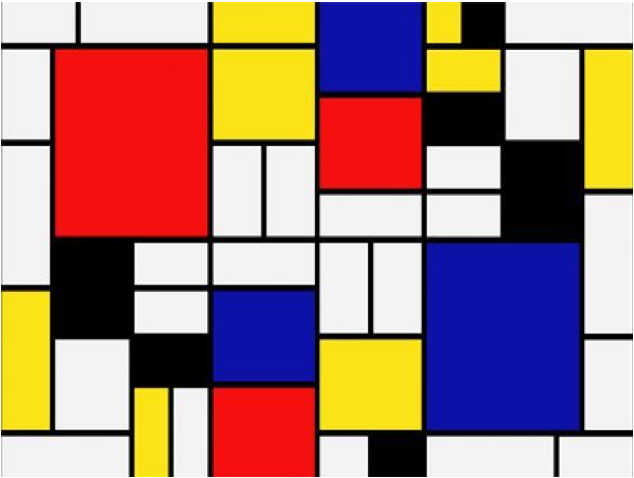
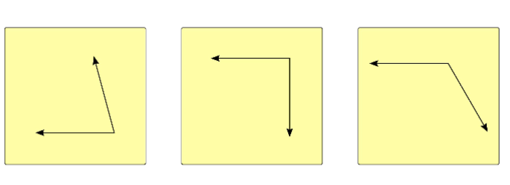
Part A
Can you spot horizontal and vertical lines in this artwork?
Find pairs of perpendicular lines

Slide 3
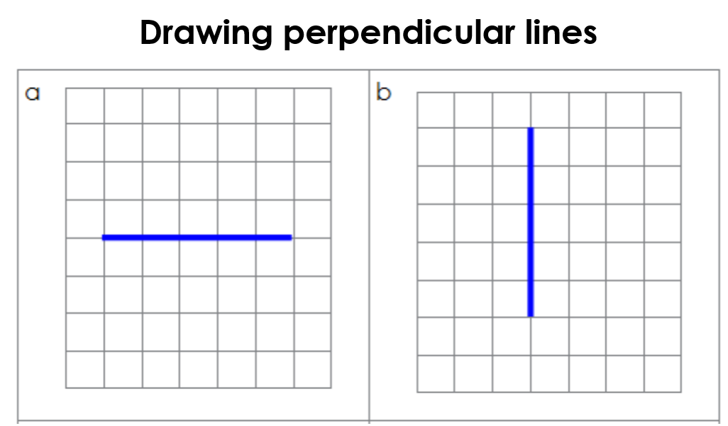
Part B
Draw lines which are perpendicular to a and b
2. True or false?
If 2 straight lines meet at a right angle they are always perpendicular

Slide 4
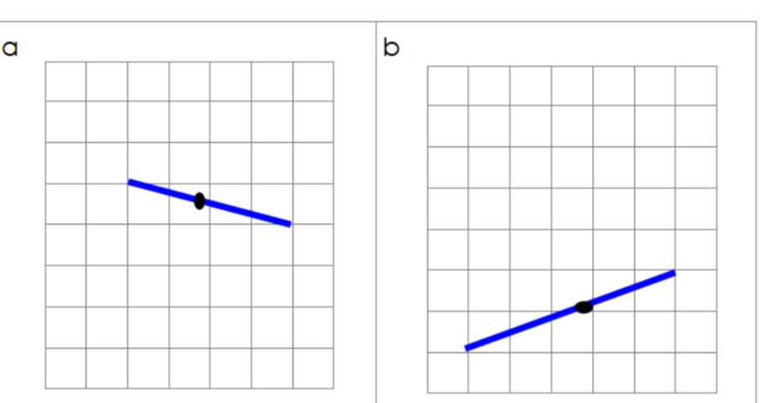
Part C - Challenge.
Use your right-angle checker to draw a line from the black dots which are perpendicular to the blue lines

