Slide 1
Grouping and sharing
Exploring sharing objects into equal groups
Mathematics
Independent Task
Mrs Khaira

Slide 2
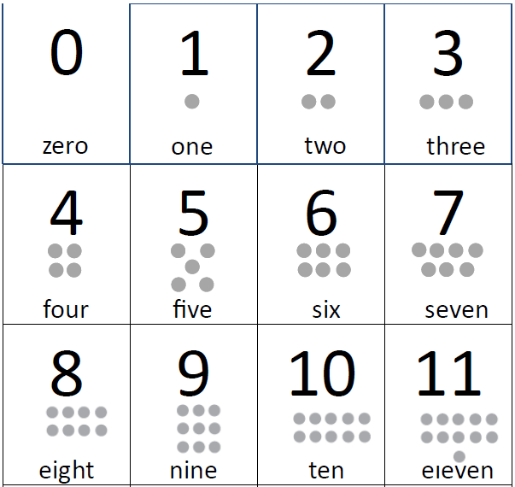
Activity 1

Slide 3
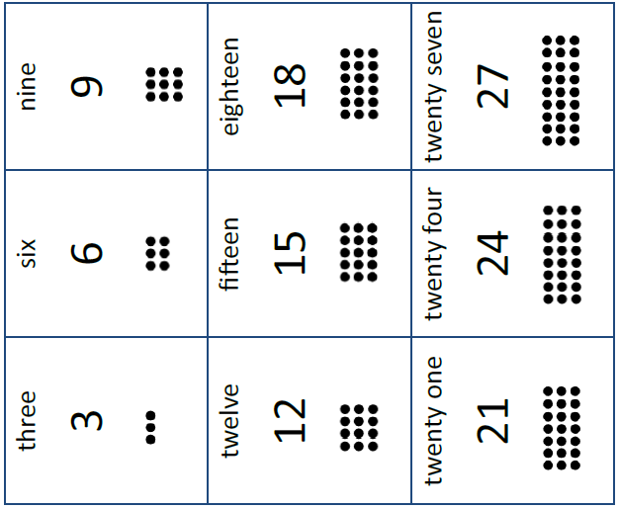
Activity 2

