Slide 1
Making a rain catcher
Communication and Language: Seasons – Applying Learning
Alison

Slide 2
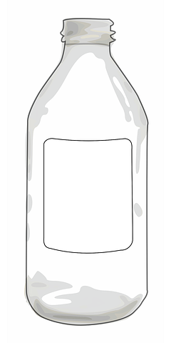
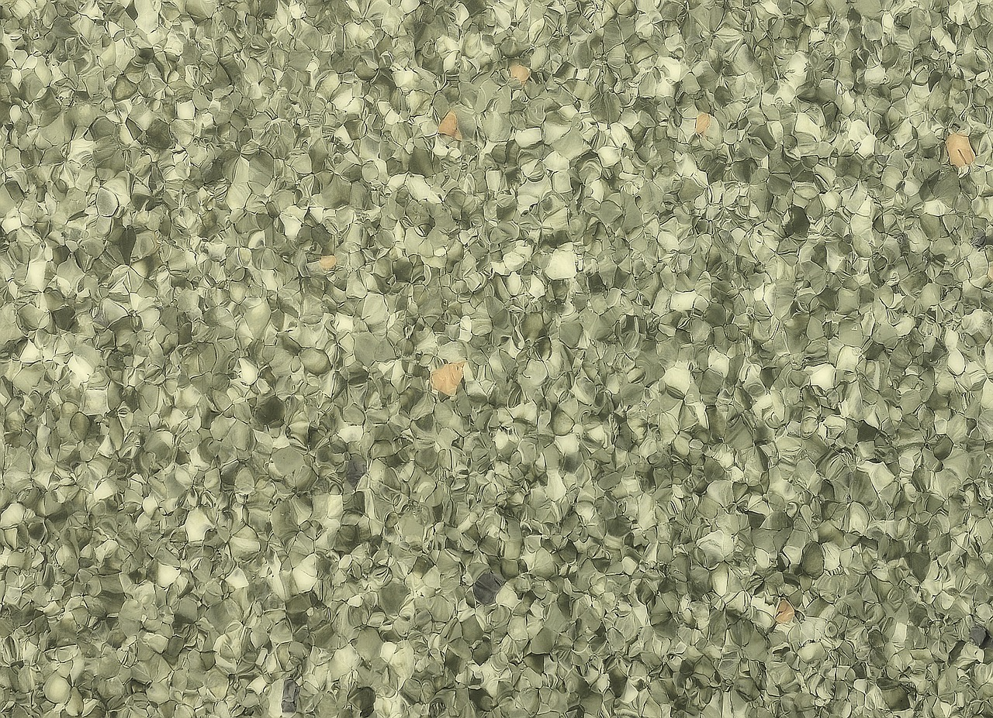
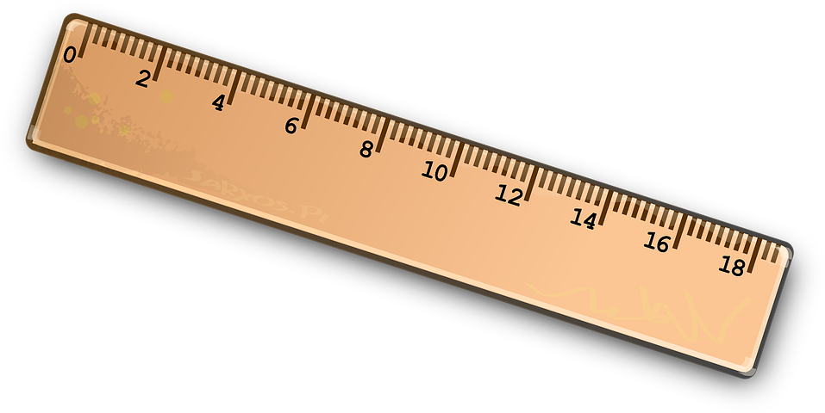
For this lesson, you will need:
An empty plastic bottle
Scissors
Gravel
Water
Ruler
Rain
Bottle
Scissors
Pen
Ruler
Gravel
Rain
Credit: Pixabay

Slide 3
Following instructions
In this lesson we are going to make a simple rain catcher for the garden. We will be following simple step by step instructions.
Adult support will be required.
Images from Pixabay.com

Slide 4
Step 1
Cut the top of the bottle off
Note: adult support is required when using scissors
Cut
Bottle
Credit: Pixabay

Slide 5
Step 2
Make marks at 1 cm intervals along the side of the bottle
1
Measure
One
Lines
Credit: Pixabay

Slide 6
Step 3
Label the marks at the side 0 - 10
0
10
Write
Zero
To
Ten
Credit: Pixabay

Slide 7
Step 4
Fill the bottom of the bottle with gravel up to one of the marks drawn on the side
Fill
Bottle
Gravel
Top
In
Bottle
Credit: Pixabay

Slide 8
Step 5
Fill the bottom of the bottle with water (only cover the gravel)
Fill
Bottle
Water
Credit: Pixabay

Slide 9
Step 6
Place the cut off top inside the base of the bottle
Top
In
Bottle
Credit: Pixabay

Slide 10
Step 7
Place the rain catcher outside and wait for it to rain.
Outside
Wait
Rain
Credit: Pixabay

Slide 11
Step 8
Keep a record of how much rain you collect.
Every day have a look at the water level to see if it changes when it rains.
You can make a simple diary to help record the weather.
1 cm
2 cm
Sun
2 cm
Sun
Credit: Pixabay

Slide 12
Make it easier
Make it harder
More ideas
When finding the right equipment, give a choice of two items
When recording the weather, have pre-drawn pictures or symbols to stick onto your chart
Reduce the amount of adult support provided
Write down your own set of instructions to follow
Use words without symbols
Follow instructions to make a:
windmill for the garden
a suncatcher
Credit: Pixabay

