Slide 1
Lesson 2: Identifying Devices
Creating Media - Video Editing
Computing
Jane Adamson
Materials from the Teach Computing Curriculum created by the National Centre for Computing Education

Slide 2
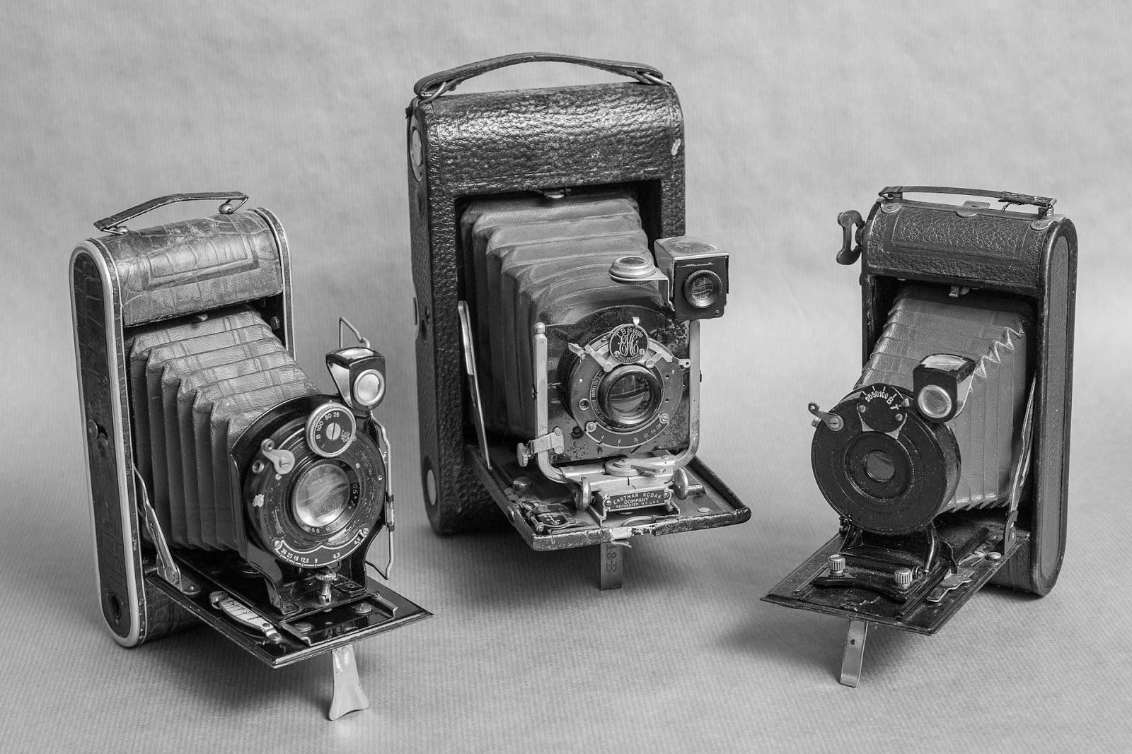
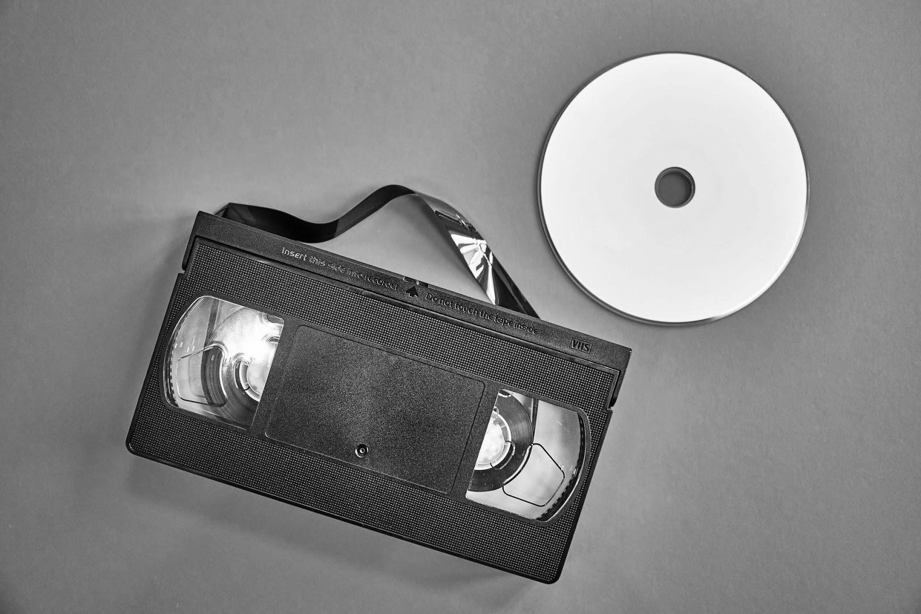
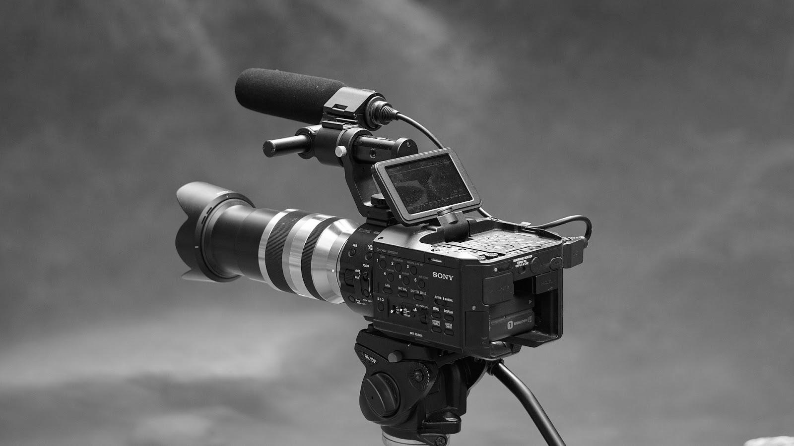
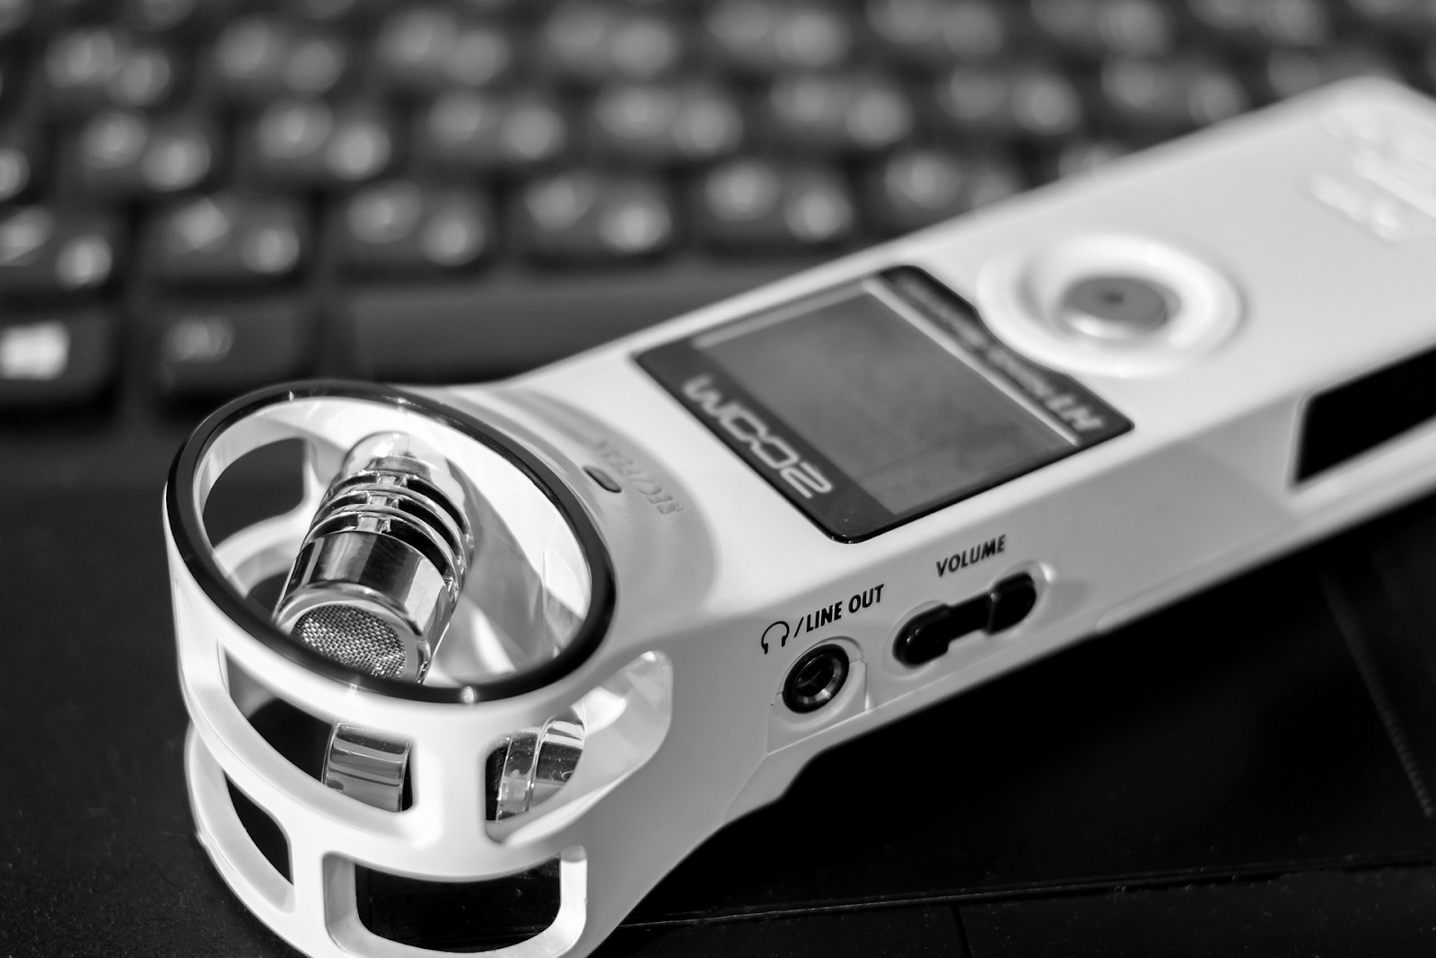
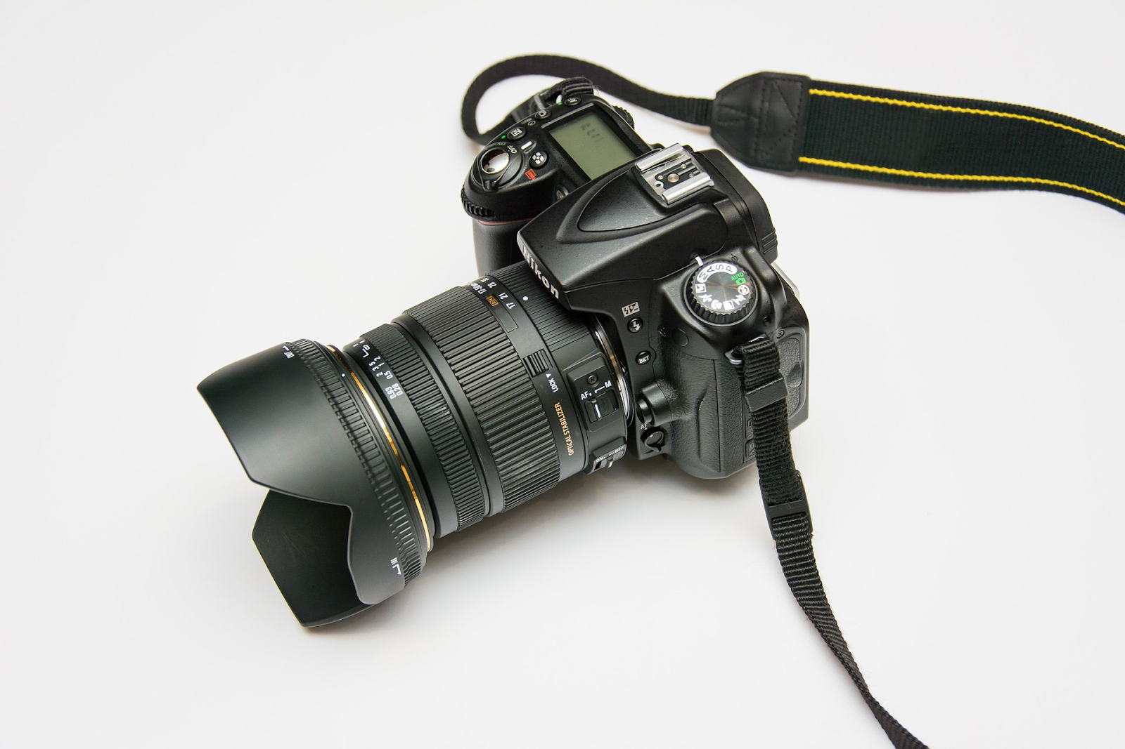
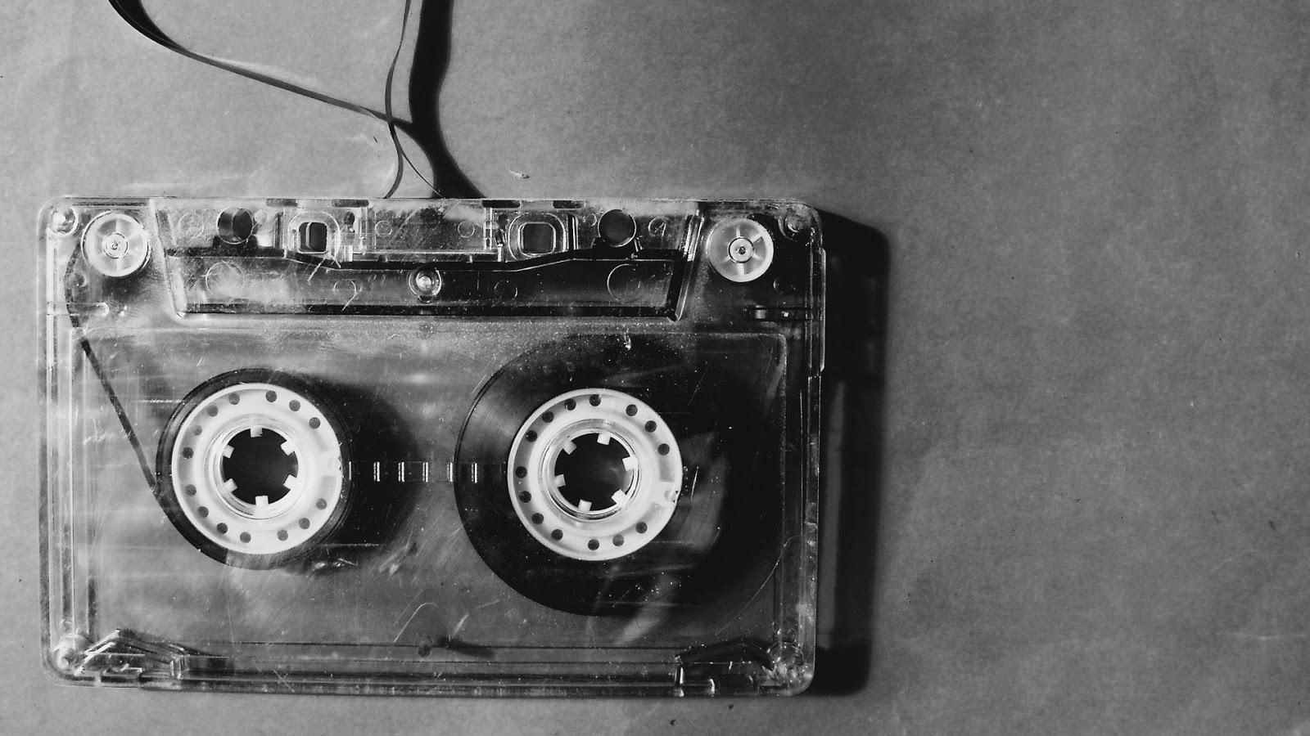
Task 1 - Name the device
1. |  | 6.
2. |  | 7.
3. |  | 8.
4. |  | 9.
5.
9 images Credit (Pixabay)

Slide 3
Task 2 - Evaluate your video recording device
Switch on your video recording device and decide the positive, negative and interesting points. Complete the table
Device 1 | Advantages / pros
 | Disadvantages / cons
 | Interesting points

