Slide 1
Strategies for Subtraction
Worksheet
Mathematics
Mrs Harris

Slide 2
Make use of known facts to solve 12,755 – 6,252 =

Slide 3
Applying efficient strategies for subtraction.
Play against a partner.
Begin with 10, 000.
Take it turns to roll three dice.
Make a 3-digit number with the numbers you rolled.
Subtract this number from your 10, 000.
Continue for 8 rounds.
The person with the answer closest to zero wins.
What strategies did the winner use to help them win?
What strategies did you use to support your subtraction?
Notes:
Introduce self and brief overview of the lesson

Slide 4
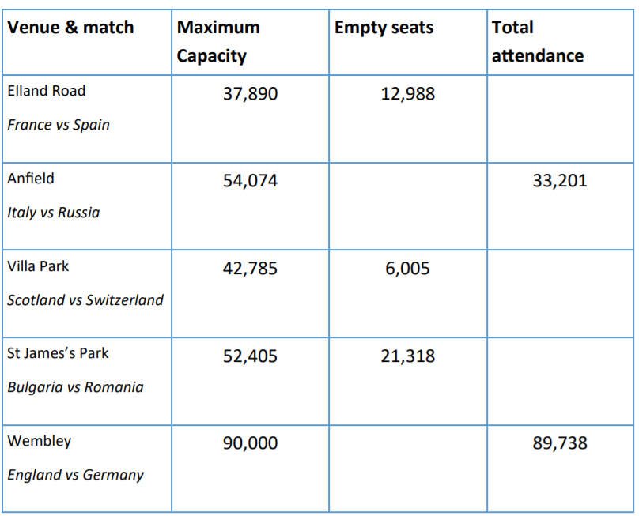
Independent Task - Questions
37,890
12,988
54,074
33,201
42,785
6,005
52,405
21,318
90,000
89,738
Notes:
Introduce self and brief overview of the lesson

