Slide 1
Lesson 4: Repeating a sequence
Lesson 4 of 4
Numeracy: Shape and Sorting - Building Understanding
Simon

Slide 2
What are we going to learn today?
To repeat a sequence of sounds and actions.
To anticipate what will come next and continue the sequence.
Key Vocabulary
sequence pattern repeat sounds

Slide 3
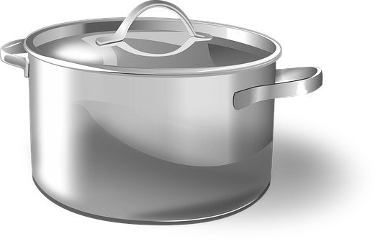
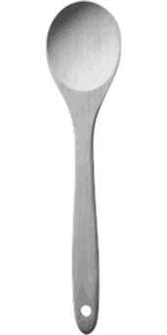
For this lesson, you will need:
Pots and pans
Something to bang on the pots and pans (e.g. wooden spoon)

Slide 4
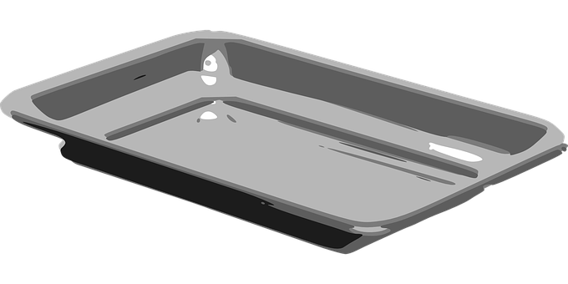
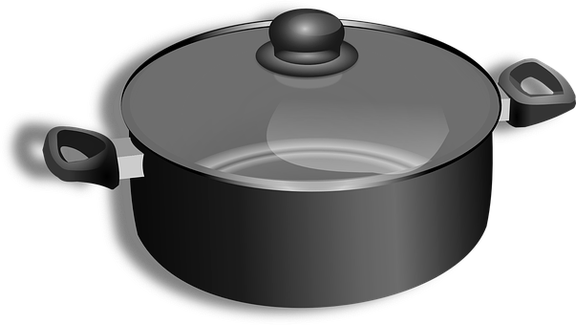
Explore the items you have gathered
Try beating each one and experiencing the different sounds that can be made by banging.
Do they sound different when you use a wooden spoon and your hand?
Images from Pixabay

Slide 5
Exploring your body - body percussion
Your body can make lots of sounds.
Try clapping your hands.
Try slapping your thigh like a cowboy/ cowgirl.
Try stamping your feet.
Try tapping with your fingertips.
Are there any more ways you can make sounds with your body?
Images from Pixabay

Slide 6
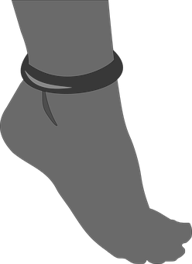
Copy this sequence and keep going
You may start with verbal or hand-over-hand support. Can you continue the sequence and keep going?
Stamp bang stamp bang stamp bang
Images from Pixabay

Slide 7
Copy this sequence and keep going
You may start with verbal or hand-over-hand support. Can you continue the sequence and keep going?
Stamp clap stamp clap stamp clap
Images from Pixabay

Slide 8
Copy this sequence and keep going
You may start with verbal or hand-over-hand support. Can you continue the sequence and keep going? What comes next?
bang clap bang clap bang
clap
Images from Pixabay

Slide 9
Task - Repeating a sequence
Instruction
Use your body percussion and pots and pans to copy, continue and then create your own sequence of sounds.
Suggestions
Start with hand-over-hand and share the experience of repeating a sequence.
Parents and carers can start a sequence for you to copy and continue.
Try creating your own sequence of two different sounds that repeat.

Slide 10
Unit 2 Lesson 4: repeating a sequence
Make it easier
Make it harder
Other ideas
Hand over hand is a useful way to feel the sequence repeating, gradually allowing more independence.
Try using a single sound to create a rhythm.
Try repeating three sounds in a sequence, or mixing loud and quiet sounds.
Experiment with the pace of the sequence.
Listen to a piece of music and add your own sequence of sounds to it. Can you keep the rhythm in line with the beat of the song.
Listen for sequences of sounds in your environment.

