Slide 1
Applying Trigonometry
Maths
Miss Davies

Slide 2
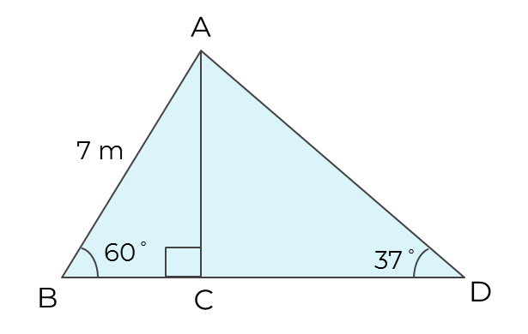
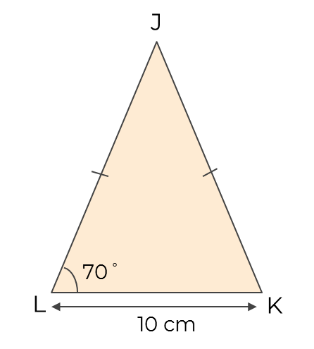
Applying Trigonometry
1. a) Find the height of triangle ABC
b) Find the length BD
Give your answer to 1 decimal place
2. JKL is an isosceles triangle.
The length of LK is 10 cm.
a) Find the height of JKL.
b) Hence, find the area.
Give your answer to 3 significant figures.

Slide 3
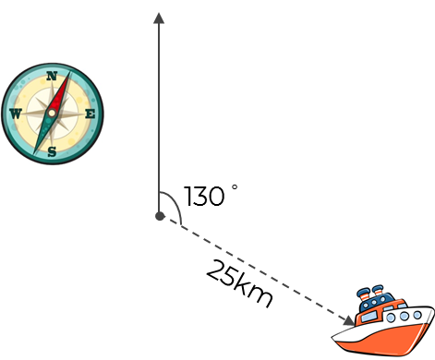
Applying Trigonometry
3. A ship travels 25 km on a bearing
of 130 °.
How far east of its original position
is it?
Give your answer to 1 decimal place.
4. Jack wants to fence the perimeter of his triangular field.
a) How much fencing will he need?
b) Fencing is only sold in 1 m lengths costing £2.16 each.
How much will it cost to fence the
field?
How far east of its original position
is it?
9 m
53 °
‹#›

Slide 4
Answers

Slide 5
Applying Trigonometry
1. a) Find the height of triangle ABC
b) Find the length BD
Give your answer to 1 decimal place
2. JKL is an isosceles triangle.
The length of LK is 10 cm.
a) Find the height of JKL.
b) Hence, find the area.
Give your answer to 3 significant figures.
6.062 . . m
13.7 cm (3 s.f)
Answers between
68.5 cm² and 68.7 cm²
11.5 m

Slide 6
Applying Trigonometry
3. A ship travels 25 km on a bearing
of 130 °.
How far east of its original position
is it?
Give your answer to 1 decimal place.
4. Jack wants to fence the perimeter of his triangular field.
a) How much fencing will he need?
b) Fencing is only sold in 1 m lengths costing £2.16 each.
How much will it cost to fence the
field?
How far east of its original position
is it?
25 cos (40) = 19.2 km
9 m
7.2m
53 °
5.4 m (1 d.p)
‹#›

