Slide 1
Recurring decimals where one number repeats
Downloadable Resource
Maths
Mrs Dennett

Slide 2
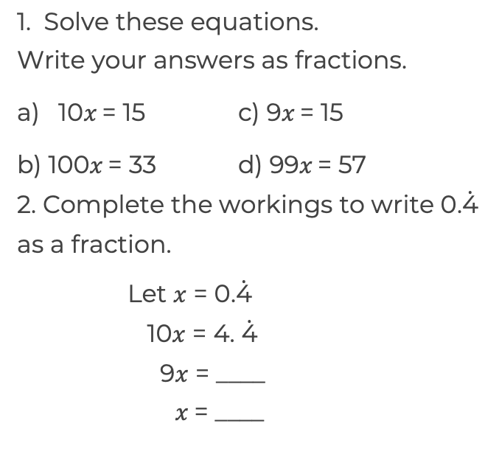
Recurring decimals where one number repeats

Slide 3
Answers

Slide 4
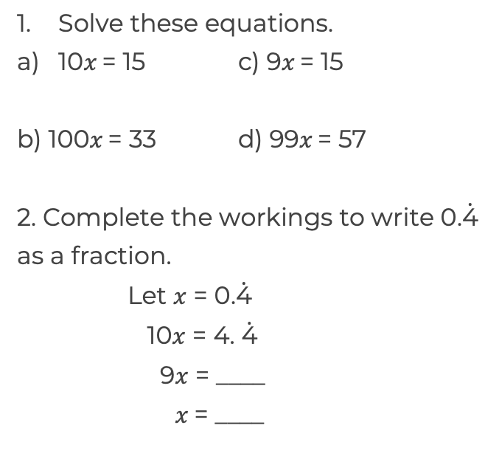
Recurring decimals where one number repeats
4

