Slide 1
Numbers within 10:
Understanding the conservation of numbers within 8
Mathematics
Lesson 3 of 10
ssss
Miss. Molnar

Slide 2
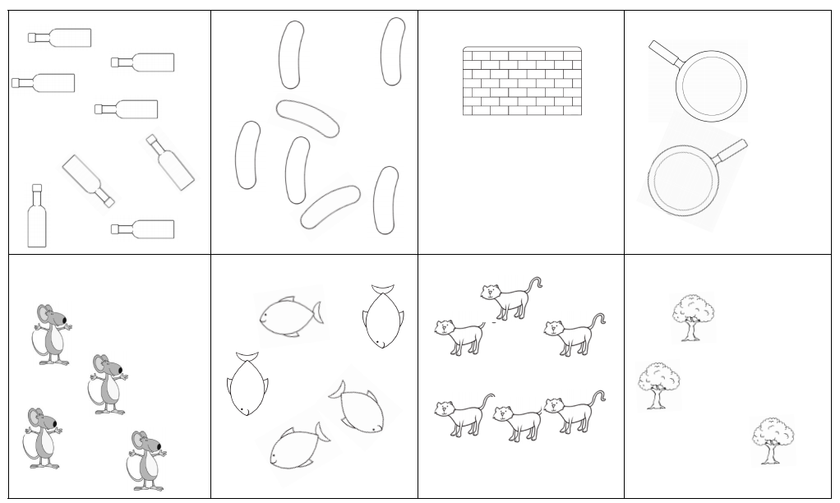
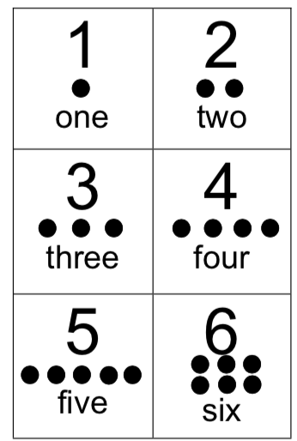
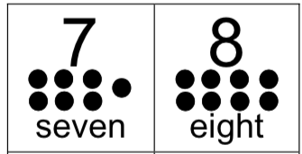
Can you represent the number and match it to the picture?

Slide 3
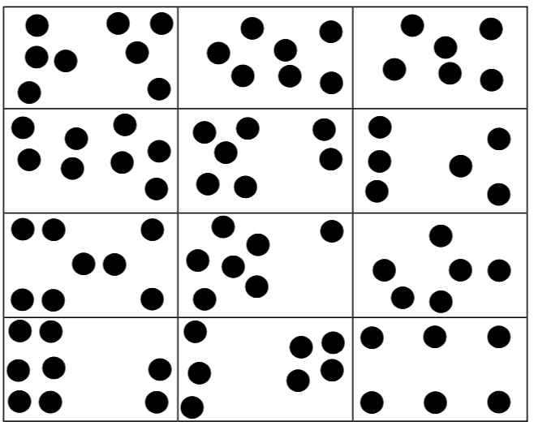

Slide 4
