Slide 1
Correlation - Worksheet
Mathematics
Mr Millar

Slide 2
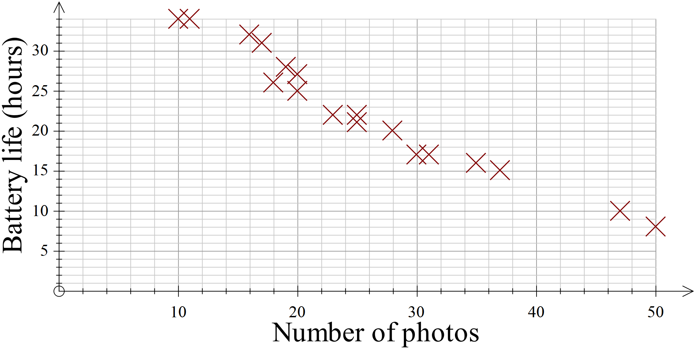
How could you describe the connection between the variables shown on the scatter graph?
How many way can you complete the sentence frame?
As the _______ increases/decreases, the _________ increases/decreases.

Slide 3
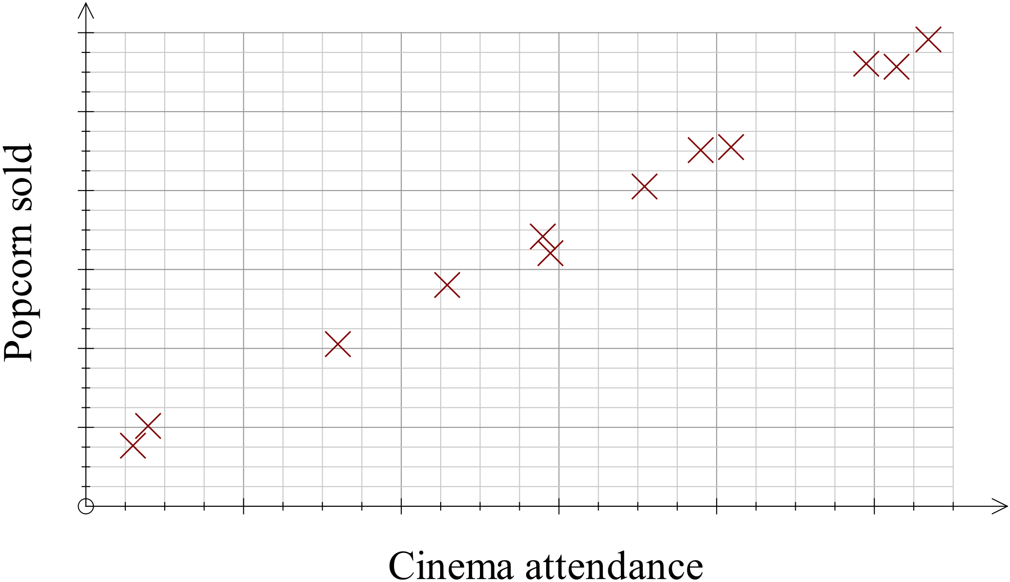
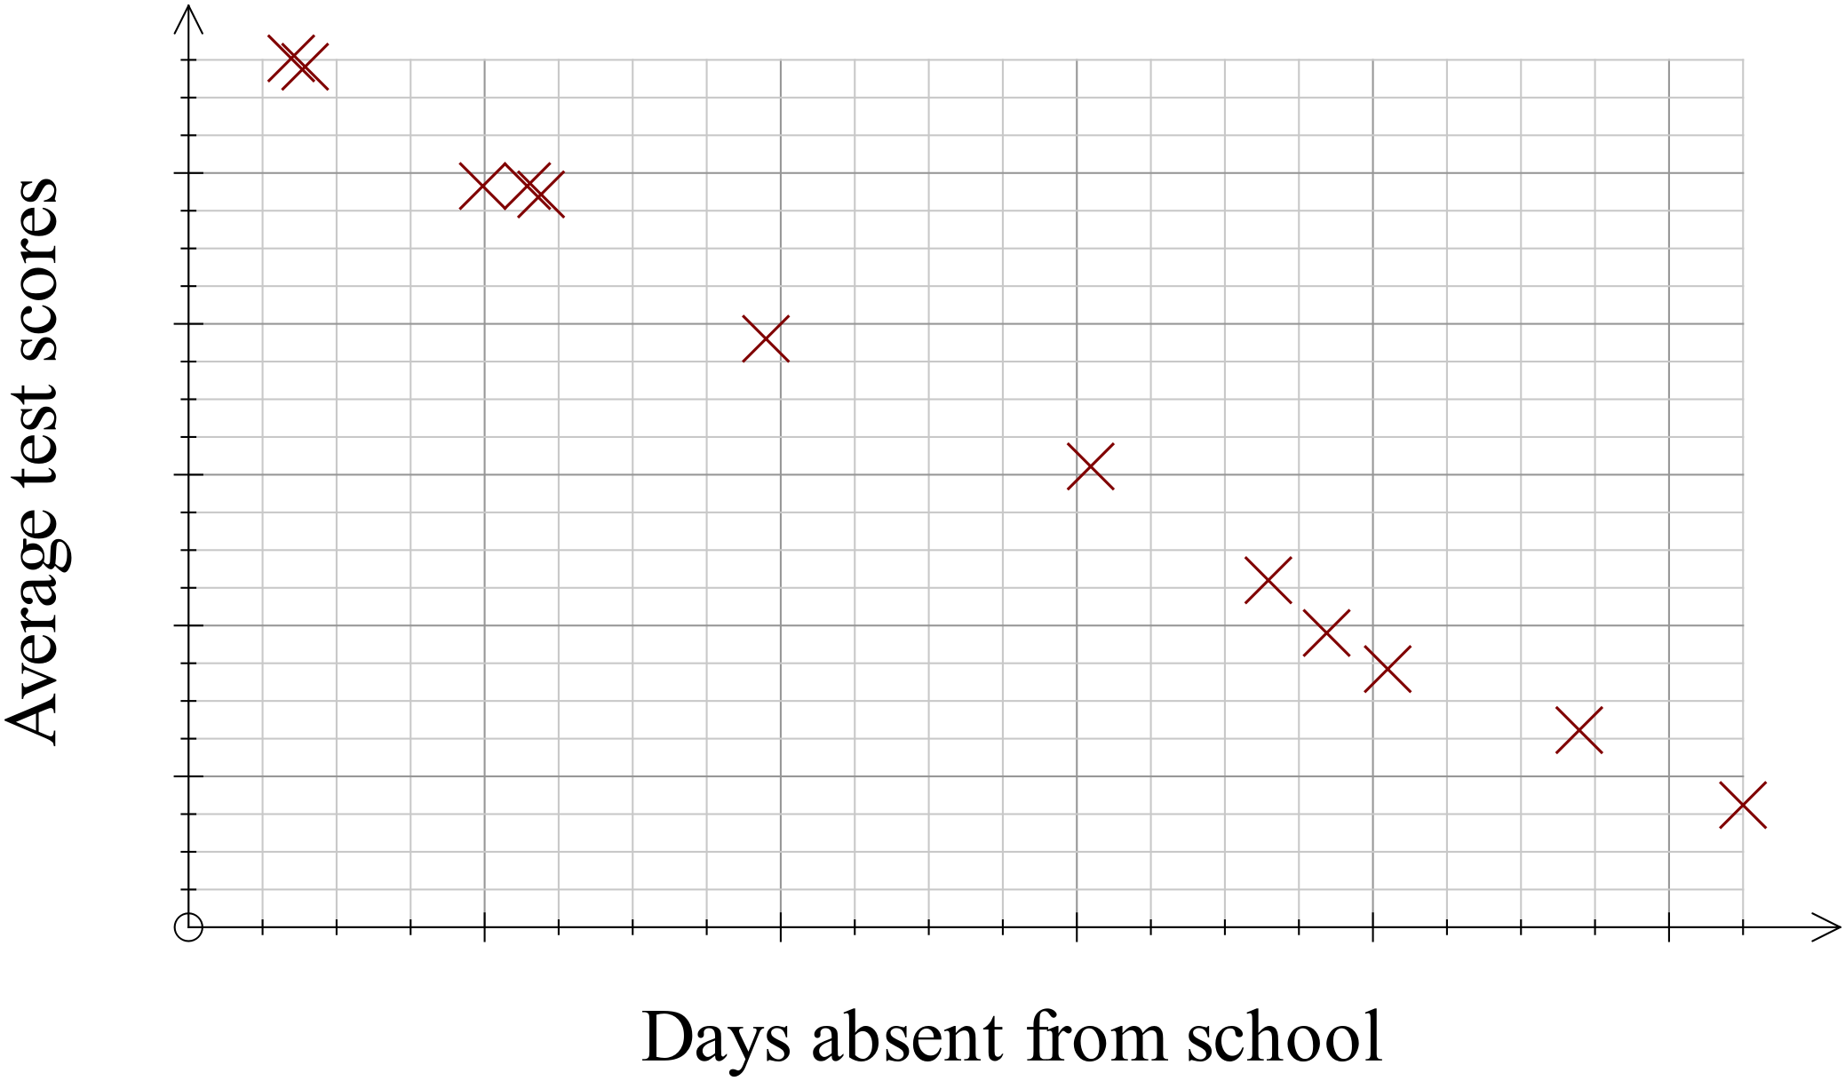
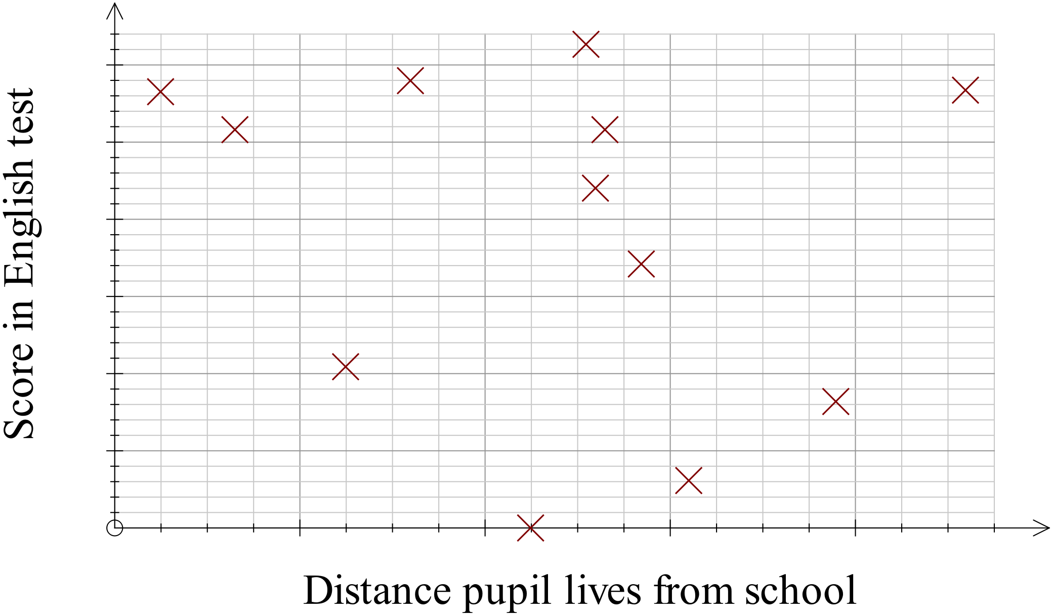
No questions here, but useful for next questions
Positive Correlation
Negative Correlation
No Correlation
As one variable increases, so does the other
As one variable increases the other decreases
No apparent pattern between the two variables

Slide 4
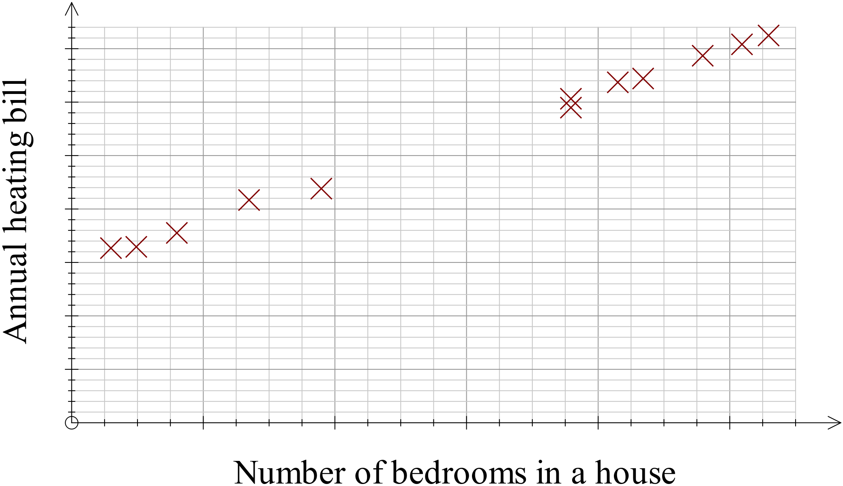
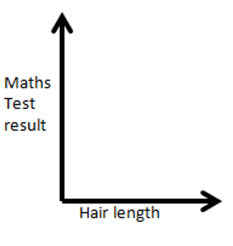
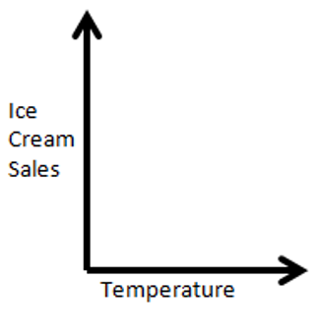
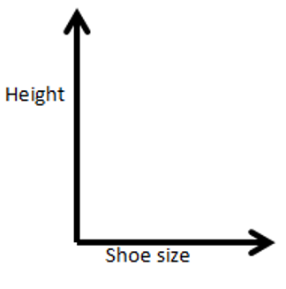
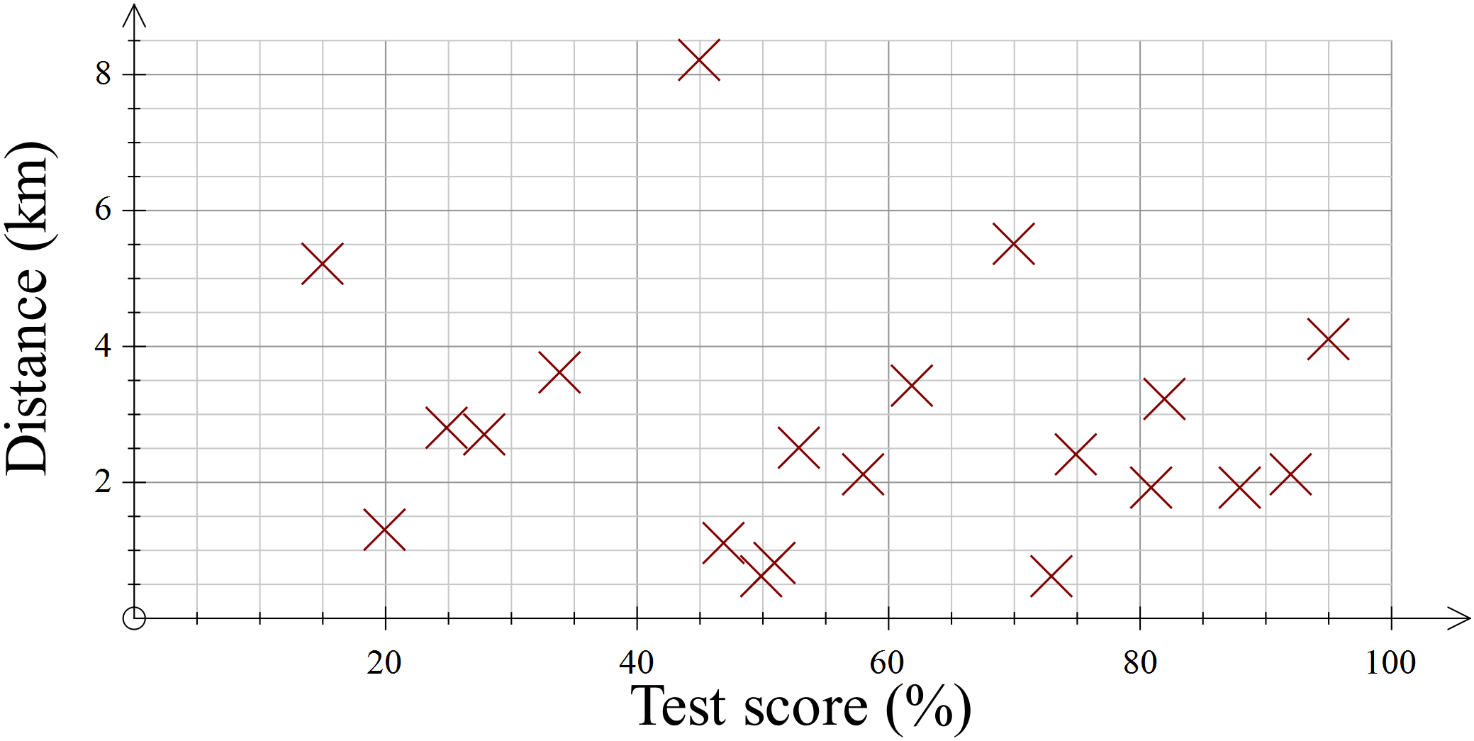
2. On each set of axes plot 8-10 points based on the correlation you would expect to find.
Write a sentence explaining what each graph is showing, and the type of correlation
Hours the heating is on
Number of cavities
Time spent brushing teeth

Slide 5
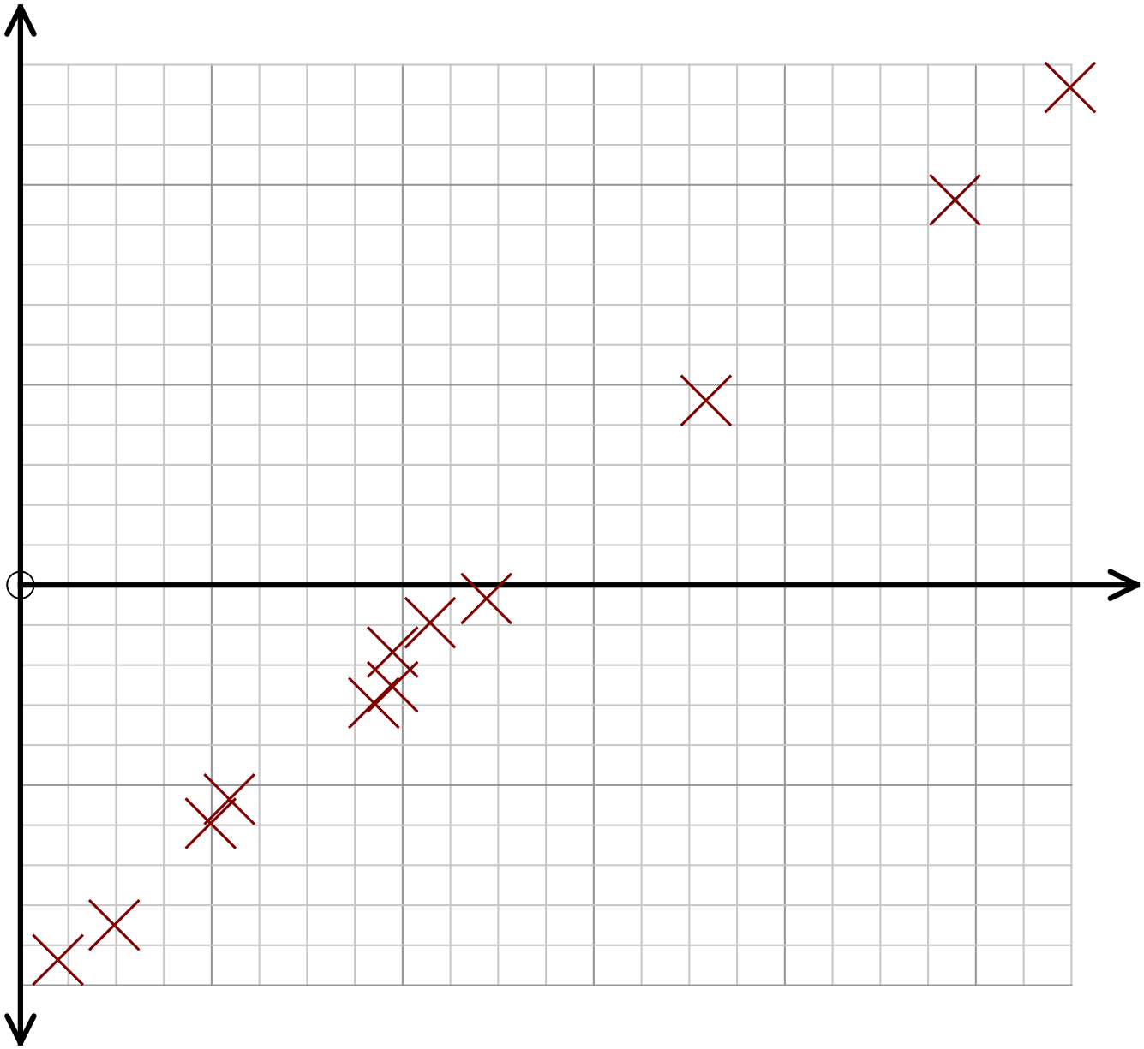
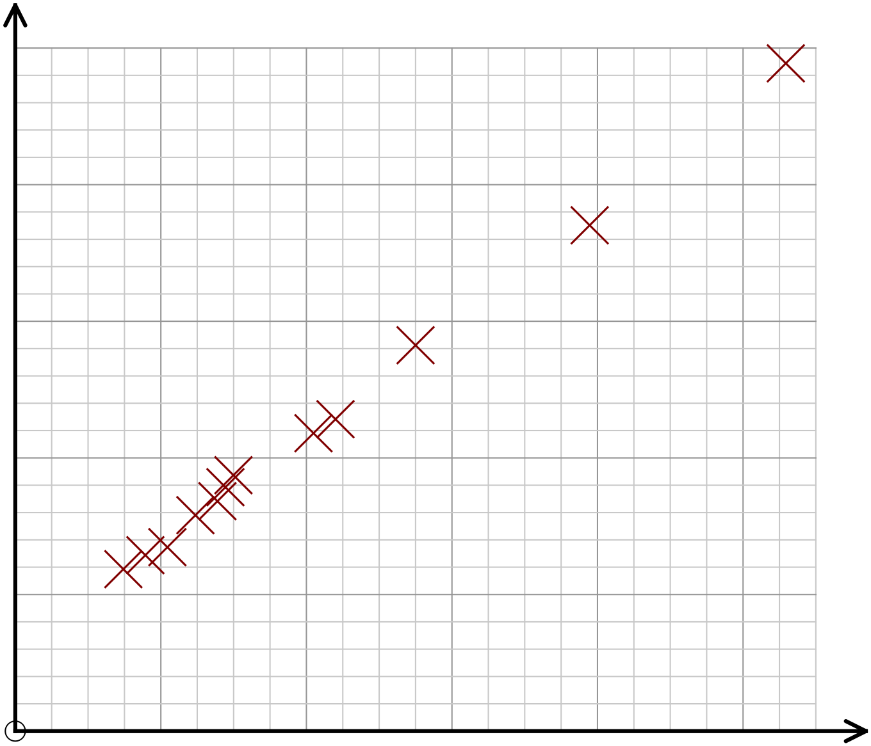
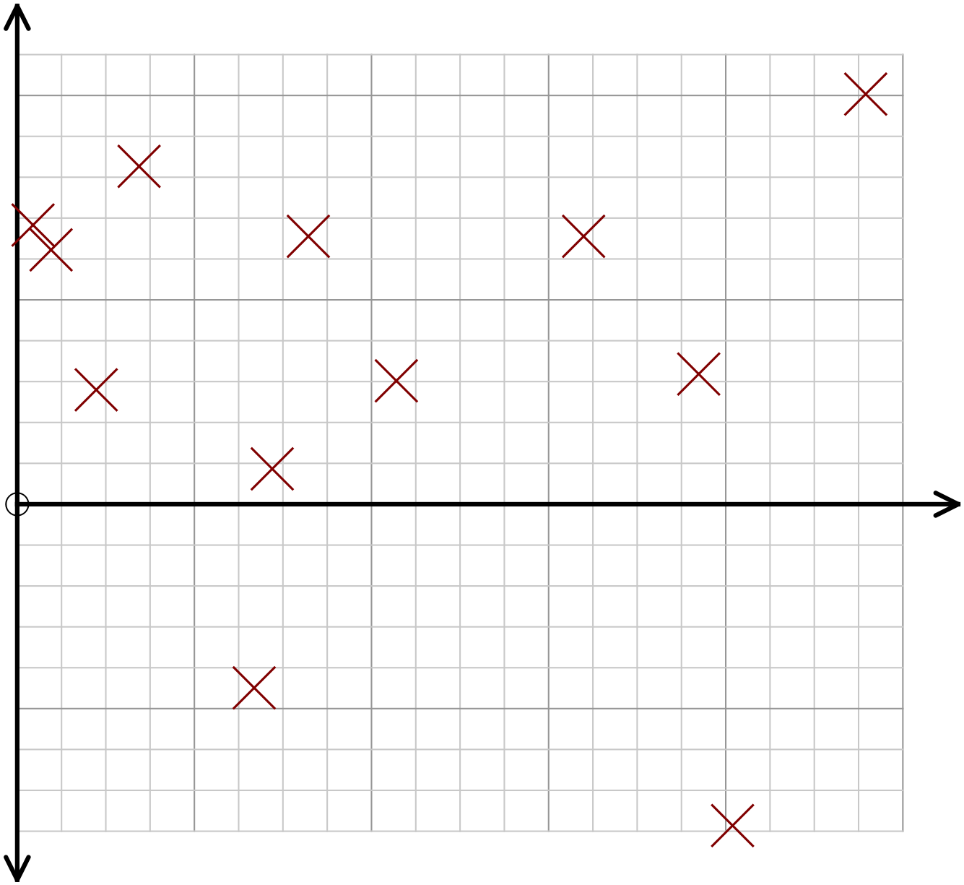
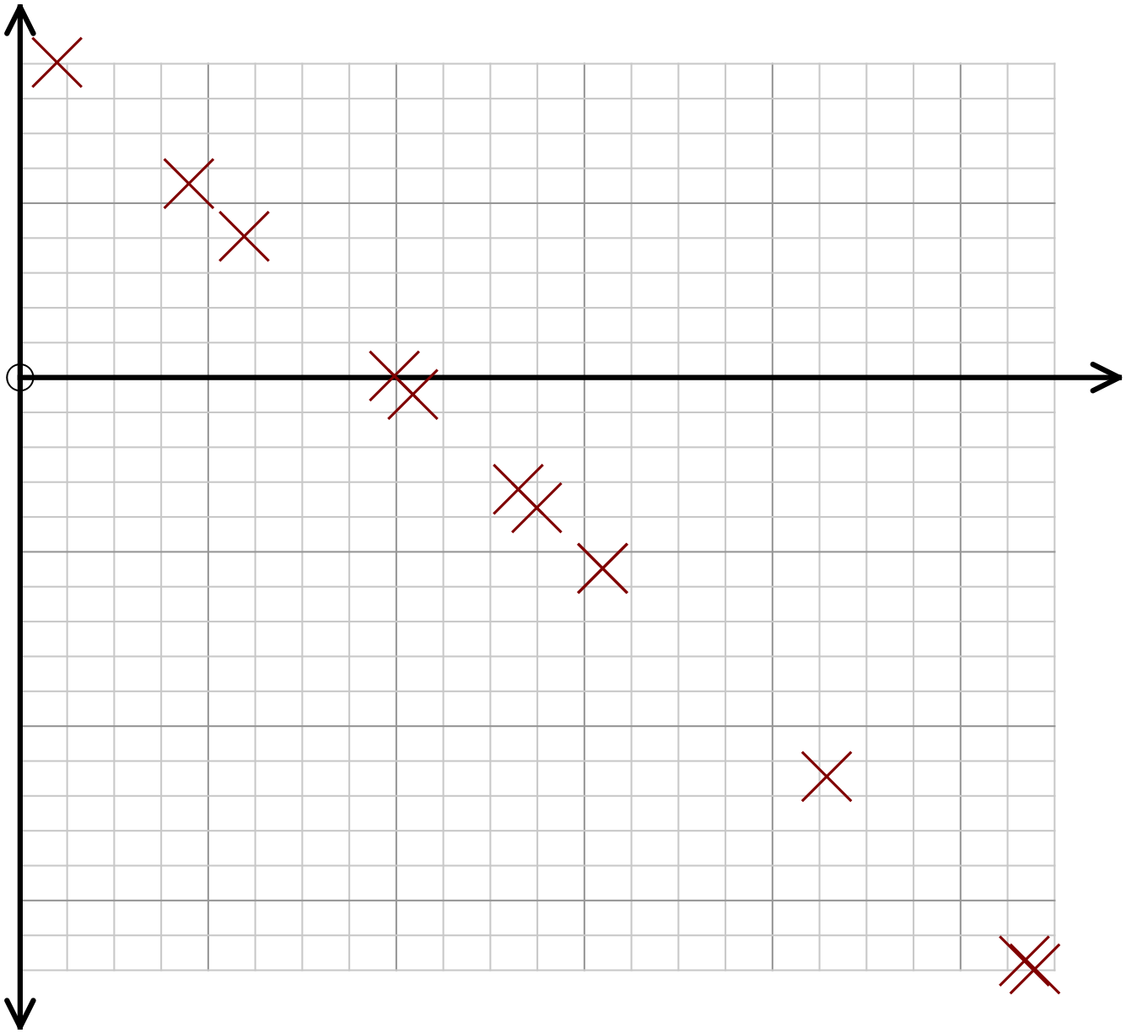
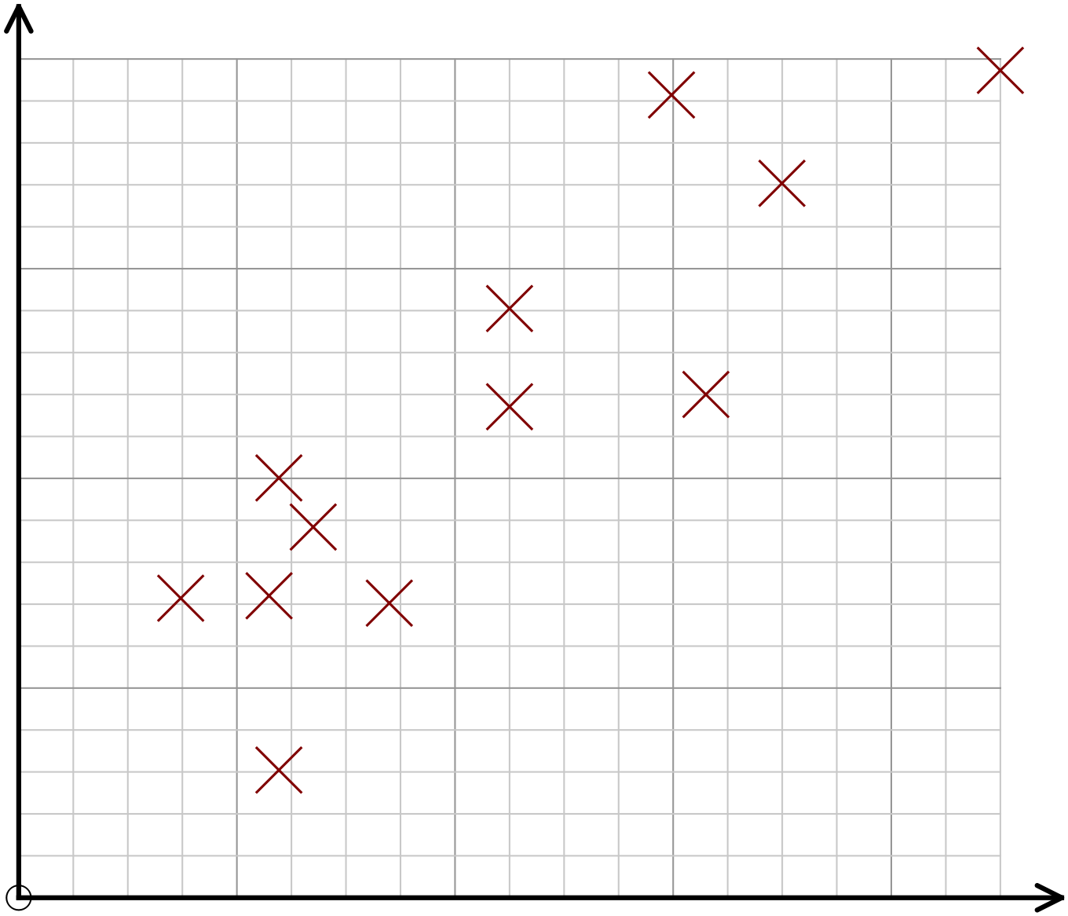
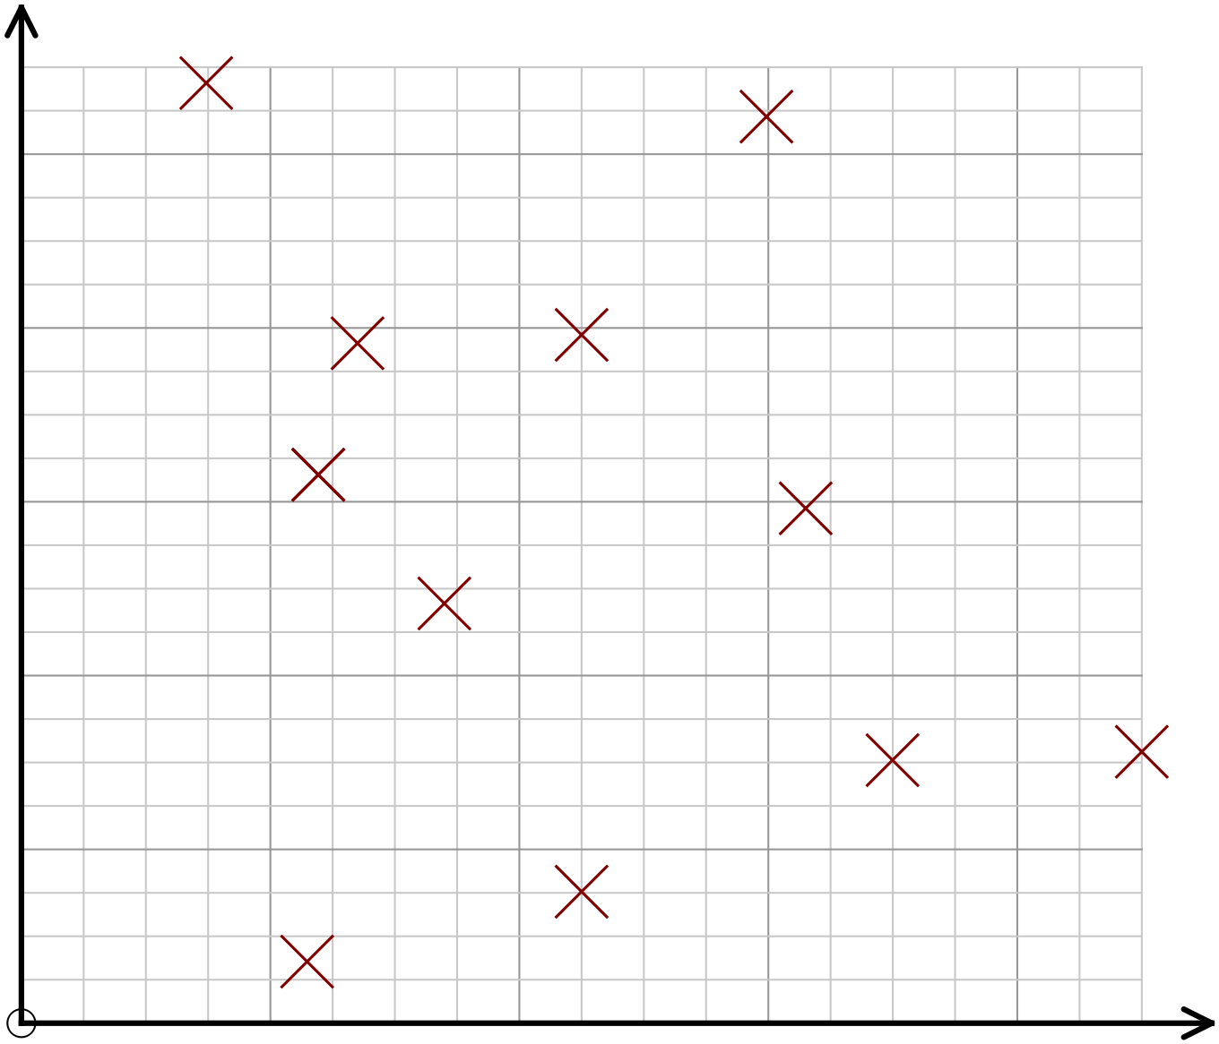
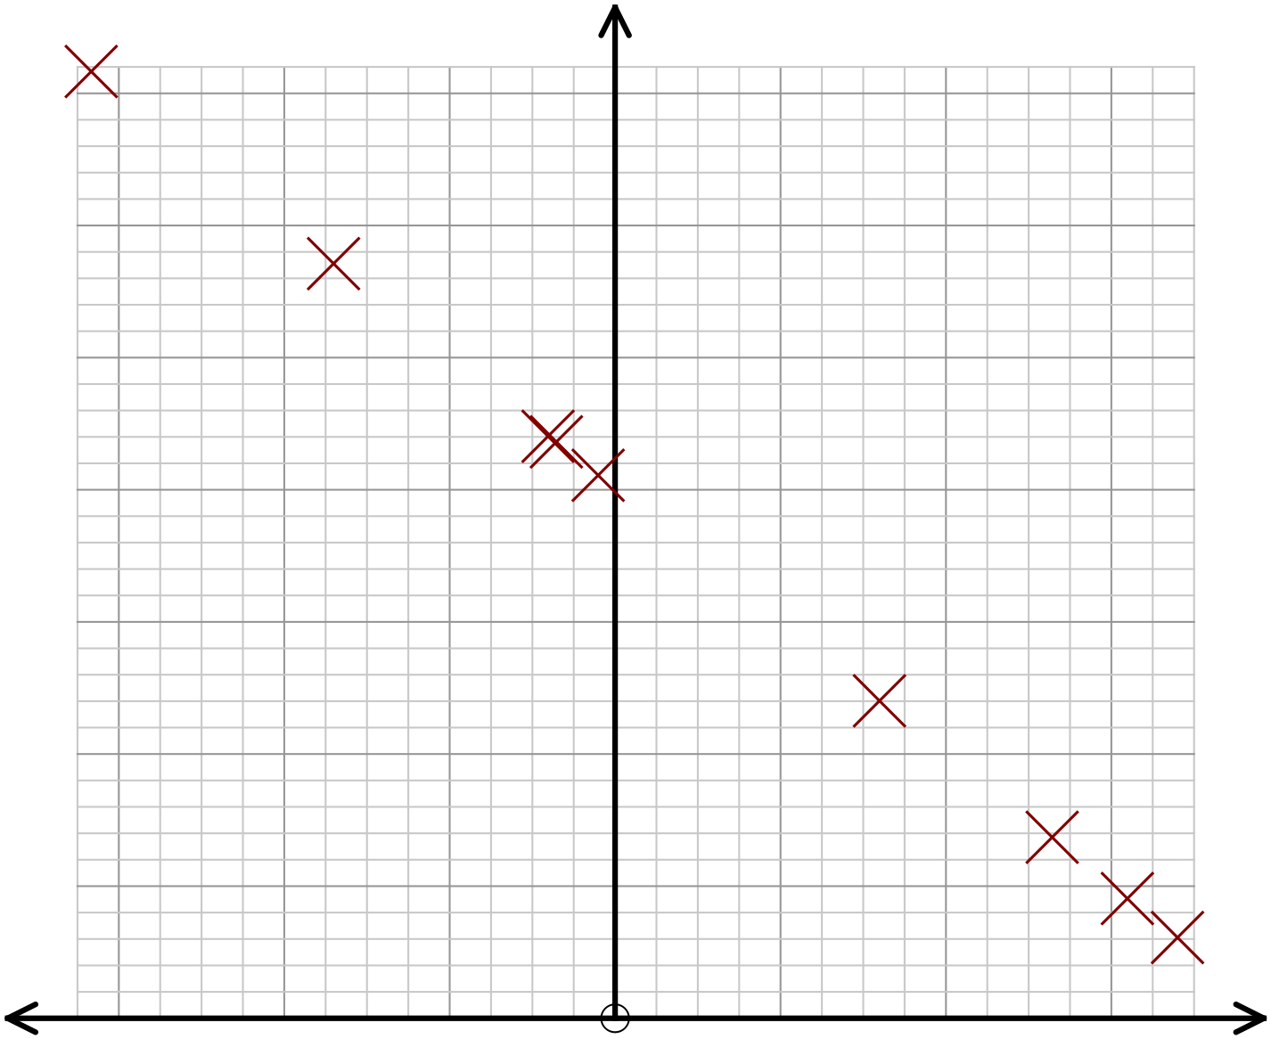
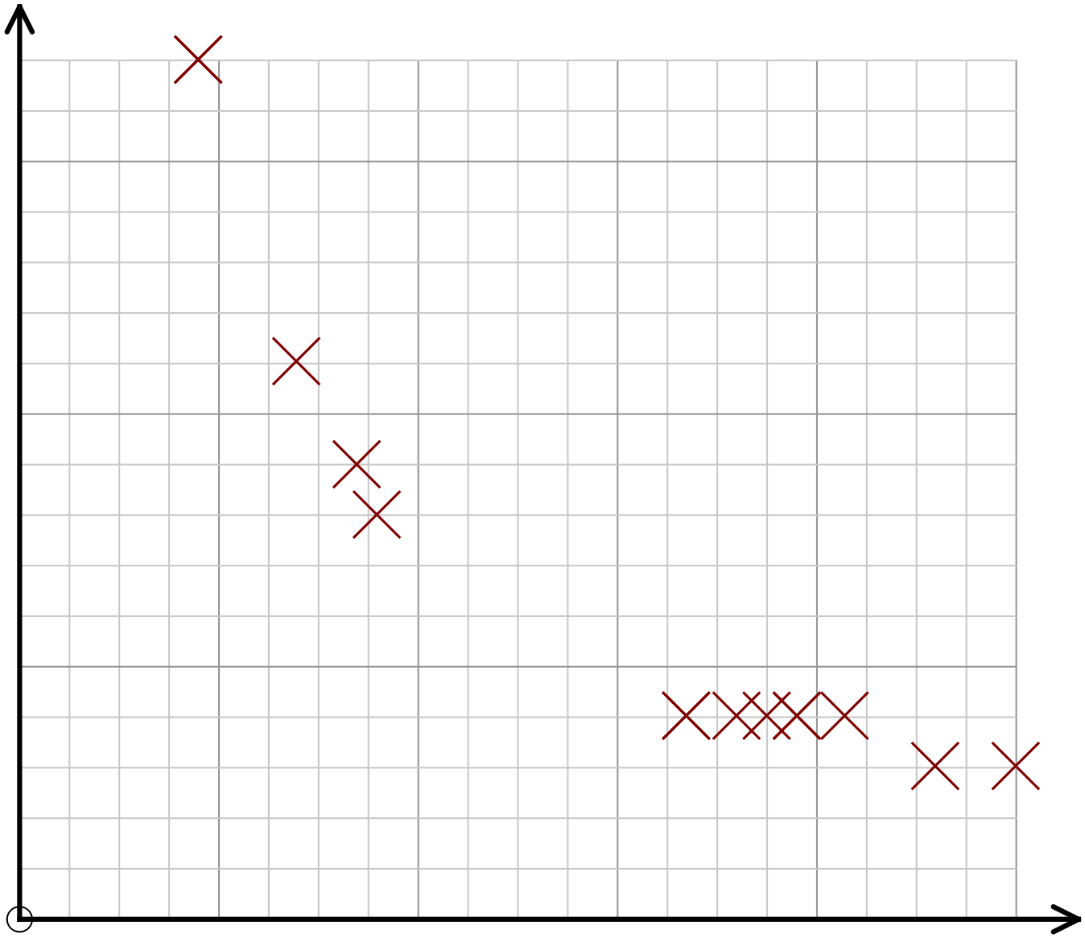
Sort these graphs into groups based on the correlation shown.
Place them in order by strength of correlation. Think of variables that might match each graph.

Slide 6
Answers

Slide 7
How could you describe the connection between the variables shown on the scatter graph?
How many way can you complete the sentence frame?
As the number of photos increases, the battery life decreases.

Slide 8
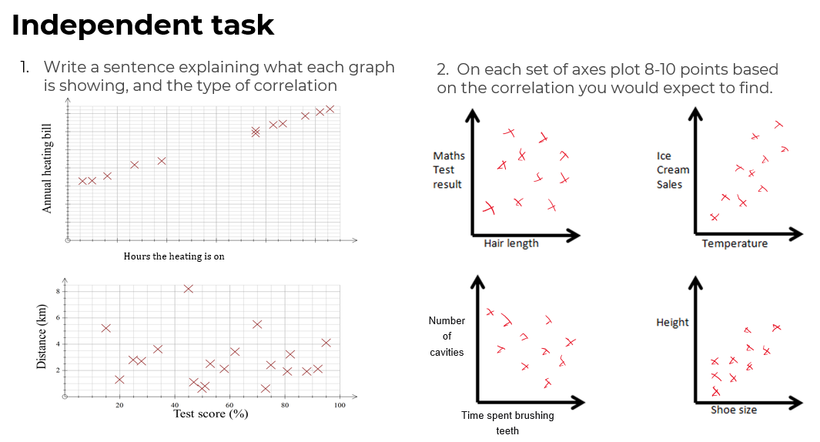
2. On each set of axes plot 8-10 points based on the correlation you would expect to find.
Write a sentence explaining what each graph is showing, and the type of correlation
No correlation
Positive correlation
The longer the heating is on, the higher the heating bill. (Strong) positive correlation
Hours the heating is on
No correlation between test score and distance
Positive correlation
Negative correlation
Number of cavities
Time spent brushing teeth

Slide 9
Sort these graphs into groups based on the correlation shown.
Place them in order by strength of correlation. Think of variables that might match each graph.
Very strong positive correlation
Very strong positive correlation
No correlation
Very strong negative correlation
Weak positive correlation
No correlation
Very strong negative correlation
Strong (non linear) negative correlation

