Slide 1
Multiplying 3-digit numbers by 1-digit numbers
Mathematics
Miss Thomas

Slide 2
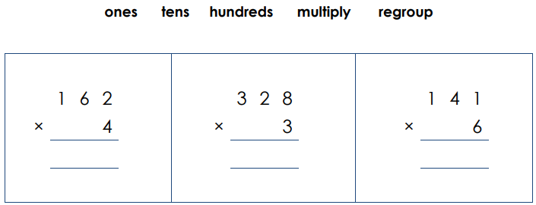
Solve the multiplication calculations. Explain each step using the key vocabulary below.

Slide 3
Independent Task
Solve the multiplication calculations. Explain each step using the key vocabulary below.
2
2
2
984
846
648

