Slide 1
Truncating Axes
Mathematics
Mr Millar

Slide 2
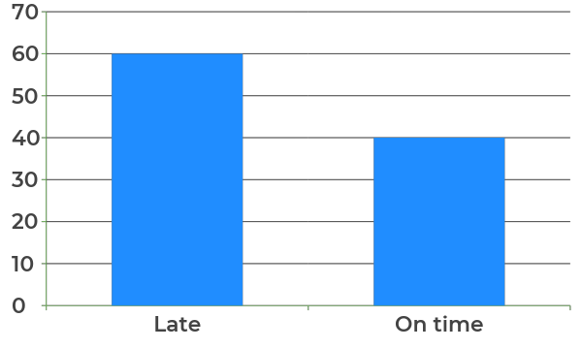
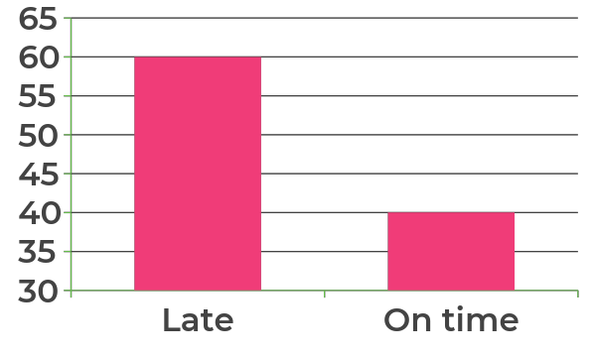
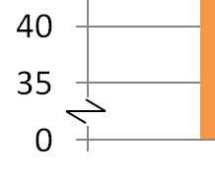
Bus arrival times
A
Do you agreed with Antoni?
Why? Why not?
Frequency
Chart B shows fewer buses were late as the bar is smaller.
Bus arrival times
B
Frequency
What does this mean?

Slide 3
Truncating axes can help us see data differences and detail in the data points more clearly but we need to be careful when reading data in this way.
Explain why Antoni is incorrect.
This chart shows triple the number of busses were late than were on time.
Frequency

Slide 4
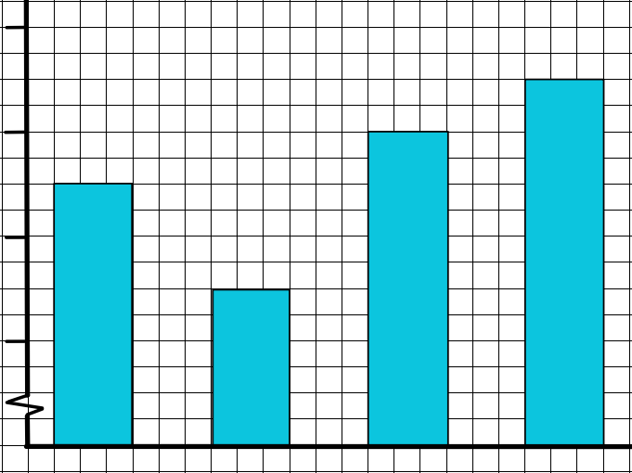
State whether the following are true or false:
September had more than double July’s sales
September was the best month of the year
8% more was sold in September than June
28
26
Sales
£1000s
24
22
June
July
Aug
Sept

Slide 5
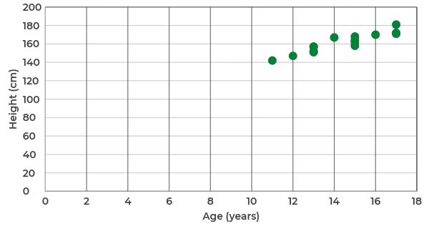
How could Cala improve this scatter graph?
Draw a version that you think shows the information better.
Height (cm) | 147 | 142 | 152 | 157 | 162 | 164 | 167 | 168 | 170 | 151 | 157 | 158 | 171 | 172 | 181
Age (years) | 12 | 11 | 13 | 13 | 15 | 15 | 14 | 15 | 16 | 13 | 13 | 15 | 17 | 17 | 17

Slide 6
Answers

Slide 7
Bus arrival times
A
Do you agreed with Antoni?
Why? Why not?
Frequency
Disagree: both charts are showing the same data; the scale on the second y axis has been truncated
Chart B shows fewer buses were late as the bar is smaller.
Bus arrival times
B
Frequency
What does this mean?

Slide 8
Truncating axes can help us see data differences and detail in the data points more clearly but we need to be careful when reading data in this way.
Explain why Antoni is incorrect.
The axis shows 60 were late vs 40 on time
This chart shows triple the number of busses were late than were on time.
Frequency

Slide 9
State whether the following are true or false:
September had more than double July’s sales
September was the best month of the year
8% more was sold in September than June
28
26
False
Sales
£1000s
24
True
22
June
July
Aug
Sept
True

Slide 10
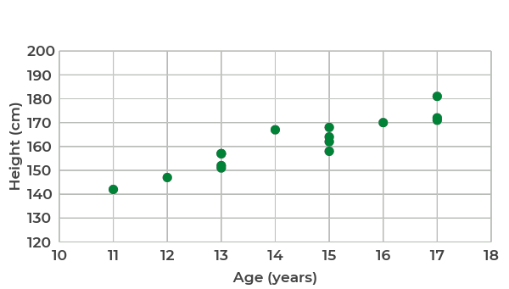
The truncated axes makes reading the data easier.
Height (cm) | 147 | 142 | 152 | 157 | 162 | 164 | 167 | 168 | 170 | 151 | 157 | 158 | 171 | 172 | 181
Age (years) | 12 | 11 | 13 | 13 | 15 | 15 | 14 | 15 | 16 | 13 | 13 | 15 | 17 | 17 | 17

