Slide 1
Biological Systems and Processes
Lesson 8 - How does the intensity of exercise affect breathing rate? - An Investigation
KS3 Biology
Miss Hindle

Slide 2
Quick Recap...
What happens to our breathing rate when we exercise? It …………….....
Why does this happen to our breathing rate? Breathing is ……………..... to get ……………..... oxygen into the body and get rid of ……………..... carbon dioxide.
How do we calculate the mean?
What is the controlled variable?

Slide 3
Risk Assessment…
Say any REAL risks that could happen in the practical.
Explain how you could reduce the risk of these.
What is the hazard? | How could it be dangerous? | How will you reduce the risk?

Slide 4
Method…
Step in Method | Steps
 | Walk on the spot for one minute
 | Immediately after sit down and count your breaths for 1 minute, record the result.
 | Repeat the whole practical three times
 | Sit quietly and calmly for one minute, don’t move or talk.
 | Count the number of breaths you take in 1 minute for your resting breathing rate. Record the result.
 | Repeat steps 1-4 but changing the exercise to jogging on the spot for 1 minute and then star jump for 1 minute.

Slide 5
Results…
Usually shown in a table and then a graph drawn from the data in the table
Type of Activity | Breathing Rate |  |  | Mean
Rest
1 min of walking on the spot
1 min of jogging on the spot
1 min of star jumps

Slide 6
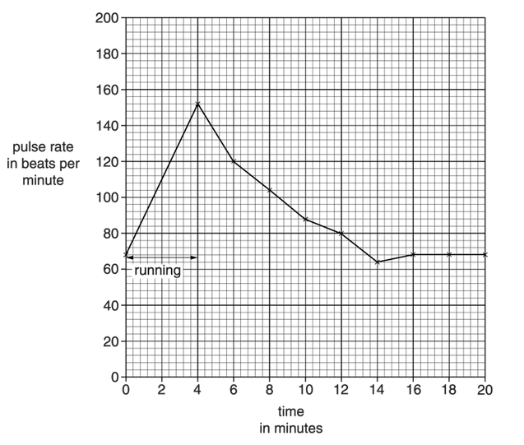
Past Paper Question...
The graph shows his results….
Peter is investigating how exercise affects his pulse rate.
He uses a pulse meter to measure his pulse rate.
He runs as fast as he can for four minutes.
Peter’s legs ache towards the end of the exercise.
He then sits down and measures his pulse rate again every two minutes for the next 16 minutes.
Explain the pattern in the graph between 4 minutes and 20 minutes. (6 marks)
June 2013 | B721/02 Additional Science

