Slide 1
Add and subtract two column vectors to give a resultant vector
Miss Davies
Maths
‹#›

Slide 2
Add and subtract two column vectors to give a resultant vector
‹#›

Slide 3
Answers
‹#›

Slide 4
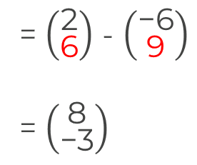
Add and subtract two column vectors to give a resultant vector
‹#›

