Slide 1
Reasoning with large whole numbers: Rounding 5-digit numbers to the nearest 100, 1000 and 10 000
Mathematics
Ms Jeremy

Slide 2
Pause the video to complete your task
Resume once you’re finished
Identify the closest smaller multiple.
Identify the closest larger multiple.
Identify the halfway point.
Which multiple is the number closest to?
56 389
56 300
56 350
56 400

Slide 3
Pause the video to complete your task
Resume once you’re finished
Can you round 45 200 to:
i) the nearest 10 000?
ii) the nearest 1000?
iii) the nearest 100?
45 200

Slide 4
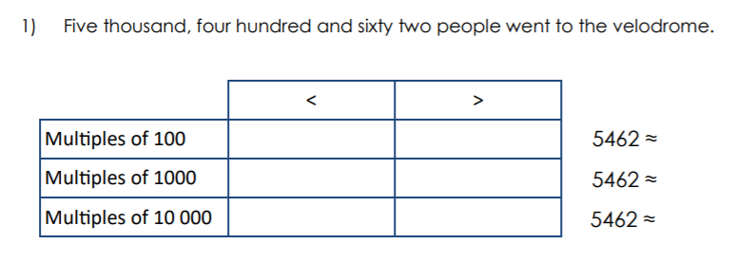
Independent Task
3) 56 342
4) 89 143

