Slide 1
Reading Scales on a Line Graph
Worksheet
Mathematics
Mr Ward

Slide 2
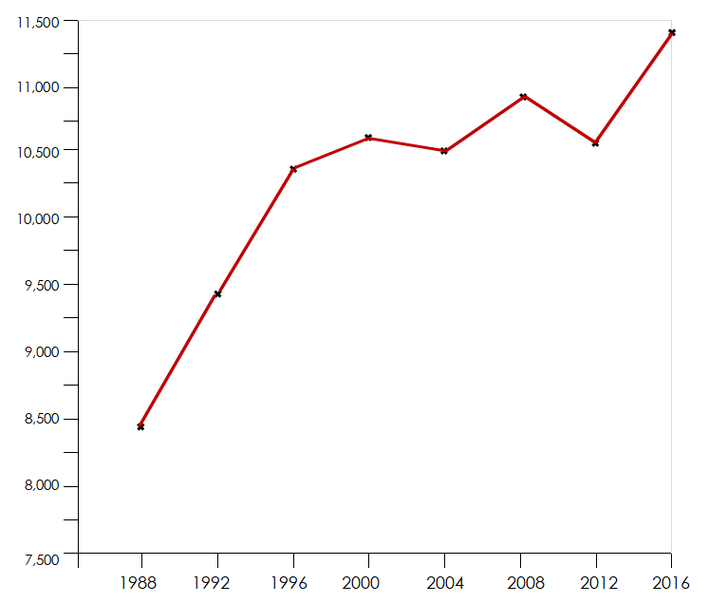
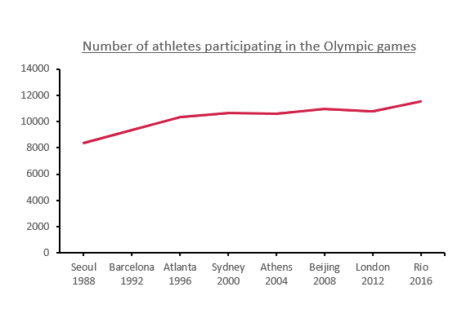
Talk Task
Compare the two line graphs. What statements can we make? make?
Number of athletes participating in the Olympics
Number of athletes participating in the Olympics
Number of Athletes
Number of Athletes
Olympic Games
Olympic Games

Slide 3
Reading scales - Intervals
Fill in the empty boxes with the correct intervals
7500
8000
8500
9000
1988
1996
2004
2012

Slide 4
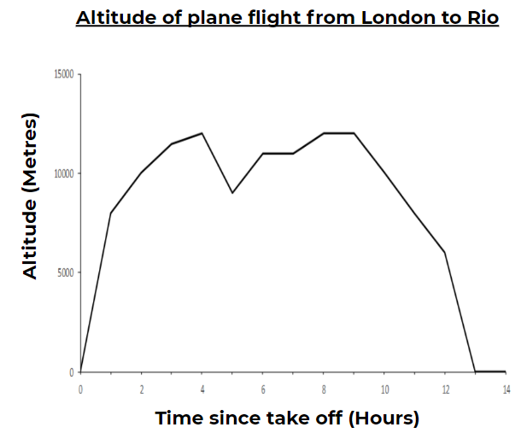
Use the information from the graph to answer the following questions (see larger version of graph on next slide!)
What was the approximate altitude of the plane at these times:
3 hours after take off
30 minutes before the plane landed
Halfway through the flight
What was the greatest height reached by the plane?
The pilot had to lower the plane to avoid a storm. When did this happen and by how much was the plane lowered?
What is the possible story for this flight - include information from the graph in your story.
What questions can you generate that can be answered by the graph?

Slide 5
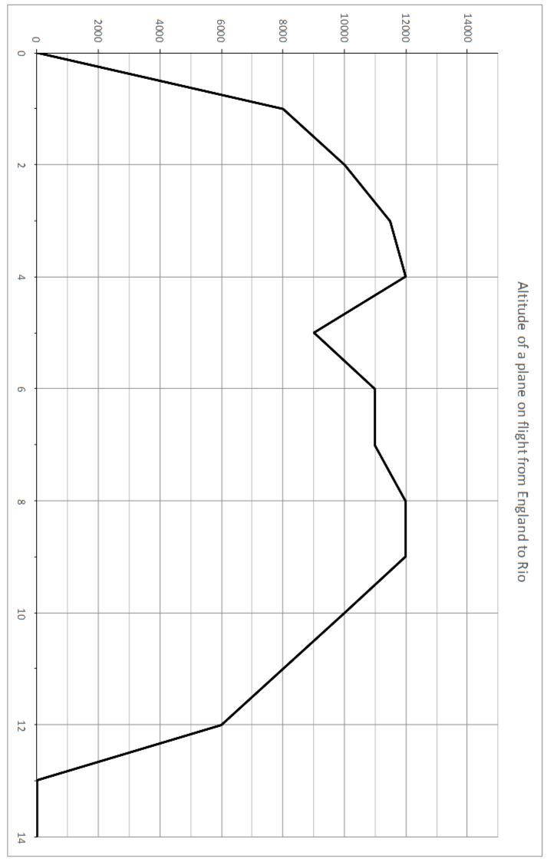

Slide 6
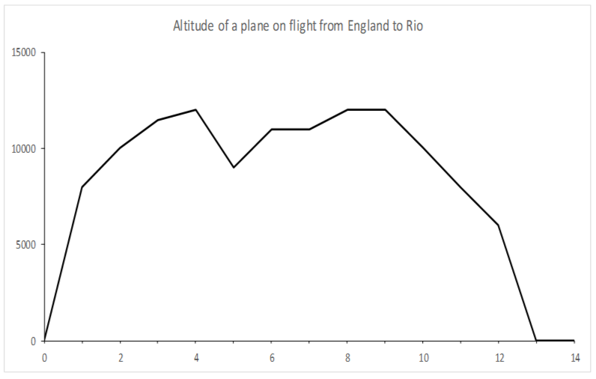
Final Answers
1a) Approximately 11,500 metres
1b) Approximately 3,000 metres
1c) Exactly 11,000 metres
2) 12,000 metres
3) Pilot dipped 4 HOURS into the flight and dropped 3,000 metres
4) Open answer - your stories are based on the information provided
5) Many different answers - e.g. How much time did it take the plane to reach its highest altitude during the flight?
Altitude of plane flight from London to Rio
Altitude (Metres)
Time since take off (Hours)

Slide 7
Challenge Slide
Don’t forget to pause the video if you want to have a go!
Sequences
Look at the following sequences and try to work out:
The next two numbers
b) The tenth number in the sequence
2, 3, 5, 9, 17, …… , …….
1, 1, 2, 3, 5, 8,......, ……..
3, 15, 9, 21, 15, 33,....., …..

