Slide 1
Estimate and interpret the gradient of a curve
Maths
Mr Clasper

Slide 2
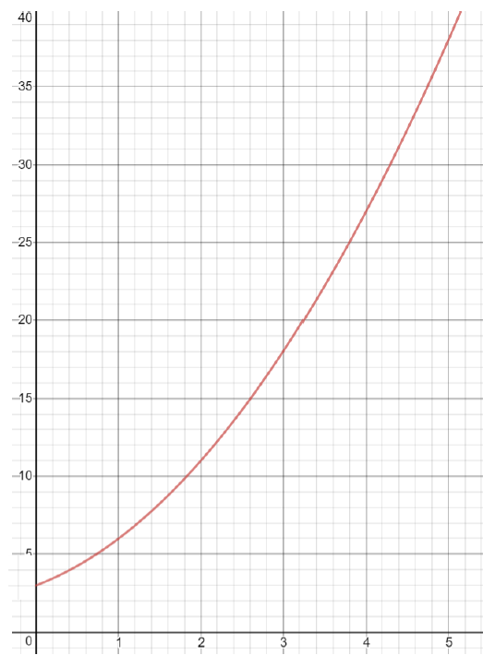
Estimate and interpret the gradient of a curve
1. A tank is filled with water.
The graph opposite shows the depth of water in the tank as time increases.
a) What is the depth of water in the tank at the start?
b) Estimate the gradient of the curve at t = 3 seconds.
c) What does the gradient tell you?
Depth of water (m)
Time (seconds)
Image created with desmos.com

Slide 3
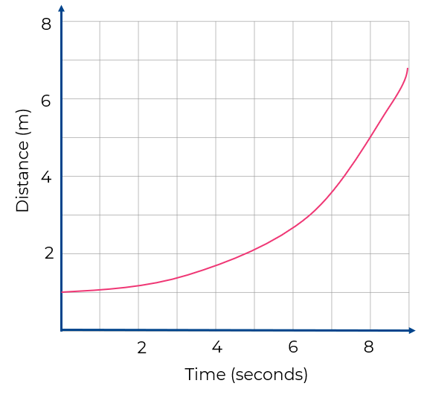
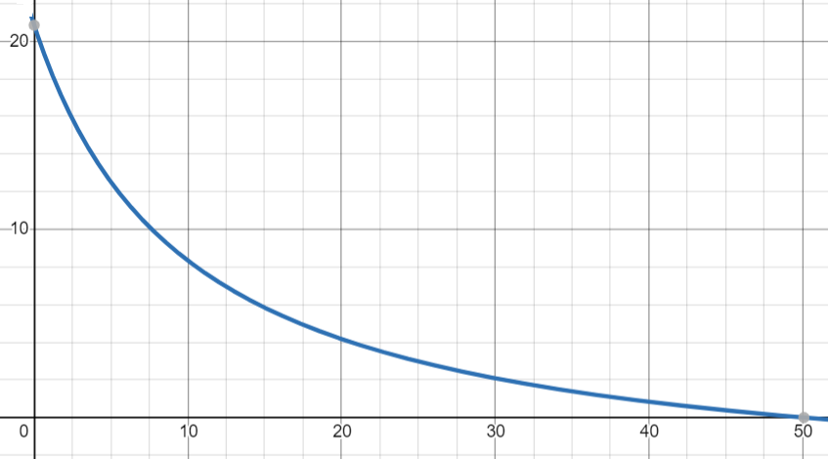
Estimate and interpret the gradient of a curve.
2. The graph shows the distance an object travels over time.
Estimate the speed of the object at 4 seconds.
3. The graph shows a train as it comes to a stop at a station.
Estimate the acceleration of the train at time t = 10 seconds.
Speed (m/s)
Time (seconds)
Image created with desmos.com

Slide 4
Answers

Slide 5
Estimate and interpret the gradient of a curve.
1. A tank is filled with water.
The graph opposite shows the depth of water in the tank as time increases.
a) What is the depth of water in the tank at the start?
b) Estimate the gradient of the curve at t = 3 seconds.
c) What does the gradient tell you?
3 metres.
Depth of water (m)
The rate of change of the depth over time. In this case a gradient of 9 means at 3 seconds the depth is increasing a rate of 9 metres per second.
Time (seconds)
Image created with desmos.com

Slide 6
Estimate and interpret the gradient of a curve.
2. The graph shows the distance an object travels over time.
Estimate the speed of the object at 4 seconds.
3. The graph shows a train as it comes to a stop at a station.
Estimate the acceleration of the train at time t = 10 seconds.
Speed (m/s)
Time (seconds)
Image created with desmos.com

