Slide 1
Finding the LCM
Maths
Mr Lund

Slide 2
Finding the LCM
1. Here is the prime factor tree for 18
a) Write 18 as a product of its prime factors.
b) Write your answer to part a) in index form.
2. Write each number as a product of its prime factors. You may want to use a factor tree to help.
24
30
50
100
120
18
3
6
3
2

Slide 3
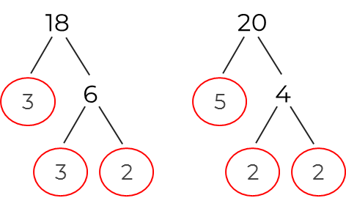
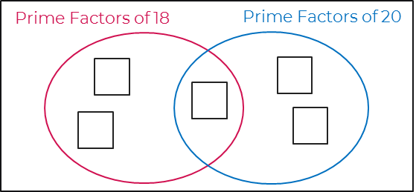
Finding the LCM
3. Here are the prime factors of 18 and 20
a) Complete the Venn diagram.
b) Work out the lowest common multiple (LCM) of 18 and 20
4. Work out the lowest common multiple of each pair of numbers.
24 and 30
18 and 50
50 and 120
45 and 36

Slide 4
Answers

Slide 5
Finding the LCM
1. Here is the prime factor tree for 18
a) Write 18 as a product of its prime factors.
b) Write your answer to part a) in index form.
2. Write each number as a product of its prime factors. You may want to use a factor tree to help.
24
30
50
100
120
18
3
6
= 2 x 2 x 2 x 3 = 2³ x 3
3
2
= 2 x 3 x 5
= 2 x 5 x 5 = 2 x 5²
18 = 2 x 3 x 3
= 2 x 2 x 5 x 5 = 2² x 5²
= 2 x 2 x 2 x 3 x 5 = 2³ x 3 x 5
18 = 2 x 3²

Slide 6
Finding the LCM
3. Here are the prime factors of 18 and 20
a) Complete the Venn diagram.
b) Work out the lowest common multiple (LCM) of 18 and 20
4. Work out the lowest common multiple of each pair of numbers.
24 and 30
18 and 50
50 and 120
45 and 36
180
120
450
3
2
600
2
3
5
180

